Slide 1

Osaka Prefectural Government
英語版
Seven Points You Need to Know Before You
Work
in Japan
For Foreign Nationals!
This booklet provides you with
peace of mind by teaching you
the basic knowledge you need to
know to work in Japan
Osaka Labor Consultation Center (Labor Environment Division, Employment
Promotion Office, Department of Commerce, Industry and Labor, Osaka Prefectural Government)

Slide 3
Table of Contents
Introduction
■ Point 1 Labor Conditions and Contracts
■ Point 2 Wages(salary)
■ Point 3 Working Hours
■ Point 4 Overtime Work
■ Point 5 Annual Paid Leave
■ Point 6 Dismissal and Resignation
■ Point 7 Workplace Harassment

Slide 4
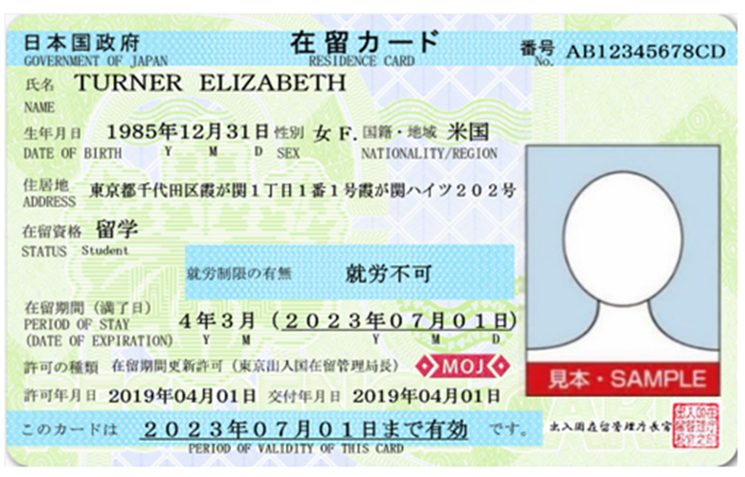
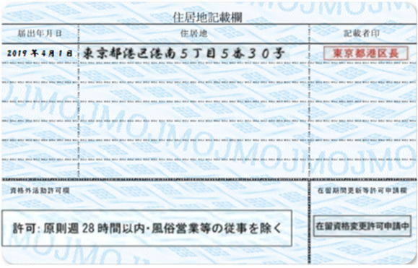
Introduction
Check your residence card
First, check if you can work
in Japan or not！
* Immigration Control and Refugee Recognition Act
①就労制限なし
No restrictions on work
②在留資格に基づく就労活動
のみ可
Limited to the work based on
your status of residence
③指定書により指定された
就労活動のみ可
Limited to the work based on
your certificate of designation
④就労不可
Working NOT allowed
You can’t work.
When you hope to work, you need permission for the changes of status of residence for permission to engage in
an activity other than those permitted under the status of residence
previously granted at the Immigration Bureau.
You can work.
Japan’s “working rules” are applied.

Slide 5
Introduction
“Notification Relating to the Organizations of
Affiliation” is required
*Immigration Control and Refugee Recognition Act, Article 19-16
You must submit the notification relating to the organizations
of affiliation when:
You got employed
You quitted a company
You change your job (working for a different company)
*Mid to long-term residents are obliged to submit the
notification to the Commissioner of the Immigration Services
Agency by themselves.
If you don’t submit the notification, a fine of not more than
200,000 yen is to be imposed.
*If you submit a false notification, you are to be punished
by imprisonment with work for not more than one year or
a fine of not more than 200,000 yen.

Slide 6
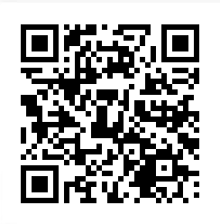
Details on the “Notification Relating to the Organizations of Affiliation”
Category | Status of residence | When the notification required | Matters to be notified | Legal ground | Penal provisions
Notification Relating to the Organizations of Affiliation | Professor, Hihly skilled professional (1)-(c), (2)-(c) Business manager, Legal/accounting services, Medical services, Instructor, Intra-company transferee, Technical intern training, Student or Trainee | -Change in the name or location, or extinction of the organization where the activities set forth -Leaving or being transferred from the organization | The following ① to ⑦ of a mid- to long-term resident who submits the notification must be notified: ①Name ②Birth date ③Sex ④Nationality/region ⑤Address ⑥Residence card number ⑦Matters to be notified depending on the case | Immigration Control and Refugee Recognition Act, Article 19-16 Enforcement Regulation of the Immigration Control and Refugee Recognition Act, Article 19-15, Appended Table 3-3 | Immigration Control and Refugee Recognition Act, Article 71-2-1 （false notification） Immigration Control and Refugee Recognition Act, Article71- 5-3 (breach of notification duty)
 | Highly skilled professional (1)-(a)(b), (2)-(a)(b), Researcher, Engineer /Specialist in humanities/ International services, Nursing care, Entertainer, Skilled labor" or "Specified skilled worker | -Change in the name or location or extinction of the organization with which the contract has been concluded, or termination of the contract -Concluding a new contract
Notification period: within 14 days of the date of the occurrence of the ground
How to submit the notification:
Submitting on the Internet at the website of the Immigration Services Agency(User registration with the "E-notification system“ is required )
Directly bringing to the local immigration services office
Sending to the Tokyo Immigration Services agency by post
(Note) Please refer to the website below for the application form template
http://www.moj.go.jp/isa/applications/procedures/index.html

Slide 7

Appendix ： Notification of the Employment Status of Foreign Nationals
Employers (companies) also have duties
*Act on Comprehensive Promotion of Labor Measures, Article 28
If a company newly hires a foreign national or if a foreign national employed by the company separates from employment (quits the job), the company must submit a “Notification of the Employment Status of Foreign Nationals!”
If the company doesn’t submit the notification, a fine of not more than 300,000 yen is to be imposed.
The notification must be submitted to Hello Work
When a company hires a foreign national, it is required for the company to confirm if the foreign national can legitimately work in Japan!
(such as his/her status of residence and its expiration date)

Slide 8


■ Case # 1
Working conditions and contracts
Can’t I have a written contract?
Working conditions are as explained in the job interview. There are no written documents.
What should you do in such a case?

Slide 9
■ Point 1
1
Contract (promises) on working:
“Labor Contract”
When you are employed by a company, you and your company conclude a “labor contract,” promises on working. A labor contract can be concluded orally, however, a written contract is highly recommended in principle, to prevent troubles.
*Labor Contracts Act, Article 6
2
Your company can’t change “working conditions” without your agreement
Your company can’t change your working conditions without your agreement.
The agreement between you and your company is necessary.
*Labor Contracts Act, Article 8
A labor contract (a contract for your work) is to be concluded only if you understand and accept all the working conditions.

Slide 10

■ Point 1
3
Notification of working conditions
Your company must inform you (an employee) of the following six conditions in written form☆.
①Your working period (From when to when you can work)
②Whether your labor contract can be continued or not
(whether your work period is fixed or not)
③Where you work and what kind of work you will be engaged in
④Your working hours, break time, and holidays
⑤Your wage amount and manner of payment
⑥Procedures and rules when quitting the company
*Labor Standards Act, Article 15, Ordinance for Enforcement of the Labor Standards Act, Article 5.(1)
☆If you (an employee) hope, notification by fax, email, and social media are also available
For example, in such a case…
Working conditions have been changed before I knew it…
Contact the Osaka Labor Consultation Center！
☎06-6946-2600

Slide 11
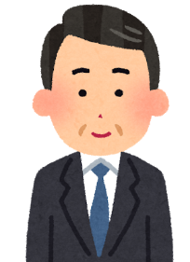




■ Case # 2
Wages (Salary)
Your hourly wage is 1,200 yen.
I understood.
At the job interview
Pay Day
We will pay you 800 yen per hour because our company’s performance has worsened.
What!?
What should you do in such a case?

Slide 12
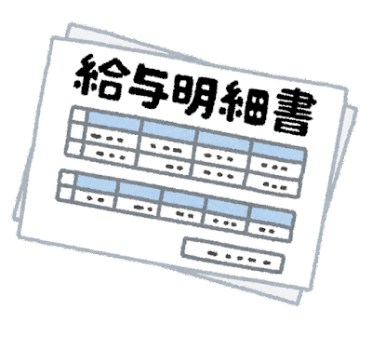
■ Point 2
1
Chingin (Wages)
“Chingin” means wages, salary, allowances, bonuses, and anything else that are paid to workers as remuneration for labor, regardless of what it is called.
An employer must pay the wages ①by currency ②directly to you ③ in full amount④at least once a month ⑤ on a fixed date.
*Labor Standards Act, Article 11 and 24
2
Minimum Wages
An employer must pay every worker a wage of not less than the minimum wage amount that is stipulated by the law.
The minimum wage amount in Osaka Prefecture: 1,177 yen per hour（Since October 16, 2025)
If your wage is less than this amount, you can claim the payment of the balance to your company.
For example, in such a case…
* Minimum Wage Act, Article 4.(1)
Only 800 yen per hour…
Pay slip
Contact the Osaka Labor Consultation Center！
☎06-6946-2600

Slide 13

■ Case # 3
Working hours
I’ve been working for 10 hours without a break…
What should you do in such a case?

Slide 14
■ Point 3
1
Working hours
It means the hours you have promised to work in your “labor contract" with the company. You are obliged to work faithfully during those hours.
The upper limit of working hours is stipulated by the law.
2
“Statutory working hours”: Working hours stipulated by the law
Working hours per day: within 8 hours（excluding break periods)
Working hours per week: within 40 hours（ excluding break periods ）
*Labor Standards Act, Article 32
3
Breaks
The following break periods are necessary:
When working hours exceed 6 hours per day:
at least 45 minutes
When working hours exceed 8 hours per day: at least 1 hour
*Labor Standards Act, Article 34

Slide 15

Appendix: When an international student got permission to engage in part-time work
※Immigration Control and Refugee Recognition Act, Article 19-2
For example, when you have a residence status of “student” and work part-time
with permission, your employer has to obey the following conditions:
-Labor hours per week: within 28 hours
-Labor hours per day during school closure such as summer holidays: within 8 hours
To obtain permission, please take the procedure at the immigration services bureau.
＜What are necessary for application:＞
・Application form
・Documents to clarify the activities for which you apply for the permit
・Residence card
・Visa or the certificate of your residence status
* Procedures are free of charge
For example, in such a case…
I work 12 hours every day…
Contact the Osaka Labor Consultation Center！
☎06-6946-2600

Slide 16

■ Case # 4
Zangyou (Overtime work)
Every day I work overtime…
But I haven’t been paid for that.
Do you understand and confirm your labor
conditions and contracts (promises) correctly?

Slide 17

■ Point 4
1
Zangyou
(Overtime work or Off-hours work)
Zangyou means that you work longer hours than you agreed in your contract. In such a case, your company is to pay you more wage than usual(premium wages). (There are exceptions.)
2
Premium wages
For example, if you work more than 8 hours per day/40 hours per week, you are to be paid by 1.25 times or more of usual wages. This is also applicable when you work midnight (from 10:00 pm to 5:00 am).
If you work on a day off, you are to be paid by 1.35 times or more of usual wages.
*Labor Standards Act, Article 37
For example, in such a case…
My boss ordered me to work overtime. Do I have to do it absolutely?
Contact the Osaka Labor Consultation Center！
☎06-6946-2600

Slide 18
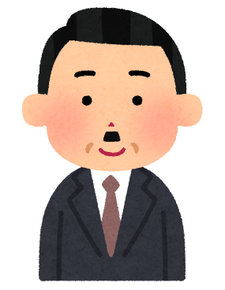

■ Case # 5
Annual Paid Leave
My company grants annual paid leave only to full-time employees but not to part-time workers！
Really?
Is what the employer is saying correct?

Slide 19

■ Point 5
1
Annual Paid Leave
*Labor Standards Act, Article 39
You have a right to take leave whenever you hope, receiving your wages. This is stipulated by the law. All the employees meeting the conditions below are eligible including part-time workers.
Conditions: To take your paid leave, you must have worked for your company for 6 consecutive months and have been present at work for at least 80% of that period.
(→For example, if you work 5 days a week, you can take 10 days of paid leave per year.)
Reasons to take leave: You can take your paid leave without being asked the reasons.
(*However, if your leave impedes your company’s normal operation, your company can make you change the days of your paid leave. )
For example, in such a case…
My company doesn’t grant me any paid leave.
Contact the Osaka Labor Consultation Center！
☎06-6946-2600

Slide 20

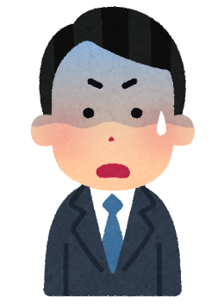
■ Case # 6
Kaiko and Taishoku
(Dismissal and Resignation )
You’re fired. You don’t have to come from tomorrow.
What!? Why?
Can a company easily fire employees?

Slide 21

■ Point 6
1
Kaiko (Dismissal)
*Labor Contracts Act, etc.
Kaiko means that your company has ordered you to leave the workplace, however, the company can’t dismiss you without legitimate reasons. Avoid immediately accepting the dismissal , and first ask about the reasons for it. (A company must provide at least 30 days' advance notice. Without this notice, the company must pay the worker the average wage they would earn working for a period of at least 30 days, the same length of time as the required notice.)
2
Taishoku (Resignation)
*Civil Code, Article 627, etc.
Taishoku means that you quit the company by your own volition. Non-fixed term workers (regular employees, for example) can leave their workplace two weeks after they have notified their company of their intention to resign.
Generally, fixed-term workers can’t leave their workplace during the fixed period. However, if there are unavoidable reasons, you can quit your company.
(If you have legitimate reasons to quit, such as a serious illness, consult with the company. You might be liable for damages claimed by the company if you quit with insufficient reasons.)
Taishokukanshou (Encouragement to resign) is what it is called when your company request your early resignation or retirement. You can decide if you will resign or not. If you do not want to resign, inform the company of your intention clearly.
For example, in such a case…
Suddenly, my boss told me that I didn’t have to come any more
Contact the Osaka Labor Consultation Center！
☎06-6946-2600

Slide 22
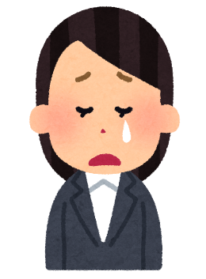
■ Case # 7
Workplace Harassment
My boss scolds and yells at me
in front of everyone every day. I feel humiliated, scared and sad…
What should you do in such a case?

Slide 23
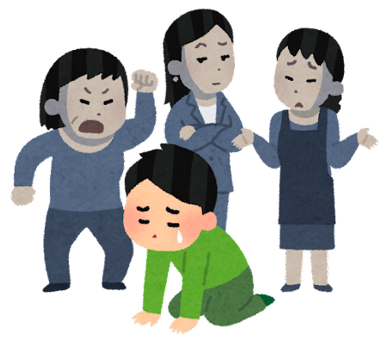
■ Point 7
1
Response to workplace harassment
*Act on Comprehensive Promotion of Labor Measures, etc.
The law stipulates that employers must respond to consultations about workplace harassment and take appropriate measures to solve the problem.
1. First, express your intention by saying, “Please stop it!!”
2. If you can’t solve the problem even after take the measure above, make a record (when and where what you are done and what you felt) and consult the company.
●Major harassment at workplace:
・Power harassment (violence, verbal abuse, not giving you work, etc.)
・Sexual harassment (touching your body, forcing a sexual relationship, talking about sexual topics, etc.)
・Maternity harassment, care harassment (harassment against pregnancy, childbearing, childrearing, long-term care, etc.)
・Discrimination against foreign nationals (rejecting certain people for their religion, culture, and not being Japanese, etc.)
For example, in such a case…
I’m left out alone……
Contact the Osaka Labor Consultation Center！
☎06-6946-2600

Slide 24
When you are in trouble…
Contact the Osaka Labor Consultation Center！
TEL:06-6946-2600
※Reservation: in Japanese only

Slide 25
Labor Consulting Available in English and Chinese!
～Consultation desk for those with labor problems/questions～
At the Labor Environment Division（Labor Consultation Centre）, Osaka Prefectural Government, consultation service is provided for labor related issues such as work conditions being different than promised, wage reduction and sudden dismissal.
Consultation is provided with assistance by an English or Chinese interpreter, who is available on demand. Prior appointment is necessary in Japanese.
▶ Please call at 06-6946-2600 from 9 a.m. to 6 p.m. (Mon-Fri), Labor Environment Division（Labor Consultation Centre）, Osaka Prefectural Government.
Okawa River
+++++++++++++++++++++++++++++++++++++++++++++++++++++++++++++++++++++++
Keihan Railways
Temmabashi Sta.
Keihan
City Mall
Exit 2
(14th stairway)
+++++++++++++++++++++++++++++++++++
Subway-Tanimachi line
HERE
Inquiry:
L-Osaka Main Bldg 10F
Labor Environment Division（Labor Consultation Centre）, Osaka Prefectural Government
3-14 Kitahamahigashi, Chuo-ku, Osaka 540-0031
TEL: 06-6946-2600

Slide 26









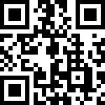
Labor Consultation Centre(Labor Environment Division), Osaka Prefectural Government
Osaka Foundation of International Exchange (OFIX) Osaka Information Service for Foreign Residents
Online
Labor Consultation
Monthly Date and Time:
The 1st Friday (1:30pm-5:30pm)
The 3rd Thursday (6:00pm-8:00pm)
（Dates may change）
Working
hours
Sexual Harassment
Wages
Dismissal, Resignation
Labor
contracts
Workplace
bullying
Consult about your labor problems with a labor specialist from Osaka Prefectural Labor Consultation Centre via Zoom. You can visit our office or access from home.
Languages:
English, Chinese, Korean, Thai, Vietnamese, Filipino, Portuguese, Spanish, Indonesian and Nepali and Japanese.
Please make an appointment by phone or e-mail.
*In principle, we will accept appointments 2 business days before the consultation date.
Contact/Appointment:
Osaka Information Service for Foreign Residents
☎ 06-6941-2297
5F My Dome Osaka, 2-5 Hommachibashi, Chuo-ku, Osaka ✉jouhou-c@ofix.or.jp

Slide 27
Other consultation centers
Consultation Details | Name | Tel | Address/Office hours
Working conditions (Labor Standards Act –related) | Advisory Service for Foreign Workers | 06-6949-6490 | 9F, Osaka Government Building No.2, 4-1-67 Otemae, Chuo-ku, Osaka City 9:30 am to 5:00 pm（except 12:00 pm to 1:00 pm） *English: Mon., Wed. and Fri, Portuguese: Wed. and Thurs. Chinese: Tue., Wed., Thurs. and Fri. Vietnamese: 1st Thurs., Fri.
Employment counseling Job placement service Reference of job offers information | Osaka Employment Service Center for Foreigners | 06-7709-9465 | 16F, Hankyu Grand Building, 8-47 Kakuda-cho, Kita-ku, Osaka City Monday to Friday, 10:00 am to 6:00 pm （except Sat., Sun. and national holidays） *English/Chinese/Portuguese: Mon. to Fri. Spanish: Tue. and Thurs., Vietnamese: Wed. and Fri. Nepali: Wed. and Thurs., Ukrainian: Mon. and Wed.（Interpreters available from 1:00 pm to 6:00 pm) *If you need an interpreter, contact the office beforehand by phone)
 | Hello Work Sakai Employment Service Corner for Foreigners | 072-222-5049 | 1F to 3F, Sakai Local Government Building, 2-29 Minamikawaramachi, Sakai-ku, Sakai City( in the Hello Work Sakai) 1:00 pm to 5:00 pm *Chinese: Mon. and Tue., Portuguese: Thur. , English: 2nd and 4th Wed. and Fri. *If you need an interpreter, contact the office beforehand by phone)
Residence status General matters related to your daily life such as labor and employment, medical care, welfare, and education | Osaka Foundation of International Exchange (OFIX) -Osaka Information Service for Foreign Residents- | 06-6941-2297 | 5F, MyDome Osaka, 2-5 Hommachibashi, Chuo-ku, Osaka City 3rd Thurs. and 4th Fri.: 9:30 am to 8:00 pm (except national holidays, appointment required after 5:30 pm) Mon. to Fri.: 9:30 am to 5:30 pm (except national holidays) 3rd Sun. of each month: 9:30 am to 5:00 pm *English, Chinese, Korean, Portuguese, Spanish, Vietnamese, Filipino, Thai, Indonesian and Nepali
Human rights of foreign nationals | Ministry of Justice Foreign-language Human Rights Hotline | 0570-090911 | Weekdays (except yearend/new year holidays): 9:00 am to 5:00 pm *English, Chinese, Korean, Filipino, Portuguese, Vietnamese, Nepali, Spanish, Indonesian and Thai
 | Osaka Bar Association Human Rights Hotline for foreign nationals | 06-6364-6251 | 2nd and 4th Fri. of each month: 12:00 pm to 5:00 pm *English, Korean, and Chinese
Consultation/guide about immigration procedure | Immigration information center for foreign nationals (Immigration Services Agency of Japan) | 0570-013904 IP-phone 03-5796-7112 | Weekdays: 8:30 am to 5:15 pm *English, Chinese, Korean, Spanish, Portuguese, Vietnamese, Nepali, Thai, Burmese, Sinhala

Slide 28

英語版
大阪府労働相談センター
Search
Ⓒ2014 大阪府もずやん
2025年00月発行

