Slide 1
Outline of the Emergency Measures of Osaka Prefecture after May 16
① Area : All parts of Osaka Prefecture
② Period: From May 16 to 31, 2020
③ Measures（ Some of the present measures are to be lifted based on the【Osaka Model】
The following measures are taken to prevent the spread of the novel coronavirus based on the article 45
and 24 of the *Act on Special Measures against Pandemic Influenza. *Hereinafter referred to as the “Act”
●Request for staying at home（Article 45, Clause1）
Osaka residents are requested to refrain from going out, aiming to “reduce social contact by at least
70%, hopefully 80%.” Above all, the following is strongly requested.
１．Refraining from travels over prefectures, such as nonessential homecoming visits or trips.
２．Refraining from going out to downtown at night, such as going to eateries with hospitality services.
３．Thoroughly avoiding “*Three Cs”, as well as practicing “New Lifestyle” to prevent infections from spreading.
（e.g. Promoting to work from home (teleworking), registering at the “Osaka coronavirus tracking system” and
using it effectively, etc.) *Three Cs : Closed spaces, Crowded places and Close-contact settings
●Request for cancelation of events（Article 24, Clause 9 )
Organizers are requested to refrain from holding events, regardless of their scale and location.
●Request for facility use restrictions（Article 24, Clause 9）
Managers of facilities used by many people are requested to restrict their use, etc.

Slide 2
Request for staying at home（Article 45, Clause1）
Osaka residents are requested to refrain from going out, aiming to “reduce social contact
by at least 70%, hopefully 80%.” Above all, the following is strongly requested.
【Self-restraint requests】
１．Refraining from travels over prefectures, such as nonessential homecoming visits or trips.
２．Refraining from going out to downtown at night, such as going to eateries with hospitality services.
３．Thoroughly avoiding “Three Cs”, as well as practicing “New Lifestyle” to prevent infections from
spreading.
“Examples of practicing “New Lifestyle” 【See attached sheet】
①Keeping social distance（Keep possibly 2 meters between persons）
②Wearing a mask（Wear a mask even if you have no symptoms）
③Washing hands (Wash your hands and face upon coming home. Wash your hands carefully using
soap and water for about 30 seconds)
④ Practicing measures such as teleworking as much as possible
⑤ Registering at the “Osaka coronavirus tracking system” and using it effectively, etc.

Slide 3
Request for cancelation of events（Article 24, Clause 9 )
Organizers are requested to refrain from holding events, regardless of their scale and location.
【Self-restraint requests】
○Scale：every scale
○Location：indoor and outdoor
○Classification/Contents：All events except those necessary for daily lives
（Examples）
festivals/local events, cultural events such as concerts, theater and recital, exhibitions, ceremonies,
lectures and workshops, sporting events, etc.
※Events which are necessary for daily lives such as information sessions/lotteries for residential tenants
of public housing, small workshops for particular business sectors can be held by taking the measures
against the infection spread .

Slide 4
Request for facility use restrictions
Managers of facilities used by many people are requested to restrict their use.
１ Facilities NOT requested to close 【Facilities essential for social lives, social welfare facilities, etc.】
⇒Requested to take appropriate infection prevention measures (Article24, Clause 9)
２ Facilities requested to close based on the Act
・Facilities where clusters occurred nationwide and similar facilities
・Among the facility categories where clusters occurred, large-scale ones other than the above
・Facilities to be requested to refrain from holding events there
・Facilities that were determined to request to continue closures at the Osaka coronavirus control headquarters meeting on May 5
⇒Facility use restrictions request（Article 24, Clause 9 of the Act ）
⇒If they don’t obey, an individual request/instruction will be considered based on the Article 45, Clause 2 and 3 of the Act
(Facilities’ names will be publicized)
３．Facilities to be asked cooperation not based on the Act（Facilities to which the closure request is to be lifted from May 16）
Requested cooperation in taking appropriate measures to prevent infection from spreading in accordance with guidelines, etc.
⇒The closure request is to be lifted provided the facilities comply with the standard measures determined by the prefecture.
However, if the industry-specific guidelines are posted on the national government’s website, those guidelines will prevail.
Facilities used by many and unspecified people are requested to introduce Osaka coronavirus tracking system.
⇒Facilities that don’t comply with guidelines or those where clusters occur in the future might be requested facility use
restrictions based on the Article 24, Clause 9 of the Act.

Slide 5
Details of the measures
1 Facilities NOT requested to close ※Requested to take appropriate infection prevention (Article24, Clause 9)
（１）Facilities essential for social lives
Categories | Facilities
Medical institutions | hospitals, clinics, pharmacies, etc.
Daily necessities stores | wholesale markets, grocery stores/corners, daily necessities corners at department stores and supermarkets, convenience stores, etc. ※Department stores and supermarkets, etc. are requested for cooperation in taking measures to prevent infections from spreading based on the guidelines, etc.
Meal service facilities | Restaurants (including pubs), restaurants with amusement services, cafés, etc. (including delivery/take-out services) ※Business hours: 5:00am to 10:00. Alcoholic beverage service: Until 9:00pm（excluding delivery/take-out services) ※Restaurants, etc. are requested for introduction of the Osaka coronavirus tracking system and cooperation in taking measures to prevent infections from spreading based on the guidelines, etc.
Housing, lodging facilities | hotels and inns, apartment houses, boarding houses, etc.
Transportation | buses, taxies, rent-a-cars, railways, ships, aircraft, logistics services(delivery service), etc.
Factories | factories, working places, etc.
Financial institutions, public offices | banks, stock markets, brokerage firms, insurance companies, public offices, etc.
Others | news organizations, funeral halls, public bathhouses, pawn shops, veterinary clinics, barbers/hair salons, laundries, waste treatment-related companies, etc.
※(“Facilities essential for social lives” are determined based on the “Basic response policies for the novel coronavirus control” revised on May 14, 2020)
（２）Social welfare facilities
Categories | Facility details
Social welfare facilities | nurseries, after-school nurseries, long-term care facilities, other facilities related to these welfare services, facilities providing health and medical services
⇒Day-care or short-period users are requested to refrain from visiting facilities as much as possible, if their family can care them.(Article24, (Clause 9 of the Act）

Slide 6
２． Facilities requested to close based on the Act
➢ Facilities where clusters occurred nationwide and similar facilities
Categories | Facilities | Request details
Entertainment facilities | eateries with hospitality services such as cabarets, night clubs bars, pubs, dance halls, karaoke boxes, and music clubs, adult entertainment facilities | Request for facility use restrictions (Article24, Clause 9 of the Act） ⇒ If they don’t obey: An individual request/instruction will be considered based on the Article 45, Clause 2 and 3 of the Act) （Facilities’ names will be publicized）
Sports/amusement facilities | Indoor sports facilities such as gymnasiums, swimming pools, bowling alleys, skating rinks, fitness center, and sporting clubs
➢Among the facility categories where clusters occurred, large-scale ones other than the above
（Following facilities with total floor areas of 1000㎡ or above）
Categories | Facilities | Request details
Entertainment facilities | private movie theaters, Internet cafés, manga cafés, shooting saloons, horse parlors, ticket counters for bike race outside the stadium, etc. | ＜same as above＞
Sports/amusement facilities | mah-jong game parlors、pachinko parlors, game centers, theme parks, amusement parks, outdoor swimming facilities, etc.

Slide 7
➢ Facilities to be requested to refrain from holding events there
Categories | Facilities | Request details
Meeting/exhibition facilities （except rental meeting rooms） | meeting rooms, auditoriums, exhibition halls, multipurpose halls, cultural halls | Request for facility use restrictions (Article24, Clause 9 of the Act） ⇒ If they don’t obey: An individual request/instruction will be considered based on the Article 45, Clause 2 and 3 of the Act) （Facilities’ names will be publicized）
➢Facilities that were determined to request to continue closures at the Osaka coronavirus
control headquarters meeting on May 5
Categories | Facilities | Request details
Education facilities | schools（except universities, etc.） | ＜same as above＞

Slide 8
３．Facilities to be asked cooperation not based on the Act
（Facilities to which the closure request is to be lifted from May 16）
Requested cooperation in taking appropriate measures to prevent infection from spreading
in accordance with guidelines, etc.
Categories | Facilities | Request details
Theaters | theaters, movie theaters, variety theaters, etc. | ・The closure request is to be lifted provided the facilities comply with the standard measures determined by the prefecture. However, if the industry-specific guidelines are posted on the national government’s website, those guidelines will prevail. ・Facilities used by many and unspecified people are requested to introduce Osaka coronavirus tracking system. ⇒Facilities that don’t comply with guidelines or those where clusters occur in the future might be requested facility use restrictions based on the Article 24, Clause 9 of the Act.
Meeting/exhibition facilities | rental meeting rooms
Universities/tutoring schools, etc. | education facilities such as universities, special training schools, miscellaneous schools, etc., driving schools, tutoring schools, etc.
Museums, etc. | museums, art museums, libraries, etc.
Hotels and inns | hotels, inns (meeting spaces ONLY)
Commercial facilities | stores other than daily necessities retailers stores offering services NOT essential in daily lives
Entertainment facilities （with floor areas of 1000㎡ or under, other than those where a cluster occurred) | private movie theaters, Internet cafés, manga cafés, shooting saloons, etc.
Sports/amusement facilities （with floor areas of 1000㎡ or under, other than those where a cluster occurred) | mah-jong game parlors, pachinko parlors, game centers, outdoor swimming facilities, etc.

Slide 9
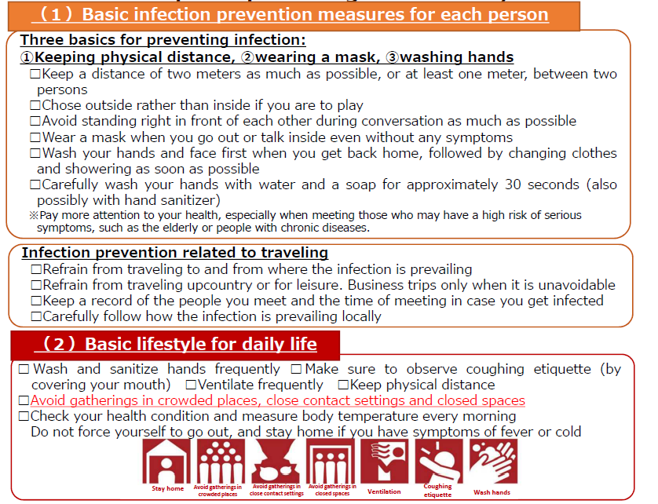
Example of practicing "New Lifestyle“
（extracted from the Expert Meeting on the Novel Coronavirus Disease Control “Analysis of the Response to the Novel Coronavirus (COVID-19)
and Recommendations” (May 4, 2020)
【Attached sheet】

Slide 10
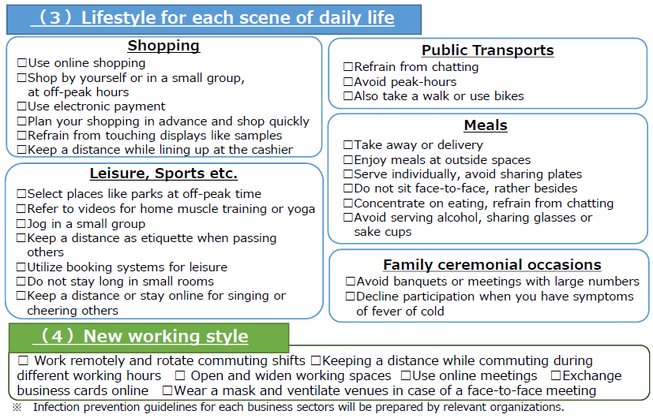
Example of practicing "New Lifestyle“
（extracted from the Expert Meeting on the Novel Coronavirus Disease Control “Analysis of the Response to the Novel Coronavirus (COVID-19)
and Recommendations” (May 4, 2020)
【Attached sheet】

