Slide 1
Beyond EXPO 2025: Post-Expo Growth Strategy Aiming for Growth and Development as the Second Capital of Japan (Summary)
Strategy Overview
■ Purpose of Formulation
It was formulated as a roadmap outlining the path Osaka should take to achieve sustainable growth and development after the Expo and to improve the lives of the Osaka residents.
While inheriting the Expo’s legacy, it is necessary to further strengthen Osaka’s economic capacity, urban strength and human resources, thereby creating an Osaka that can compete on the world stage. Furthermore, alongside ongoing discussions regarding legislation for establishing Osaka as the Second Capital of Japan, it is essential for Osaka to develop into a major economic engine for Japan, with a view to realizing this second capital. With this in mind, this strategy has been compiled to outline the fundamental principles and policy directions for Osaka’s growth.
■ The “Second Capital” Envisioned by Osaka
Significant progress has been made toward establishing Osaka as the second capital, including the start of national-level discussions on drafting legislation.
With the view to serving as the second capital, Osaka drives Japan’s growth in peacetime and backs up the capital’s functions in emergencies as one of the key pillars of Japan’s multi-polar structure.
■ Current Status of Osaka
Since Osaka began pursuing its bid in 2015 to host the World Expo 2025, joint public-private initiatives, including integrated prefectural and municipal growth strategies, urban development, and infrastructure improvements, have been progressing.
Since the hosting of Expo 2025, various future technologies have been showcased, with events captivating the world hosted and Osaka’s unique charm highlighted, resulting in expanded promotion of the Osaka brand to the world and increased business opportunities
⇒ There have been signs that Osaka’s economy is entering a virtuous cycle, represented by the record-high nominal GDP (43.1 trillion yen in FY2022), the record-high inbound tourists (14.09 million visitors in 2024) and a net migration surplus since 2011.
■ Accelerating Efforts toward Growth and Development
Inheriting the legacy of the Expo, Osaka will accelerate a virtuous cycle of “economic growth,” “enhanced urban vitality,” and “population growth,” and as the second capital of Japan, it will function as an engine for growth that drives Japan's economy.
Fundamental Principles
[Basic Policy and Vision for the City]
Basic Policy: To realize Osaka as the second capital as soon as possible and drive Japan's growth
Vision for the City: A city with world-class economic and urban strength and a unique charm of its own
Target: Achieving a nominal GDP of 80 trillion yen in the 2040s
(Achieving an average annual real growth rate of 2% or more in Osaka to roughly double the current GDP)
[Focal Area] Achieving world-class economic and urban strength to drive Japan’s growth
Realization of the Second Capital, Osaka
Economic strength
A leading innovation city making inroads into next-generation industries by leveraging Osaka’s unique strengths
An entertainment hub that inspires fun and excitement unique to Osaka
Engine for Japan’s growth
Urban strength
[Infrastructure Supporting the Second Capital] Laying foundations for economic and urban strength
Talent strength
A vibrant hub city that attracts and produces global and creative talent
A friendly city that embodies the spirit of “can’t leave it alone” and “give it a try”
A city with advanced urban functions that support growth
A city that serves as an engine for growth in normal times and a backup in emergencies
Community development and urban infrastructure
Developing functions befitting the second capital
Enhanced well-being

Slide 2
Policy Direction of Beyond EXPO 2025
Policy Direction
The policy direction summarizes the initiatives under each pillar, based on the Fundamental Principles, while taking into account the circumstances at the time of formulation of Beyond EXPO 2025.
Going forward, this policy direction will be reviewed flexibly on an annual basis, considering the policy’s progress and environmental changes, toward further enhancement.
Area | Area | Vision for the city | Pillars of initiatives | Major initiatives
 | Economic strength | Leading innovation city | Enhancing support | To accelerate the implementation of cutting-edge technologies showcased at the Expo, a top management body comprising representatives from the business community, the national government, the Union of Kansai Governments, Osaka Prefecture and Osaka City will be established to provide project-based support for concrete implementation Enhancing and strengthening the digital infrastructure comprising communications networks, data centers, and power systems, which form the foundation of next-generation smart cities
 |  |  | Establishing hubs | Formulating a life sciences cluster centered on Nakanoshima Qross (regenerative medicine, etc.), KENTO (health and medical care) and Saito (drug discovery), while leveraging the strengths of each hub to support the development of startups. Promoting the industrialization of cutting-edge carbon-neutral technologies, with a focus on hydrogen, etc., perovskite solar cells, and biomanufacturing Advancing the initiatives for the commercial operation of advanced air mobilities (AAMs), collaborating with the national government, neighboring local authorities and the business community
 |  |  | Attracting investments | Organizing WHX Osaka (an international trade fair) that inherits Japan Health, WHX Leaders Osaka (an international conference), and startup conferences focusing on the deep tech field inheriting the philosophy of the GSE (Global Startup Expo 2025) Expanding strategic business exchanges with overseas partners that have been connected through the Expo Promoting investment under the initiative of the Global Financial City OSAKA Strategy (promoting investment and collaboration from domestic and international financial institutions to Osaka-based companies)
 | Urban strength | Entertainment hub | Establishing the city’s unique branding | Establishing Yumeshima as a new international tourism hub that achieves a world-class growth-oriented IR (Phase 1) and promotes urban development inheriting the Expo legacy (Phase 2) Creating world-class entertainment content with an eye toward the construction of the large-scale arenas in the area around Expo ’70 Commemorative Park Station Making the unique characteristics and strengths of Osaka's cuisine an international brand while encouraging domestic and international tourists to travel through the enhancement of the appeal of Osaka-mon (Osaka-made products) as a tourist attraction
 |  |  | Expanding tourism consumption | Enriching and enhancing night-time activities, such as drone shows, projection mapping and night cruises
 |  |  | Promoting tourism throughout the prefecture | Creating vibrancy in “Mountains and Villages” and “Oceans,” by enhancing the appeal and accessibility of surrounding mountain ranges’ national parks, repurposing traditional houses, and revitalizing the bay areas particularly around the Rinku Town, thereby improving the accessibility of the area
Focal Area

Slide 3
Policy Direction of Beyond EXPO 2025
Area | Area | Vision for the city | Pillars of initiatives | Major initiatives
 | Talent strength | Vibrant hub city | Securing talent | Creating an environment that encourages the entry of global talent and foreign companies, such as by attracting international schools Building a mechanism where various personnel can coexist and thrive, by establishing schemes that connect overseas talent with companies within the prefecture
 |  |  | Fostering talent | Researchers from Osaka Metropolitan University collaborating with related companies to foster industry professionals in growth sectors Fostering global talent through the enhancement of educational programs in the Department of International Relations at prefectural high schools and at Suito Kokusai Senior High School and the internationalization of Osaka Metropolitan University, through the introduction of an autumn enrollment system for undergraduate programs Complete abolition of tuition fees at high schools and Osaka Metropolitan University, etc.
 | Community development and urban infrastructure | Friendly city | Integrating cutting-edge technologies into everyday life | Providing new transport services including the social implementation of AAMs and autonomous buses Improving the quality of life for residents using health care data and providing the next-generation digital services utilizing AI, aiming to establish the Next-Generation Smart City OSAKA Deploying comprehensive measures against infectious diseases to prepare for the next pandemic and developing healthcare services leveraging cutting-edge technologies
 |  |  | Creating a symbiotic society | Promoting universal tourism based on the initiatives of the Expo
 |  |  | Revitalizing local communities and enhancing fundamental local government functions | Promoting business establishment, transforming agriculture and fishery sectors into a growth industry, enhancing and showcasing the appeal of the tourism content leveraging local resources, enhancing fundamental local government functions and introducing autonomous buses
 |  | City with advanced urban functions | Developing new industrial hubs for attracting visitors and stimulating exchange | Promoting urban development that leads to the creation of the hubs for attracting visitors and new industries at the east-west urban axis (areas around Yumeshima and Osaka Castle Park, etc.), the north-south urban axis (areas around Shin-Osaka Station, Umekita, etc.) and bay areas (Yumeshima and Sen'nan Satoumi / Misaki area, etc.)
 |  |  | Developing transport infrastructure | Implementing the early opening of the Linear Chuo Shinkansen and the entire Hokuriku Shinkansen lines, improving rail and road networks, and enhancing airport and port functions
 |  |  | Community development | Promoting urban development that leverages local characteristics (such as Minamikawachi Urban Development Vision) and creating green towns
 | Developing functions befitting the second capital | A city that serves as an engine for growth in normal times and a backup in emergencies | Strengthening the functions to drive Japan’s growth during peacetime | Developing social infrastructure and promoting urban development befitting a second capital while strengthening economic functions as one of the two poles of East and West
 |  |  | Strengthening functions to prevent Japan’s economy from stalling during emergencies | Developing urban functions and infrastructure capable of serving as alternatives to the capital’s functions and enhancing functional concentration through the development of national and local hubs to back up the capital’s functions during emergencies
Infrastructure supporting the second capital of Japan

Slide 4
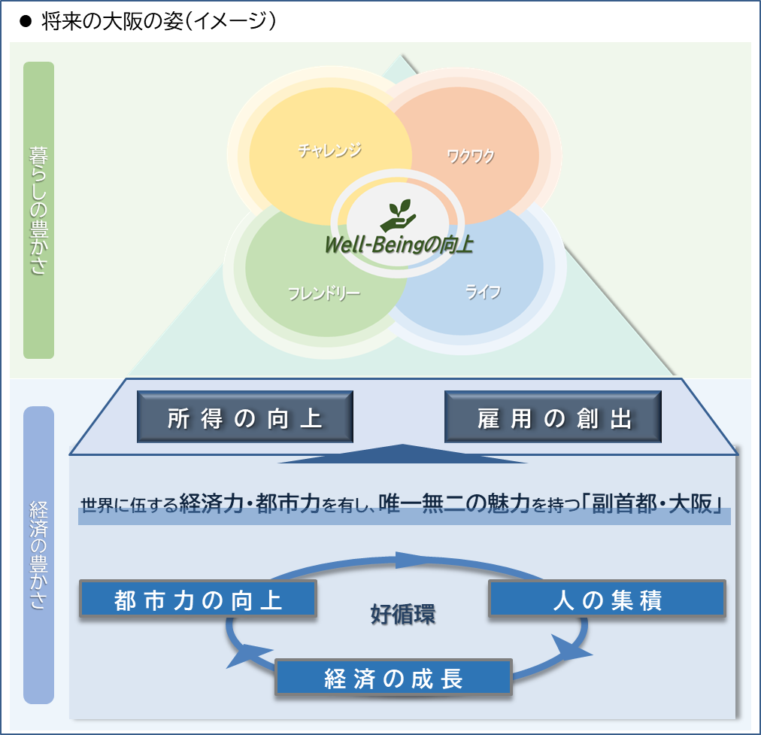
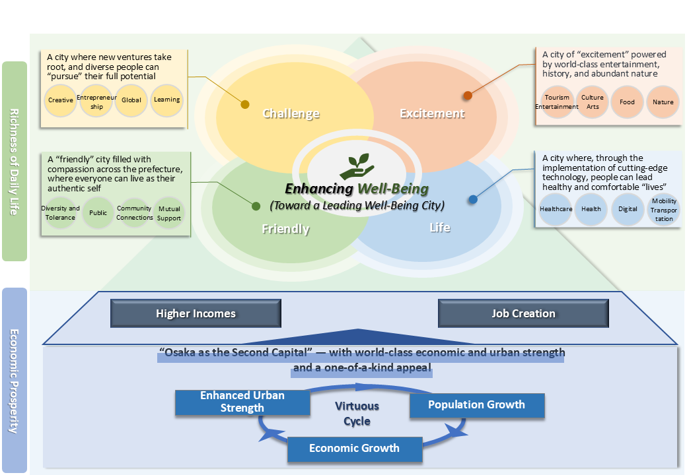
Well-Being and Progress Management at Beyond EXPO 2025
Realizing a Prosperous Osaka through Growth —Towards a Leading Well-Being City—
Richness of Daily Life
Building a future society in which every resident can truly feel a sense of prosperity
The Future of Osaka (Concept Image)
Challenge
Excitement
A city where new ventures take root, and diverse people can “pursue” their full potential
A fertile environment for new challenges — from entrepreneurship to creative endeavors — where anyone can take a first step
An educational environment that lets students choose the path they want to pursue
A city of “excitement” powered by world-class entertainment, history, and abundant nature
People can enjoy world-class entertainment and content as part of everyday life
Both domestic and international visitors can enjoy the prefecture’s abundant culture and historical heritage, cuisine, and the nature of all four seasons
A city where, through the implementation of cutting-edge technology, people can lead healthy and comfortable “lives”
Everyone can live vibrantly thanks to cutting-edge medical and care technologies
Autonomous vehicles and AAMs make convenient travel possible for anyone, anywhere
Next-generation digital services are rolled out, making administrative procedures more convenient
A “friendly” city filled with compassion across the prefecture, where everyone can live as their authentic self
Every individual is respected and can live with peace of mind, regardless of gender, age, nationality, or disability
A culture of valuing human connections and helping one another is widespread
Life
Friendly
Economic Prosperity
“Higher Income” and “Job Creation”
To ensure a prosperous life for the people of the prefecture, we will further strengthen the foundations of daily life, such as income and employment
To this end, by steadily implementing initiatives outlined in Beyond EXPO 2025, Osaka will establish and accelerate a virtuous cycle in which “economic growth,” “enhanced urban strength,” and “population growth” reinforce one another. This will drive further leaps forward and bring about “Osaka as a Second Capital,” a city with “world-class economic and urban strength and a one-of-a-kind appeal,” at an early stage.
Progress Management Toward Achieving Goals
To ensure the strategy is steadily implemented, we will manage progress by setting strategic goals, objective indicators and subjective indicators while assessing and verifying the effectiveness of the initiatives.
Target: Achieving nominal GDP of 80 trillion yen in 2040s
Major subjective indicator
Major objective indicator
Classification of well-being | Indicator
Overall | Percentage of people who feel that Osaka’s economy is vibrant Percentage of people who feel that Osaka has appeal that attracts people How happy are you at present?
Challenge | In the community where I live, there are opportunities to take on new challenges and grow
Excitement | In the community where I live, I can feel nature close at hand
Friendly | In the community where I live, there is an atmosphere in which women and young people can thrive
Life | I am physically healthy
Pillars of policies | Indicator
Overall | Real growth rate, employee compensation per capita
Economy | Number of startups created, value added per company
Urban strength | Number of visitors to Osaka, total number of overnight stays, average spending per visitor
Talent strength | Female employment rate, number of students studying abroad
Community development and urban infrastructure | Net in-migration rate (vs. national), healthy life expectancy of residents

