Slide 1
Global Financial City OSAKA
Strategy
Formulated in March 2022
(Revised in March 2026)
March 30, 2026
General Meeting of the Global Financial City OSAKA Promotion Committee

Slide 3
Table of Contents
Ⅰ Overview of the Strategy
1. Objectives of the Strategy Formulation
(Formulated in March 2022)
2. Key Perspectives
3. Osaka’s Vision as a Global Financial City
Ⅱ. Initiatives under Phase 1 (through FY2025)
Ⅲ. Changes in the Socioeconomic Environment (Global, Japan, Osaka)
Ⅳ Directions for Action Plan Phase 2
Ⅴ Pillars of the Initiatives & Specific Initiatives (Action Plan)
Ⅵ Strategy Implementation Period & Strategic Goals
Ⅶ Conclusion
References
・・・・・・・・・ 5
・・・・・・・・・ 6
・・・・・・・・・ 6
・・・・・・・・・ 7
・・・・・・・・・ 10
・・・・・・・・・ 19
・・・・・・・・・ 22
・・・・・・・・・ 33
・・・・・・・・・ 36
Notes:
３．めざす国際金融都市像は2022年版においては「Image of the City Osaka Aims to Be 」となっています。直訳では正しいですが、タイトルとしては少し長いのと、「Image 」よりも「Vision 」の方がニュアンスが近いかと思い、訳を考えてみました。
この文言は頻繁に出てきますので、とりあえず暫定で「Osaka’s Vision as a Global Financial City」としております。

Slide 4
Summary
Ⅰ Overview of the Strategy(p.5-)
◆Strategy Formulation Objectives ：We aim to strengthen financial functions—often referred to as the "the lifeblood of the economy ”— and seek to establish a unique global financial city with distinctive
functions that will serve as a key pillar for the growth and development of the Osaka-Kansai economy.
◆Osaka’s Vision as a Global Financial City（p.6）：Global city that develops by leveraging finance, attracting the energy of Asia and the world · Frontrunner city in finance, which challenges the world with
innovative initiatives
Ⅱ Initiatives under Phase 1 (through FY2025) （p.7-）
Promote the attraction of foreign financial institutions, the development of cutting-edge financial products and markets, the designation as a Special Zone for Financial and
Asset Management Businesses, and the enhancement of consultation systems and information dissemination to support business entry.
Ⅲ Changes in the Socioeconomic Environment (Global, Japan, Osaka) （p.10-）
Outcomes of the Osaka-Kansai Expo, and international comparisons in areas such as start-up investment, private equity, derivative investment, and digital finance, etc.
Ⅳ Directions for Action Plan Phase 2 （p.19-）
Building on the outcomes of Phase 1 and addressing challenges in the market environment, Osaka will further advance its initiatives by leveraging the legacy of the Expo, including the social
implementation of advanced technologies, international exchange, and the demonstration of financial services
V Pillars of the Initiatives & Specific Initiatives (Action Plan) (p. 22– )
“Global city that develops by leveraging finance”
Promote investment in and collaboration with startups and other entities from domestic and international sources
Promote the concentration of financial institutions that contribute to realizing Osaka as a secondary capital the Secondary Capital, incorporating the perspective of enhancing resilience
“Frontrunner city in finance”
Create cutting-edge, innovative financial products and markets
Promote Financial Innovation
“Shared Initiatives to Realize the Two Future Visions of the City”
Promote Initiatives to enhance financial literacy and develop highly skilled professionals in the financial sector
Develop a Living and Business Environment Attractive to International Investors
Promote strategic public relations domestically and internationally, and strengthen global partnerships
Ⅵ Strategy Implementation Period （p.33-）
・Phase 1： through FY2025, Phase 2： FY2026–FY2030, Final Target Year： FY2050
Strategic Goals (p.35)
◆Activity Indicators：
・Number of participants in business matching events related to start-ups (including the number of
investors and fintech companies) , Number of English-language business matching events, Number
of business matches facilitated through Osaka Prefecture and City initiatives
・Number of courses and events held by the Financial and Economic Literacy Promotion Network
◆Goals：
・Number of foreign financial and related companies attracted： 50(Cumulative total： 80 companies
since Phase 1)
・Total startup funding raised： ¥160 billion, number of fundraising cases from overseas： 10, Number
of startups created： 1,200
・Number of proof-of-concept trials for new financial services： 10
・Attraction of international schools to meet the needs of highly skilled foreign professionals:： Full
curriculum covering elementary, junior high, and high school levels
・Number of international media features： 10 ・ Number of social media followers： 5,000
Ⅶ Conclusion(p.36)
・The member organizations of the Promotion Committee—including government agencies, economic groups, and private companies—will collaborate organically to advance Osaka’s initiatives.
・The strategy will be reviewed around FY2030, upon the completion of Phase 2, based on the achievement status of strategic goals and the prevailing socioeconomic conditions.

Slide 5
Ⅰ Overview of the Strategy
1. Objectives of the Strategy Formulation (Formulated in March 2022)
Given that Japan will proceed at full speed to realize a global financial city, including tax reforms and regulatory compliance owing to substantial changes in the global financial situation, several financial cities with international competitiveness will be required to enhance Japan’s growth potential while taking account of the presence of multiple global financial centers in the US and the UK.
Making Osaka a global financial city is a key initiative for strengthening Japan’s resilience in the financial front to handle critical events when they occur.
Furthermore, to strengthen financial functions, which can be called “the lifeblood of the economy,” this will contribute to the realization of the region’s vision that seeks to achieve growth and development of the Osaka-Kansai economy in the post-Covid era. This in turn will lead to benefit and happiness for the residents of the prefecture and serves not only as a pillar for new growth in the Osaka-Kansai region but also contributes to the economic development of Japan as a whole.
Based on this, to formulate this strategy, we aim to create a proprietarily unique and
functional global financial city by contributing to the further rapid growth of Osaka,
which is one of Japan’s two leading economic centers, of which one is in East Japan and one in West Japan.

Slide 6
2. Key Perspectives
<Perspectives of the Overall Strategy>
In a global financial city, strengthening financial functions — the “lifeblood of the economy” — contributes to realizing the vision and strategy of regions seeking economic development. This, in turn, should lead to the well‑being and prosperity of Osaka’s residents. Therefore, the first key perspective of the strategy is [Regional Development].
A global financial city should also contribute to the achievement of the SDGs (Sustainable Development Goals), the shared global objectives for realizing a sustainable and better society, including initiatives undertaken by individual actors. Therefore, the second key perspective is [SDGs].
<Perspectives for Realizing Osaka’s Future Vision of the City>
With the two key perspectives of the overall strategy in mind, the following viewpoints will guide Osaka toward its vision of becoming a global financial city.
The first is “Asia/Global”. It is crucial for Osaka to attract talent, capital, and information from around the world by leveraging its strengths and opportunities, while fostering collaboration with geographically proximate Asian economies.
The second is “Differentiation/Complementarity.” In the midst of intensifying global intercity competition, for Osaka — as a city aiming to become Japan’s secondary capital — and the broader Kansai region to be chosen on the global stage, it is essential to enhance financial functions through cutting-edge initiatives that highlight Osaka’s unique characteristics. At the same time, Osaka must serve as a growth engine for Japan during normal times and play a vital role in mitigating the risks of domestic overconcentration, while also contributing to Japan’s overall resilience by functioning as a backup for the capital in times of emergency.
3. Osaka’s Vision as a Global Financial City
Building on the key perspectives of “Asia/Global” and “Differentiation /Complementarity,” Osaka has identified two strategic visions for becoming a global financial city.
Global city that develops by leveraging finance, attracting the energy of Asia and the world
Frontrunner City in Finance: Challenging the World with Pioneering Initiatives

Slide 7

Ⅱ Initiatives under Phase 1 (through FY2025)
■Main Initiatives and Outcomes
With two envisioned models of a global financial city in place, Osaka designated the period through FY2025 as Phase 1. During this phase, Osaka has focused on laying a solid foundation by attracting foreign financial institutions, developing Osaka’s unique financial markets and products, and enhancing the business environment through measures such as the designation of special zones for financial and asset management businesses and regulatory reforms.
Osaka’s Future Vision of the City | Key Initiatives and Outcomes
【Vision 1】 Global city that develops by leveraging finance | Attract foreign financial institutions through overseas promotion and establish incentive programs, such as subsidies and local tax reduction schemes Establish startup support hubs and organize business matching events Develop BCP and dual-operation sites by financial institutions Create a network connecting schools, companies, and financial institutions to promote financial and economic education
【Vision 2】 Frontrunner City in Finance | Develop cutting-edge financial products and markets, including listing Rice Index futures and Shanghai natural rubber futures, and establishing secondary markets for digital securities and precious metals futures Be designated as Special Zones for Financial and Asset Management Businesses (13 out of 23 proposed regulatory reforms realized) Deliver lectures at universities and accept university students for internship programs offered by financial institutions
Shared Initiatives | Establish a support framework for the entry of financial companies (e.g., Osaka One-Stop Support Center, Professional Services Consortium, and Business Establishment Support Office) Disseminate information through social media and participate in international events
EXPO 2025,Osaka, Kansai
– Accelerated Initiatives –
Promoted the following overseas through hosting international business missions and related activities, while expanding global connections:
➤ Pilot and demonstration projects
➤ Companies participating in the Reborn Challenge
➤ The business appeal of Osaka
■ Achievement Status of Strategic Goals (KPIs)
Item | 【Output Goals】 Number of consultations at the Osaka Global Finance One-Stop Support Center |  | 【Outcome Goal 01】 Number of foreign financial companies and investors (including FinTech) attracted | 【Outcome Goal 02】 Creation of unicorns, start-ups, university-launched ventures
Target | Achieve an average of 100 companies per year by FY2025 |  | Recruit 30 companies by FY2025 | Generate 3 unicorn companies and 300 start-ups (of which 100 are companies launched at universities) by FY2024
Actual | Average: 93 companies per year (FY2022: 54, FY2023: 91, FY2024: 106, FY2025: 122) |  | 31 companies established operations *Company list on the next page | 653 startups (including 211 university-launched startups)
Output / Outcome 1: As of March 25, 2026 Outcome 2: As of the end of FY2024

Slide 8










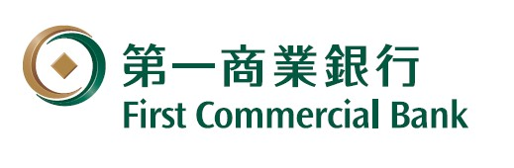



















■Status of Foreign Financial Companies’ Expansion in Osaka (Outcome Goal)
During Phase 1 (through FY2025), a total of 31 foreign-affiliated financial companies established a presence in Osaka. These include major international private equity firms, domestic and international fintech companies, as well as overseas accelerators planning to invest in deep tech startups. However, only one foreign venture capital firm entered the Osaka market during this period.
Asset Management Business・
Financial Instruments Business (12 companies, 39%)
Fintech (8 companies, 26%)
Other( 11 companies, 35%)
International
12 (39%)
Osaka
1st entrant
Osaka
1st entrant
Osaka
1st entrant
Osaka
1st entrant
Domestic
19(61％）
Osaka
1st entrant

Slide 9
＜Status of Companies Expanding into OSAKA＞
● Support and Enhance the Management of Osaka‑based Companies and Promote Investment in Osaka
・Support improving profitability through solutions to management challenges, and expanding investment for further growth 〔Bain Capital (Kirin-do HD, Nihon Safety), Fintech Global, Marathon Capital ( SMEs in Osaka), First Commercial Bank (approx. 50 real estate investments), MedTech Actuator (collaborations with approx. 10 Osaka-based companies).〕
・Promote Open Innovation through CVC*^{１}Activities 〔Sourcing Brothers (support for investment in perovskite solar cell R&D firms), (Sugimoto Shoji × INDUSTRIAL-X)〕
・Promote Data Utilization for Operational Efficiency 〔Alteryx Japan (services introduced to approx. 3 companies), LayerX〕
・Encourage new corporate entry into insurance agency businesses and support the digital transformation of insurance agencies 〔Sasuke Financial Lab〕
・Provide a diverse range of products, including overseas hedge funds, to institutional investors and others within the prefecture, thereby contributing to the diversification of their investment portfolios 〔Teneo Partners〕
・Provide mortgage services to Osaka-based homebuilders and developers 〔UI Bank (offering sustainable banking services in collaboration with Kansai Electric Power)〕
●Expand Global Business for Osaka-based Companies
・Revitalize Japan-Taiwan Business through Loans to Taiwanese Companies in Osaka 〔Chang Hwa Bank〕
・Leverage expertise in financial technology and overseas credit risk management to support Japanese companies in securing new investment opportunities abroad 〔AMFC, Fintech Association (Funds)〕
・Support the Growth and Global Expansion of Startups in Osaka and Kansai 〔Kiraboshi Bank (collaboration with local financial institutions in the Kansai region), IMM Investment (support overseas expansion of semiconductor-related SUs), Ibex Japan (collaboration with Osaka University to support global SU expansion).〕
●Enhance Financial Resilience
・Establish a Dual-Operation System in Tokyo and Osaka to Ensure Business Continuity in the Event of an Emergency in Tokyo 〔Morgan Stanley MUFG, Tokyo Tanshi, Daiwa Next Bank〕
● Social Implementation of Innovative Fintech
・Promote the Adoption of Security Tokens (STs) *² (e.g., Real Estate) through the Development of Secondary Markets and the Expansion of Services for Individual Investor 〔Osaka Digital Exchange (7 ST listings), Mitsui & Co. Digital Asset Management〕
・Promote NFT*³ utilization across various fields 〔HashPort: Dining (Osaka Restaurant Management Association), Tourism (JR West, Nankai Electric Railway, Higashi-Osaka City, etc.),TicketMe: Arts and Culture (e.g., Ohtsuki Noh Theatre)〕
・Provide family trust services contributing to solutions for an aging society 〔Trinity Technology: Collaborate with Ikeda Senshu Bank〕
・Promote digital wallet adoption triggered by the Expo 〔HashPort: Develop a digital wallet based on the EXPO Digital Wallet〕
●Develop next-generation financial talent
・Train professionals with financial expertise in line with BCP function expansion 〔Morgan Stanley MUFG〕
・Foster startup talent through internships and accelerator programs 〔The Seed Capital〕
・Collaborate with universities to develop advanced financial professionals (planned)〔Altair Engineering〕
*1 CVC…Corporate Venture Capital
*2 ST… Digital Securities
*3 NFT…Non-Fungible Tokens (NFTs) created
using blockchain technology
9

Slide 10
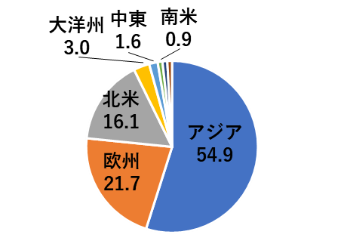
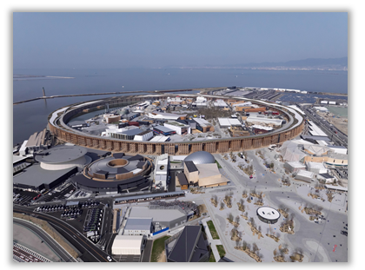

Ⅲ Changes in the Socioeconomic Environment (Global, Japan, Osaka)
Enhance the Phase 1 initiatives and organize and analyze Osaka’s surrounding environment to support the growth of Osaka and the Kansai region from a financial perspective.
■Main Achievements of the Osaka-Kansai Expo 2025
The Osaka-Kansai Expo 2025 was held on Yumeshima Island from April 13 to October 13 under the theme “Designing Future Society for Our Lives.”
The Expo attracted a large number of visitors not only from across Japan but also from around the world, and various business matching events, seminars, and networking sessions were held both inside and outside the venue, creating numerous business opportunities.
Total visitors to the Expo
Provision of business opportunities via business matching events, seminars, and networking sessions
Cumulative number of visitors: Approx. 29.02 million
Visitors from 183 countries and regions
869 official hospitality cases handled by Osaka Prefecture and City (including both
inside and outside the venue)
International companies participated : Over 7,500 (cumulative total)
Domestic companies participated : Over 17,000 (cumulative total)
Accelerated B2B collaboration in fields such as healthcare,
environment, and smart technologies
Oceania
Middle East
South America
・ Heads of State, Royalty, and Ministers: 196
・ Government Representatives, Ambassadors,
and Senior Ministry Officials: 201
・ Others: 472
North America
Asia
Europe
Source: Japan Association for the 2025 World Exposition

Slide 11
■Initiatives Related to the Global Financial City at the Osaka–Kansai Expo
In addressing shared global challenges, cutting-edge technologies across a wide range of fields — including life sciences and carbon neutrality — were showcased at the Expo. In the financial sector as well, the first-ever demonstration initiatives in Expo history were carried out.
Business exchanges between overseas business delegations and companies in Osaka were actively conducted, further strengthening connections with international cities.
* Main countries and cities engaged in international financial exchanges with Osaka Prefecture and Osaka City：
United Kingdom, Hamburg (Germany), Abu Dhabi (United Arab Emirates), Saudi Arabia, Luxembourg, and others
Cutting-Edge Technology Showcase and Startup Events
Demonstration and Experience Events for Financial Services
■ Social Experiments with Cutting-Edge Technology
■ Reborn Challenge (432 companies)
SMEs and startups took weekly turns to showcase new technologies and products, promoting their innovative technological capabilities both domestically and internationally(e.g., ophthalmological examinations via smartphone, laser fusion power generation technology, etc.)
■ GSE（Global Startup EXPO 2025）
Hosted an event that brought together deep-tech startups and investors from around the world
■ Fully Cashless Payments
A world-first international event operated entirely with cashless payments
■ EXPO 2025 Digital Wallet
Introduction of the official Expo digital wallet app (This digital
wallet integrates Web2 and Web3 functions and enables
electronic money payments, point rewards, receiving NFTs, and
more)
■ Global Financial City OSAKA Festival
Hosted an event where visitors could experience future financial
technologies and services
Life Sciences & Healthcare
A real myocardial sheet derived from iPS cells
Carbon Neutrality
Perovskite Solar Cells
Methanation
Mobility
Flying cars
➡ Approximately 1 million downloads
The service has continued after the Expo through a renewed version of the app

Slide 12
■Startup Investment
Global startup funding from venture capital (VC) firms and other investors targeting high‑growth unlisted companies declined from 2022 to 2023 but has since shown signs of recovery, reaching approximately USD 470 billion in 2025 (about JPY 70 trillion, calculated at the average exchange rate for 2025). In contrast, startup funding in Japan is projected to reach 761.3 billion yen in 2025, highlighting a significant gap compared to the global market.
Within Japan, funding remains heavily concentrated in Tokyo. While the city accounts for 7.6% of university-launched startups and 9.5% of VCs (including operational offices), startup funding in Osaka remains at approximately 2%.
Startup Funding in Japan and Osaka (JPY billions)
Global Startup Funding (USD billions)
Year | 2021 | 2022 | 2023 | 2024 | 2025
Tokyo | 7379 | 7907 | 6557 | 6916 | 5590
Fukuoka | 181 | 368 | 167 | 125 | 301
Kanagawa | 175 | 261 | 213 | 288 | 221
Hokkaido | 70 | 74 | 61 | 81 | 178
Osaka | 157 | 208 | 244 | 184 | 174
Kyoto | 168 | 272 | 179 | 261 | 167
Others | 746 | 819 | 863 | 973 | 982
Total | 8876 | 9909 | 8284 | 8828 | 7613
Source：Speeda Startup Information Research（as of January 18, 2026）
Number of University-Launched Startups and VCs in Japan and Osaka
Prefecture |  | Tokyo | Osaka | Others | Total
Number of University‑Based Startups |  | 1,936 | 384 | 2,754 | 5,074
 | Share of National Total | 38.2% | 7.6% | 54.3% | 100%
VC Headquarters / Branch Offices |  | 96 | 17 | 66 | 179
 | Share of National Total | 53.6％ | 9.5% | 36.9％ | 100%
Source: Prepared by Osaka Prefecture based on
CB Insights’ “State of Venture 2025”
Source: Ministry of Economy,Trade and Industry (METI), “Survey on the Status of University-Launched
Ventures in FY 2024 ” Venture Enterprise Center, “2025 Japan Venture Capital Directory”

Slide 13
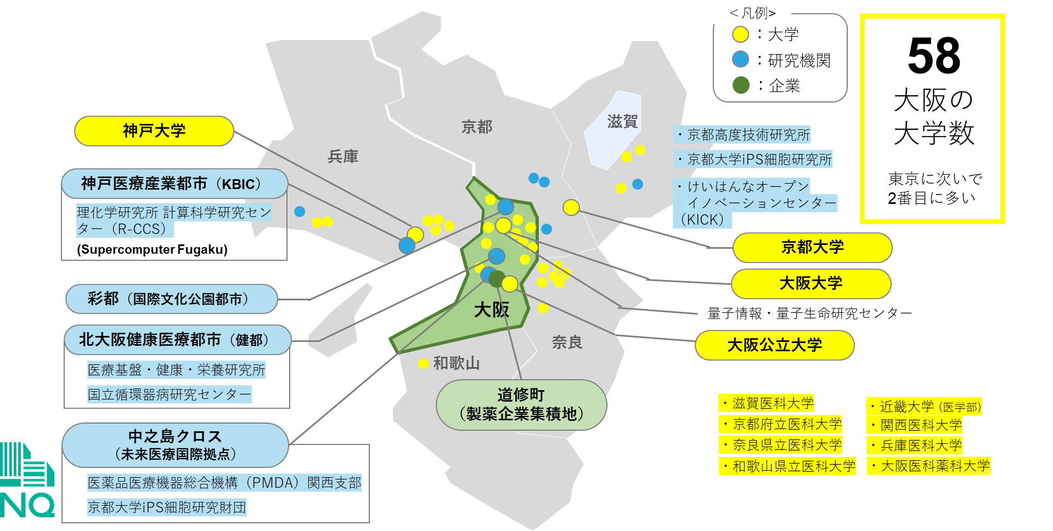
■Fostering Deep-Tech Startups
In the Osaka and the Kansai regions, startups are emerging based on research findings from a concentration of globally competitive universities and research institutions. The region possesses advanced technological capabilities, particularly in the fields of life sciences and carbon neutrality, and an ecosystem for fostering innovation is taking shape through collaboration with industry.
Going forward, it will be essential to further strengthen support systems and build a virtuous cycle that accelerates the commercialization of research outcomes.
Top 10 Universities by Number of University-Launched Startups (FY2024)
Concentration of Universities, Research Institutions, and Companies in Osaka (Life Sciences)
Rank | University | YoY（No. of SU） | Total（No. of SU）
１ | Kyoto Univ. | 149 | 422
２ | Keio Univ. | 86 | 377
３ | Kobe Univ. | 58 | 113
４ | Tokyo Univ. | 48 | 468
５ | Osaka Univ. | 46 | 298
６ | Hokkaido Univ. | 44 | 147
７ | Professional Degree Program in Info Management & Innovation | 39 | 85
８ | Kansai Univ. | 38 | 47
９ | Kinki Univ. | 37 | 118
１０ | Tokyo Univ. of Science | 35 | 226
<Legend>
Universities
Research Institutes
Companies
The Number
of
Universities
in Osaka
This is the
second largest
in Japan,
following Tokyo
KOBE University
KYOTO
SHIGA
Advanced Science, Technology & Management Research Institute of KYOTO
HYOGO
Center for iPS Cell Research and Application, Kyoto University
KOBE Biomedical Innovation Cluster（KBIC）
Keihanna Open Innovation Center （KICK）
RIKEN Center for Computational Science （R-CCS）
KYOTO University
SAITO（International Culture Park City）
OSAKA
University
OSAKA
Center for Quantum Information
and Quantum Biology
Northern Osaka
Health and Biomedical Innovation Town（KENTO）
NARA
OSAKA Metropolitan University
National Institute of Biomedical Innovation, Health and Nutrition
National Cerebral and Cardio Vascular Center
WAKAYAMA
By Region | Total（No. of SU） | YoY（No. of SU）
Osaka-Kyoto-Kobe | 998 | 328
Tokyo Metropolitan Area （Tokyo and ３Prefectures） | 1,156 | 208
Doshomachi (Pharmaceutical Company Cluster)
Shiga University of Medical Science
Kyoto Prefectural University of Medicine
Nara Medical University
Wakayama Medical University
KINDAI University (Faculty of Medicine)
Kansai Medical University
Hyogo Medical University
Osaka Medical and Pharmaceutical University
Nakanoshima Qross
（Organization of Future Medicine）
Pharmaceuticals and Medical Devices Agency
（PMDA）
Kansai Branch
CiRA Foundation-Kyoto University
Opened in June 2024
Source: Ministry of Economy, Trade and Industry (METI),
“Survey on the Status of University-Launched Ventures in FY 2024”

Slide 14
■Private Equity (PE) Investment
Private equity (PE) is an investment strategy in which investors invest in unlisted companies — such as small and medium-sized enterprises (SMEs) — and participate in their management to enhance corporate value, ultimately generating returns through IPOs or M&A.
Global private equity (PE) investment reached a record high in 2022, followed by a temporary decline, but has been on a recovery trend since 2024.
While global PE investment in 2024 is estimated at approximately USD1.75 trillion (about 265 trillion yen, calculated at the 2024 average exchange rate), PE investment in Japan stands at around JPY2.3 trillion — only about 1% of the global total — yet the number of deals has been steadily increasing.
Global PE Investment (billion USD)
PE Investment in Japan
Q1 2022
Q2 2022
Q3 2022
Q4 2022
Q1 2023
Q2 2023
Q3 2023
Q4 2023
Q1 2024
Q2 2024
Q3 2024
Q4 2024
Q1 2022
Q2 2022
Q3 2022
Q4 2022
Q1 2023
Q2 2023
Q3 2023
Q4 2023
Q1 2024
Q2 2024
Q3 2024
Q4 2024
東芝案件
Deal Value (JPY 1 Billion)
Number of Deals
Source: Prepared by Osaka Prefecture based on PwC data
Source: Prepared by Osaka Prefecture based on Deloitte Tohmatsu’s
“2025 Asia Pacific Private Equity Almanac”

Slide 15
■Derivatives Investment
The global derivatives market surpassed 200 billion contracts for the first time in 2024, reaching 206.7 billion contracts — a 50.5% increase from the previous year.
India has become the world’s largest derivatives market, driven by a rapid surge in trading volume as investor participation expands, supported by factors such as its status as the world’s most populous country and advancements in fintech.
Compared to the global market, Japan’s derivatives market remains relatively small, indicating substantial room for future growth.
Global Trends in Derivatives Trading Volume
Global Ranking of Derivatives Trading Volume (2024)
Ranking | Name of Stock Exchange | Country | 出来高(枚) | Trading Volume (Contracts) | YoY (%)
1 | NSE of India | India | 125,136,727,379 | 125,136,727,379 | 47.60%
2 | Bombay SE | India | 30,782,522,810 | 30,782,522,810 | 428.30%
3 | BM&F Bovespa（B3） | Brazil | 9,814,294,411 | 9,814,294,411 | 18.00%
4 | Chicago Mercantile Exchange | USA | 3,283,392,693 | 3,283,392,693 | 2.30%
5 | Korea Exchange | South Korea | 2,616,172,636 | 2,616,172,636 | 28.30%
6 | Zhengzhou Commodity Exchange | China | 2,609,598,908 | 2,609,598,908 | ▲26.10%
7 | Chicago Board of Trade | USA | 2,590,601,381 | 2,590,601,381 | 17.20%
8 | Dalian Commodity Exchange | China | 2,268,350,238 | 2,268,350,238 | ▲9.60%
9 | Shanghai Futures Exchange | China | 2,259,954,284 | 2,259,954,284 | 9.70%
10 | CBOE | USA | 2,179,921,772 | 2,179,921,772 | 7.70%
～ | ～
28 | OSE | Japan | 462,741,044 |  | 18.00%
50 | TFX | Japan | 77,876,088 |  | ▲9.10%
73 | ODEX | Japan | 2,501,876 |  | 183.10%
78 | TOCOM | Japan | 1,424,912 |  | ▲23.60%
（Unit: Millions）
Stock Price Index
Single Shares
Interest
Currency
Energy
Precious Metals
Non-Precious Metals
Agricultural Products
Other
Source：FIA (Futures Industry Association)
Source：FIA (Futures Industry Association)

Slide 16
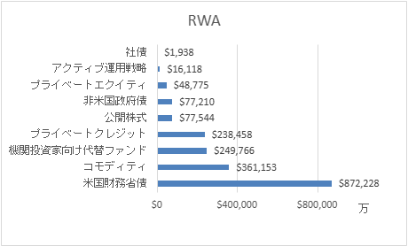
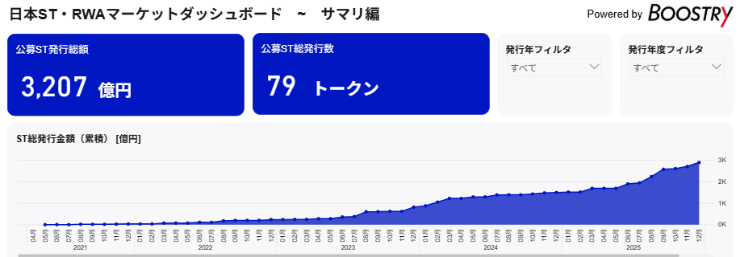
■Digital Finance (Security Tokens)
The global market for security tokens (STs) — digitized securities issued using blockchain technology — has grown to USD 19.4 billion as of January 2026. By asset class, U.S. Treasury bonds hold the largest share at 45%, followed by commodities at 19%, institutional alternative funds at 13%, and private credit at 12%.
While government bonds and commodities dominate the global ST market, Japan’s ST market is characterized by a strong concentration in real estate, which accounted for approximately 89% of issuance in 2024. Greater product diversification and increased participation by institutional investors are expected to enhance market liquidity.
Global ST Market (as of January 2026)
Japanese ST Market
Japan ST/RWA Market Dashboard – Summary Edition
Corporate Bonds
Active Investment Strategies
Private Equity
Non‑U.S. Government Bonds
Public Equities
Private Credit
Alternative Funds for Institutional Investors
Commodities
U.S. Treasuries
Number of Public ST Issuances
Filter by Issuance Year
Filter by Issuance Year
Total Issuance of Public Security Tokens (STs)
320.7 billion yen
79 STs
ALL
ALL
ST Total Issuance (Cumulative) (¥100M)
( ×10,000)
Source: Prepared by Osaka Prefecture based on data from RWA.xyz
Source：Security Token（ST/RWA）Dashboard by Boostry

Slide 17
■Digital Finance (Stablecoins, etc.)
“Stablecoins” — cryptocurrencies designed to maintain a stable value by being pegged to real-world assets such as fiat currencies — are seeing an increasing number of countries, led by the United States, advance regulatory frameworks and issuance. In Japan, JPYC Co., Ltd. began issuing the country’s first yen‑denominated stablecoin in October 2025. The global stablecoin market has experienced rapid growth since around 2023, reaching a market capitalization of over USD 300 billion by 2025.
Meanwhile, policies regarding the issuance of CBDCs (Central Bank Digital Currencies) (*) vary across countries, with some actively promoting them while others take a more cautious approach, resulting in a lack of global alignment.
Furthermore, as AI continues to advance rapidly, the financial industry — which holds vast data assets — is accelerating AI‑related initiatives, including AI‑driven services and operational transformation.
(*) CBDC: A digital form of legal tender issued and managed by a central bank, equivalent in value to physical cash and usable for electronic payments.
Status of Major Digital Currency Markets
Global Stablecoin Market (in USD billions)
Countries / Regions | CBDC Policy | Stablecoin Policy
USA | ・Digital dollar: TBD ・The U.S. Federal Reserve (FRB) maintains a cautious stance | ・Issuance and circulation are progressing under the GENIUS Act
EU/Eurozone | ・The digital euro is in the preparation phase, with progress being made on institutional and technical considerations for potential issuance | ・Under MiCA, rules for issuance and circulation have been clarified ・Issuance remains limited, and policy efforts aim to foster euro‑denominated stablecoins
Singapore | ・CBDC pilot projects are being promoted | ・MAS has clarified its regulatory framework ・SGD‑pegged and USDC stablecoins are already being issued and used under this framework
Japan | ・The digital yen is currently in the pilot phase, and no decision has been made regarding issuance. | ・The amended Payment Services Act came into effect in June 2023 ・JPYC began issuing Japan’s first yen‑denominated stablecoin, though issuance remains limited
Source: Created by Osaka Prefecture based on data from DeFiLlama
(as of January each year)

Slide 18
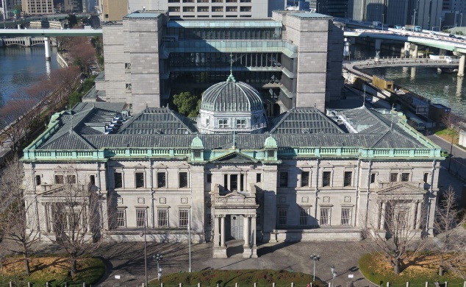

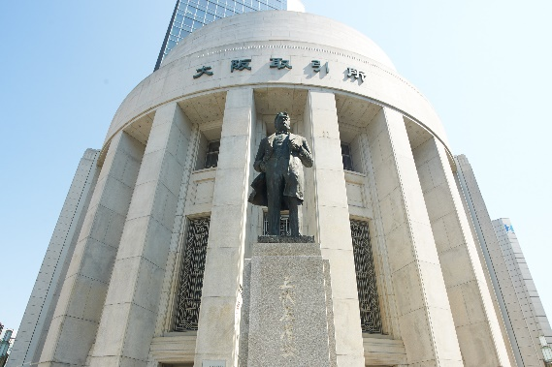
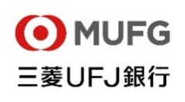














■Realization of the Secondary Capital Osaka
Under the “Vision of the Secondary Capital,” Osaka Prefecture and Osaka City are working toward the realization of Osaka as a secondary capital. Meanwhile, the national government is considering legislation to establish the Secondary Capital. Against this backdrop, the prefecture and city are also advancing discussions on the Secondary Capital concept designed to serve as a backup for the capital’s functions and to drive economic growth.
In the financial sector, there is an expectation not only to enhance the backup system for the capital’s financial functions during emergencies, but also to strengthen financial capabilities during normal times to support economic growth. Leveraging Osaka’s concentration of financial institutions, it is becoming increasingly important to promote innovation — particularly in startups — through financial support and ecosystem development.
Examples of Financial BCP Functions in Osaka（Refined Version）
Concentration of Financial Institutions in Osaka
Mega banks with deep roots in Osaka
Major banks, securities firms, and life insurers originating in Osaka
Bank of Japan, Osaka Branch
Osaka Exchange, Inc.
Regional banks and credit unions supporting local businesses
Exchanges and proprietary trading systems operating in Osaka
And many more
In the event of a disaster in Tokyo, the Osaka Branch of Japan’s central bank would take over interbank settlement and liquidity provision functions
A mutual backup system has been established with the Tokyo Stock Exchange, the core of Japan’s financial futures market
■Number of Financial Institutions Headquartered in Osaka (as of March 2026)
Depository Institutions | Financial Instruments Business Operators
 |  | Type I | Type II | Investment advisory / Agency businesses | Investment Management Businesses
25 | 138 | 11 | 104 | 34 | 9
Source: Financial Services Agency website, “List of licensed (registered) Financial Institutions”
Notes:
副首都の訳について： 有友さんからご提案いただいた “Alternative Capital Osaka” についてですが、この表現は「副次的・補完的」というよりも「代替首都」というニュアンスが強く、“置き換え”の印象を与えてしまう可能性があります。一方で “The Second Capital” は、これまでの資料やビヨンドチームの文書でもタイトルとして使用されてきました。こちらは、法的に定義された「副首都」という意味ではなく、象徴的でイメージしやすい「第2の首都」というニュアンスを持っており、より印象的なスローガンやキャッチコピーとして適していると判断し、今回もタイトルとして採用しています。また “secondary capital” は制度文書や Japan Times などの報道でも用いられており、「副首都」（補完・バックアップ）の意味に最も近い表現です。そのため、一般的な「副首都」について説明する部分では “secondary capital” を使用しています。

Slide 19
Ⅳ Directions for Action Plan Phase 2
Building on the achievements of Phase 1 and the current market environment, and leveraging the Expo legacy — including social implementation of advanced technologies, international exchange, and demonstrations of financial services — we will further deepen initiatives such as promoting investment from overseas with a focus on growth industries and advancing financial innovation
➡ Promote financial initiatives aligned with the “Beyond EXPO 2025” vision of becoming a leading innovation city
Challenges Based on Phase 1 Results and the Market Environment
The Expo Legacy
Direction for Phase 2
【Vision 1】
Global city that develops by leveraging finance
While progress has been made in attracting financial firms, the entry of investment funds such as venture capital and private equity, as well as their investment and collaboration with Osaka-based companies, remains limited.
Investment in deep tech — a growth sector in which Osaka has a competitive advantage — has not been sufficiently drawn in, due in part to market conditions and limited connections with overseas markets.
A stronger financial framework is needed to function as a backup engine for Japan’s growth.
Social implementation trials of advanced technologies
Hosting international events that bring together deep‑tech startups and investors
Exchanges with overseas business mission delegations
Pilot projects for financial services such as cashless payments
Signing MOUs with overseas cities
Strategic promotion to investors by leveraging advanced technologies showcased at the Expo and Osaka’s international connections, along with initiatives to encourage investment and collaboration with Osaka‑based companies
Promotion of the concentration of financial institutions and related entities that contribute to realizing Osaka as the Secondary Capital, including from the perspective of enhancing resilience
【Vision 2】
Frontrunner City in Finance
While initiatives to develop cutting‑edge financial products and markets have emerged, Osaka’s market scale remains limited in the global context.
Digital finance — such as security tokens and stablecoins — is advancing worldwide, and similar expansion is expected in Japan.
Although Osaka has been designated as a Special Zone for Finance and Asset Management Busiinesses, no Osaka‑specific measures have been approved.
Formation of cutting‑edge financial products and markets, taking into account digital advancements, and promotion of transactions through enhanced payment systems
Promotion of financial innovation through the use of blockchain technology, stablecoins, and related digital financial tools
Shared Initiatives
Initiatives by the Financial and Economic Education Promotion Network have begun (*).
A consultation system has been established to support the entry of foreign financial firms and others. Although the number of consultations at the One-Stop Support Center (the support desk) is increasing, this has not yet sufficiently translated into investment in Osaka.
Information dissemination through social media and other channels is being carried out .
Enhancement of financial literacy among residents and development of advanced financial talent through collaboration among financial institutions, schools, and government
Improvement of business and living environments for overseas investors, including residence visas and the educational environment
Promotion of strategic public relations highlighting Osaka’s business appeal and the enhancement of collaboration with overseas partners
(*)In Action Plan Phase 1, financial and economic education was positioned under Vision 1, but in Action Plan Phase 2 it is categorized as a “cross‑cutting initiative.”

Slide 20
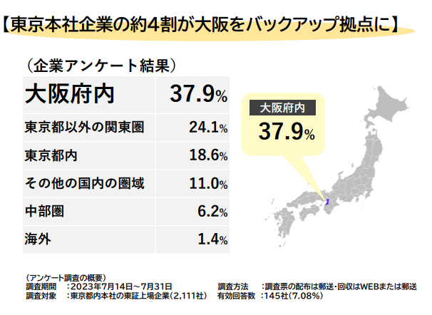
Key Initiatives for Realizing [Vision 1]
Strategic promotion to investors by leveraging advanced technologies showcased at the Expo and Osaka’s international connections, along with initiatives to encourage investment and collaboration with Osaka‑based companies
Promotion of the concentration of financial institutions and related entities that contribute to realizing Osaka as the Secondary Capital, including from the perspective of enhancing resilience
Strategic promotion that identifies key industries and target overseas regions for investment, building on the legacy of the Expo
Encouraging the establishment of an Osaka base as a backup site capable of dual operations for financial institutions in the Tokyo metropolitan area — such as the Government Pension Investment Fund (GPIF) — and promoting related initiatives
【Key Expo Legacies】
・Showcasing advanced technologies related to life sciences, carbon
neutrality, and other cutting‑edge fields, as well as exhibiting new
technologies and products developed through the Reborn Challenge
・Exchanges with overseas mission delegations from regions such as
Europe and the Middle East, along with promotional activities highlighting
Osaka’s attractiveness
■Reference
【 】
About 40% of Tokyo‑headquartered companies use Osaka as a backup base
（Based on corporate survey results）
◆Key Industries for Investment Promotion
• Life Sciences
• Carbon Neutrality
• Mobility
• Robotics and AI
• Startups (Deep Tech Fields)
◆Priority Overseas Regions
(for the time being)
Europe
(Partnerships with financial hubs, investment promotion, etc.)
Middle East
(Investment promotion, etc.)
Asia
(Business attraction and investment promotion, etc.)
Within Osaka Prefecture
Within Osaka Prefecture
Kanto region outside Tokyo
Within Tokyo
Other regions in Japan
Chubu region
Overseas
(Overview of the Survey)
Survey period: July 14–31, 2023
Target respondents: 2,111 Tokyo‑headquartered companies listed on the Tokyo Stock Exchange
Survey method: Questionnaire distributed by mail;
responses collected via web or mail
Valid responses: 145 companies (response rate: 7.08%)
*Taking into account geopolitical factors
Promoting exchanges with international financial hubs
Source: “Regarding the Secondary Capital Concept” (Materials from the 19th Secondary Capital
Promotion Headquarters Meeting of Osaka Prefecture and Osaka City, December 23, 2025)
*In promoting investment and collaboration, we will advance our initiatives in coordination with support measures for the implementation of cutting‑edge technologies, as well as initiatives related to the Keihanshin startup ecosystem

Slide 21
Key Initiatives for Realizing [Vision ２]
Key Points of Shared Initiatives between the Two Visions
Promotion of transactions through the development of cutting‑edge financial products and markets that reflect advances in digital technology, as well as the enhancement of payment systems
Financial Literacy Improvement and Development of Highly Skilled Financial Professionals through Collaboration among Financial Institutions, Schools, and Government Agencies
Expand courses offered by the Network for the Promotion of Financial and Economic Education in schools, companies, and other organizations
Develop highly skilled financial professionals with expertise in Web3, AI, and other fields through collaboration among universities, technical colleges, and financial institutions
Examine new derivative products that reflect advances in financial digital technologies
Expand security‑token‑based products, including the tokenization of equities
Promote more efficient and advanced market settlement systems, including the use of stablecoins for payments
Improvement of residency status systems and educational environments to enhance business and living environments for foreign investors and other international professionals
Promotion of financial innovation through the use of blockchain technology and stablecoins
Advocate the establishment of a residency status for foreign investors to the national government
Attract international schools by providing land information and other support tailored to the needs of highly skilled foreign professionals
Support businesses conducting pilot projects on new financial services — such as Web3 and stablecoin‑based solutions —by leveraging the Special Zones for Financial and Asset Management Businesses, and identify regulatory ‑ reform needs and submit proposals to the national government
Promotion of strategic public relations to highlight Osaka’s business attractiveness and collaboration with overseas partners
Promote strategic public relations regarding Osaka’s business appeal — including its growing industries — by leveraging portal sites, social media, and overseas media
Explore the possibility of signing memorandums of understanding (MOUs) and strengthen collaboration with cities that have signed MOUs

Slide 22
Ⅴ Pillars of the Initiatives & Specific Initiatives (Action Plan)
Pillars of the Initiatives
Global city that develops by leveraging finance
1
Frontrunner city in finance
2
Promote investment and collaboration for startups and
other emerging businesses from both domestic and
International sources
Promote the concentration of financial institutions and related entities that contribute to realizing Osaka as the
Secondary Capital, including from the perspective of enhancing resilience
Create cutting-edge, innovative financial products and markets
Promote financial innovation
【Key Points of Shared Initiatives across the Two Visions】
Promote Initiatives to enhance financial literacy and develop highly skilled professionals in the financial sector
Develop a Living and Business Environment Attractive to International Investors
Promote strategic public relations domestically and internationally, and strengthen global partnership

Slide 23
Specific Initiatives Currently Being Implemented or Under Consideration (Action Plan)
Global city that develops by leveraging finance, attracting the energy of Asia and the world
Global city that develops by leveraging finance
Promote investment in and collaboration with startups and other entities from domestic and international sources
(2) Promote the concentration of financial institutions and
related entities that contribute to realizing Osaka as the
Secondary Capital, including from the perspective of
enhancing resilience
  Implement strategic promotional activities targeting domestic and international financial institutions to attract companies and promote investment
  Create opportunities for startups and small to medium-sized enterprises (SMEs) to connect with venture capital and private equity firms
  Invite investors from both domestic and international markets
  Support the implementation of advanced technologies showcased at the Expo
  Promote collaboration between financial institutions that have expanded into Osaka and local Osaka-based companies
  Encourage and attract investment from asset owners to Osaka
  Explore diverse financing methods, including venture capital funds with specialized themes, through public-private partnerships
  Advocate tax reforms and regulatory easing (e.g., enhanced tax incentives to promote open innovation and angel investment) to the national government
  Support startup exits through IPOs, M&A, secondary offerings, and other means
  Support foreign financial institutions and related companies in establishing business bases in Osaka through incentive programs
  Promote the establishment of Osaka‑based facilities — including data centers and middle/back‑office functions — that enable dual‑site operations by financial institutions.
23

Slide 24
Specific initiatives are organized into the following three approaches:
“Invite” funds, talent, and companies to Osaka from within and outside Japan
“Nurture” Osaka’s own strengths to enhance its appeal
“Support” by building the foundation needed to “invite” and “nurture”
(1) Promote investment in and collaboration with startups and other
entities from domestic and international sources
Global city that develops by leveraging finance
Policy Name | Summary | Responsible Entity
Implement strategic promotional activities targeting domestic and international financial institutions（*）, leading to corporate attraction and investment promotion （*）Venture capital (VC), private equity (PE), family offices, fintech firms, etc. | Promote cutting-edge technologies showcased at the Expo, growth industries where Osaka can leverage its strengths (*), and the city’s appeal to domestic and international investors (such as venture capital firms and family offices) (*) Life sciences, carbon neutrality, etc. Identify financial institutions (VCs, PEs, fintech firms, etc.) that are expected to contribute to investment in growth industries and to the advancement of payment methods for Osaka-based companies; facilitate business attraction through individual outreach and ongoing support; and promote investment and collaboration with Osaka-based companies Collaborate, as needed, with Osaka Prefecture and Osaka City in engaging domestic and international fintech firms, VCs, and related companies with which organizations participating in the Promotion Committee have ties | Osaka Prefecture, Osaka City, Private Sector, Business Community
Create opportunities for startups and small to medium-sized enterprises (SMEs) to connect with venture capital and private equity firms | Host acceleration programs for startups that invite domestic and international venture capital firms (VCs), family offices, and others, and organize English-language pitch events and business‑matching sessions Hold seminars introducing private equity (PE) for mid‑sized and small businesses Create collaboration opportunities by hosting matching events and networking sessions between fintech firms and Osaka‑based companies Promote the potential of Osaka’s life sciences sector and support business expansion for companies within the prefecture by leveraging opportunities such as domestic and international trade fairs | Osaka Prefecture, Osaka City, Private Sector, Business Community
Invite investors from both domestic and international markets | Invite domestic and international venture capital firms to Osaka to participate in events that serve as platforms for matching Osaka-based startups with overseas investors | Osaka Prefecture, Osaka City
Invite
Invite
Nurture
Invite
Notes:
2022年度版の戦略では「主体」はOwnership で訳されていますが、Responsible Entity の方が近いのでは？暫定でこちらとしています。

Slide 25
Policy Name | Summary | Responsible Entity
Support the implementation of advanced technologies showcased at the Expo | Support companies working to commercialize cutting-edge technologies showcased at the Expo through subsidies and the dissemination of information both domestically and internationally | Osaka Prefecture, Osaka City, Business Community, Private Sector
Promote collaboration between financial institutions that have expanded into Osaka and local Osaka-based companies | Promote networking among companies that have established a presence in Osaka and potential collaboration partners, such as Osaka-based companies and financial institutions | Osaka Prefecture, Osaka City
Encourage and attract investment from asset owners to Osaka | Organize meetings, including lectures and discussions on asset management, targeting asset owners such as pension funds of Osaka-based companies | Osaka Prefecture, Osaka City
Explore diverse financing methods, including venture capital funds with specialized themes, through public-private partnerships | Examine multifaceted funding methods, including the formation of venture capital funds specializing in industrial sectors where Osaka has a competitive advantage, and facilitate the smooth provision of funds through the management of existing public–private funds | Osaka Prefecture, Osaka City, Private Sector
Advocate tax reforms and regulatory easing (e.g., enhanced tax incentives to promote open innovation and angel investment) to the national government | Advocate expanding support systems — such as broadening the scope of the Open Innovation Tax Credit and the Angel Tax Credit — to the national government. | Osaka Prefecture, Osaka City, Business Community
Support startup exits through IPOs, M&A, and secondary offerings, and other means | Promote the growth of startups and support their exit strategies through individual support measures, including the establishment of consultation the desks, hosting of public–private partnership seminars, and the diversification of financing methods such as venture debt. | Private Sector, Exchanges, Osaka Prefecture, Osaka City
Global city that develops by leveraging finance
Nurture
Nurture
Invite
Nurture
Support
Nurture

Slide 26
(2) Promote the concentration of financial institutions and related entities that contribute to
realizing Osaka as the Secondary Capital, including from the perspective of enhancing resilience
Global city that develops by leveraging finance
Policy Name | Summary | Responsible Entity
Support foreign financial institutions and related companies in establishing business bases in Osaka through incentive programs | Implement subsidy programs, for foreign financial and related companies, to cover office rent for preliminary surveys related to establishing, as well as necessary initial costs immediately after launching operations Implement special local tax measures for foreign financial and related companies | Osaka Prefecture, Osaka City
Promote financial institutions to establish their Osaka-based facilities (including data centers and middle/back-office functions) that enable their dual-site operations | Promote the establishment of Osaka bases as backup locations capable of supporting dual-site operations for financial institutions in the Tokyo metropolitan area, such as the GPIF (Government Pension Investment Fund) Explore opportunities to attract international financial institutions — such as the BIS Innovation Hub — that would enhance Osaka’s global presence Support the development and implementation of business continuity plans (BCPs) to enhance the business continuity of financial institutions and related entities Disseminate information on initiatives that evaluate and certify corporate business continuity — including dual‑site operations — and extend preferential financing incentives Establish the “Osaka Digital Infrastructure Council” through industry –academia – government collaboration to promote the development of digital infrastructure, including data centers | Osaka Prefecture, Osaka City, Private Sector, Exchanges
Invite
Invite

Slide 27
Frontrunner city in finance, which challenges the world with pioneering initiatives
Create cutting-edge, innovative financial
products and markets
(2) Promote financial innovation
Frontrunner city in finance
  Explore the development of new derivative products
  Advocate tax reforms to expand the scope of offsetting gains and losses on income taxation for financial products, including derivative transactions
  Promote the expansion of corporate bonds and financial products utilizing security tokens
  Facilitate market transactions by enhancing trading through the utilization of new financial infrastructure
  The issuance of ESG bonds, including green bonds, by government entities
  Support companies engaging in decarbonization through sustainable finance, such as low-interest loans
  Encourage the issuance of ESG bonds through active underwriting, hosting workshops, and emphasizing SDGs in asset management
  Support proof-of-concept trials for financial services and identify regulatory reform needs
  Advocate regulatory reforms related to proof-of-concept trials for financial licenses
  Promote the sharing and dissemination of knowledge about fintech and Web3 businesses

Slide 28
(1) Create cutting-edge, innovative financial products and markets
Policy Name | Summary | Responsible Entity
Explore the development of new derivative products | Explore new derivative products in light of advancements in financial digital technology and corporate needs | Exchanges, Private Sector
Advocate tax reforms to expand the scope of offsetting gains and losses on income taxation for financial products, including derivative transactions | Collaborate with private‑sector organizations to advocate to the national government for the inclusion of derivative transactions within the scope of offsetting gains and losses under income taxation for financial products | Osaka Prefecture, Osaka City, Business Community
Promote the expansion of corporate bonds and financial products utilizing security tokens | Diversify funding methods by issuing and distributing a wide range of publicly offered bonds and products utilizing STs Explore the expansion of diverse ST products, including the tokenization of stocks, on the Osaka Digital Exchange (ODX) | Private Sector, Exchanges
Facilitate market transactions by enhancing trading through the utilization of new financial infrastructure | Promote the efficiency and sophistication of market transactions through mechanisms for recording and clearing on blockchain, as well as the utilization of digital payment methods such as stablecoins | Private Sector, Exchanges
Issue ESG bonds, including green bonds, through government entities | Issue ESG bonds, such as green bonds, through Osaka Prefecture and Osaka City to encourage private companies to undertake initiatives such as issuing their own ESG bonds | Osaka Prefecture, Osaka City
Support companies engaging in decarbonization through sustainable finance, such as low-interest loans | Support corporate decarbonization efforts by encouraging regional financial institutions to develop sustainable financial products and providing information on such products and services Provide products such as sustainability-linked loans | Osaka Prefecture, Osaka City, Private Sector
Encourage the issuance of ESG bonds through active underwriting, hosting workshops, and emphasizing SDGs in asset management | Support private companies in issuing SDG bonds through initiatives such as green finance and sustainability-focused financing by institutional investors and securities firms, underwriting and selling ESG bonds, and hosting workshops | Private Sector, Osaka Prefecture, Osaka City
Invite
Frontrunner city in finance
Support
Nurture
Nurture
Invite
Nurture
Support
Nurture

Slide 29
(2) Promote financial innovation
Policy Name | Summary | Responsible Entity
Support proof-of-concept trials for financial services and identify regulatory reform needs | Identify support needs — such as subsidies — for businesses conducting pilot tests of new financial services (*) and assessing their regulatory reform needs (*) This refers to new financial services utilizing blockchain-based networks (Web3) or stablecoins | Osaka Prefecture, Osaka City
Advocate regulatory reforms related to proof-of-concept trials for financial licenses | Advocate regulatory reforms based on the needs of financial institutions, including the provisional granting or temporary exemption of financial licenses under certain conditions to facilitate pilot tests, as well as amendments to existing regulations informed by the results of such tests | Osaka Prefecture, Osaka City
Promote the sharing and dissemination of knowledge about fintech and Web3 businesses | Organize seminars and study sessions to share insights on leading cases, business models, and technological trends in the fintech and Web3 sectors with companies based in Osaka, thereby promoting understanding of fintech and Web3 businesses and encouraging new market entrants | Private Sector, Osaka Prefecture, Osaka City
Frontrunner city in finance
Invite
Invite
Nurture

Slide 30
Shared Initiatives across the Two Visions
Global city that develops by leveraging finance
(1) Promote Initiatives to enhance financial literacy and
develop highly skilled professionals in the financial
sector
(3) Promote strategic public relations domestically
and internationally, and strengthen global
partnerships
Frontrunner city in finance
  Implement financial and economic education through a consortium that connects schools, businesses, and financial institutions
  Provide education in finance, entrepreneurship, and technology at universities and other higher education institutions
  Conduct PR activities via diplomatic missions, government agencies, local government offices, private sector networks, etc.
  Disseminate information via multilingual websites and social media platforms
  Disseminate information via international media
  Strengthen partnerships through initiatives such as signing MOUs with international financial centers
(2) Develop a Living and Business Environment
Attractive to International Investors
  Attract international schools that meet the needs of highly skilled foreign professionals
  Operate English-language one-stop service centers and professional service consortiums, and dispatch personnel to support offices for business establishment
  Utilize Special Zones for Financial and Asset Management Businesses to support resident status and related matters
  Advocate national corporate tax incentives to the central government
  Disseminate disaster prevention information to ensure the safety and security of foreign residents

Slide 31
(1) Promote Initiatives to enhance financial literacy and develop highly skilled professionals in the financial sector
Policy Name | Summary | Responsible Entity
Implement financial and economic education through a consortium that connects schools, businesses, and financial institutions | The consortium (Osaka Financial and Economic Education Promotion Network) works to improve financial literacy in Osaka by providing financial and economic education, dispatching lecturers to schools, companies, and other organizations that request it, and organizing related events | Osaka Prefecture, Osaka City, Universities, Private Sector, Exchanges, Business Community
Provide education in finance, entrepreneurship, and technology at universities and other higher educational institutions | Implement practical programs at universities and other institutions in collaboration with financial institutions, along with classes featuring invited experts and internships in related industries, in order to foster globally competitive, forward-thinking talent with expertise in fintech (the convergence of finance and technology), as well as professionals with know-how in fund formation and investment | Universities, etc., Osaka Prefecture, Osaka City, Private Sector, Business Community
Global city that develops by leveraging finance
Nurture
Frontrunner city in finance
Nurture
(2) Develop a Living and Business Environment Attractive to International Investors
Policy Name | Summary | Responsible Entity
Attract international schools that meet the needs of highly skilled foreign professionals | Attract foreign financial companies and related entities to Osaka by collaborating with relevant stakeholders to facilitate their relocation, by introducing public land — such as former school sites — for the establishment of international schools to improve the educational environment for the families of their employees | Osaka Prefecture, Osaka City
Operate English-language one-stop service centers and professional service consortiums, and dispatch personnel to support offices for business establishment | Operate the “Osaka Global Finance One-Stop Support Center,” which provides one-stop consultation on business matters — such as office introductions — and lifestyle matters — such as housing — for foreign financial companies and related entities seeking to expand into Osaka, as well as the “Professional Service Consortium,” which provides legal support for matters such as license acquisition. Dispatch personnel to the base-establishment support offices set up by the national government and establish the Osaka Virtual Office | Osaka Prefecture, Osaka City
Utilize Special Zones for Financial and Asset Management Businesses to support resident status and related matters | Advocate to the national government for the implementation of measures related to the designation of Special Zones for Finance and Asset Management Businesses, such as the creation of residency statuses for investors Examine proposals for new deregulation measures based on an understanding of corporate needs | Osaka Prefecture, Osaka City
Support
Support
Support

Slide 32
Policy Name | Summary | Responsible Entity
Advocate national corporate tax incentives to the central government | Continue to call for the national government to implement tax relief measures (national taxes) for foreign financial companies and related entities | Osaka Prefecture, Osaka City
Disseminate disaster prevention information to ensure the safety and security of foreign residents | Provide the multilingual disaster-prevention app and website “Osaka Disaster Prevention Net”, which disseminates disaster-prevention information useful for evacuation and other emergency actions Create video content for “Disaster Prevention Seminars” (covering risks from natural disasters such as earthquakes and appropriate actions during emergencies) for foreign residents in Osaka, including foreign visitors to Japan | Osaka Prefecture, Osaka City, Private Sector
Support
Global city that develops by leveraging finance
Support
Frontrunner city in finance
(3)Promote strategic public relations domestically and internationally, and strengthen global partnerships
Policy Name | Summary | Responsible Entity
Conduct PR activities via diplomatic missions, government agencies, local government offices, private sector networks, etc. | Conduct PR activities via diplomatic missions such as the consulates -general in Kansai, connections through the Osaka business partner cities, and by utilizing private sector networks. | Osaka Prefecture, Osaka City, Private Sector, Business Community
Disseminate information via multilingual websites and social media platforms | Disseminate information on All-Osaka initiatives aimed at investors through the “Global Financial City Osaka” website, social media, and other channels, and amplify this content through ambassadors. (Content to be shared: Osaka’s growth industries; support for the entry of foreign financial companies; information on investor-focused events hosted by the public and private sectors; startup support measures; and examples of collaboration between financial firms and Osaka-based companies.) | Osaka Prefecture, Osaka City, Private Sector, Business Community
Disseminate information via international media | Disseminate information on Osaka’s business appeal and the initiatives of “Global Financial City Osaka” through overseas media. | Osaka Prefecture, Osaka City
Strengthen partnerships through initiatives such as signing MOUs with international financial centers | Explore the possibility of signing Memorandums of Understanding (MOUs) related to “Global Financial City Osaka” initiatives with cities in key overseas regions where effective collaboration is feasible, and foster cooperation with cities that have signed MOUs or are sister cities. | Osaka Prefecture, Osaka City Business Community
Support
Support
Invite
Support
Invite
Support

Slide 33
IV Strategy Implementation Period and Strategy Goals
1. Strategy Implementation Period
Global financial cities around the world have been built upon long financial histories; therefore, becoming a global financial city requires sustained, long-term initiatives.
Accordingly, the period up to fiscal year 2025 — the year of the Osaka-Kansai Expo — was positioned as the foundation-building phase for realizing a global financial city (Phase 1). During this phase, we promoted the business appeal and living environment of Osaka-Kansai to Asia and the world, while also improving the environment for foreign financial institutions and related entities to enter the market and advancing attraction efforts.
The period until fiscal year 2030 — the target year for achieving the SDGs — constitutes Phase 2.
In this phase, we carry forward the Expo legacy and strategically attract domestic and international investment into the social implementation of cutting-edge technologies and deep-tech startups. At the same time, we promote financial innovation that enhances convenience for companies and residents, and support the realization of Osaka as Japan’s secondary capital and a leading SDGs city. Through these initiatives, we demonstrate Osaka’s presence as a global financial city to the world.
Finally, fiscal year 2050 — the year targeted globally for achieving carbon neutrality — will mark the stage for realizing Osaka’s future city vision. By elevating Osaka’s status as a city, creating new financial products and markets, and developing innovative financial services, Osaka will continuously attract investment from within Japan and abroad and establish its position as a cutting-edge global financial city.

Slide 34
Strategy Implementation Period (Illustration)
2022
2025
2030
2050
Strategy Formulation for
Global Financial City OSAKA
Short Term Goals
Osaka-Kansai
Expo
Medium Term Goals
Strategy Target Year
Start-Up Phase/
Phase 1 Activity Period
Share with Asia and the world, the business appeal of Osaka-Kansai, our living conditions, etc.
Gather start-ups that will be the target of investments while also working to attract talent, companies, and capital
Phase 2 Activity Period
・Dive deep into the initiatives
・Promote the realization of Osaka as Japan’s secondary capital and as a leading SDGs city from a financial standpoint
Create new financial products and markets and develop innovative financial products
Global city that develops by leveraging finance
Frontrunner city in finance
Currently setting strategy goals
Improve Osaka’s presence, leading to growth of the Osaka-Kansai economy
Show the world our presence as a global financial city
Establish a position as a cutting-edge global financial city

Slide 35
2. Strategy Goals
To move forward with our strategy, we have set strategic goals and activity indicators for Action Stage Phase 2 (FY2026–FY2030)
Activity Indicators | Goals
【Investment and Collaboration Promotion】 Number of participants in business matching events related to startups(including the number of investors and fintech participants, where identifiable) Number of English-supported business matching events related to startups Number of business matching cases related to startups (Osaka Prefecture/City initiatives) 【Financial and Economic Education】 Number of courses and events organized by the Financial and Economic Education Promotion Network | 【Promotion of Investment and Collaboration / Attraction of Financial Companies】 Number of foreign financial and related companies (including fintech companies) and investors attracted: 50 (Cumulative total since Phase 1: 80 companies) Total startup funding raised: ¥160 billion（cumulative total for FY2025–FY2029）^{（*1）} Number of fundraising cases from overseas: 10（cumulative total for FY2025–FY2029）^{（*1）} Number of startups created: 1,200（cumulative total for FY2025–FY2029）^{（*1）} (*1) Based on Osaka Prefecture’s KPI from the Phase 2 Startup Ecosystem Hub Development Plan of the Osaka–Kyoto–Hyogo Kobe Consortium 【Promotion of Financial Innovation】 Number of proof-of-concept trials for new financial services: 10 by FY2030 【Environmental Development】 Attraction of international schools to meet the needs of highly skilled foreign professionals: Full curriculum covering elementary, junior high, and high school levels^{（*2）} （*2）irrespective of whether they operate as integrated schools 【Public Relations】 Number of international media outlets featuring the initiatives of Global Financial City OSAKA: 10 cases by FY2030 Number of social media followers: 5,000 by FY2030
Reference Indicators
Number of participations in business-matching events related to startups (to be published on the Global Financial City OSAKA portal site)
Number of attracted foreign financial companies (including fintech firms) and investors that contribute to supply‑chain finance
Number of new derivative products developed
Number of ST-based products issued
Trading volume of newly developed markets and products following the formulation of the strategy
Number of participants in financial and economic education programs
Osaka Prefecture’s average score in the financial literacy survey
Number of social media posts

Slide 36
Ⅶ Conclusion
The strategy in this document was formulated to serve as a compass for the realization of a Global Financial City Osaka based on the expertise of the promotion committee members, observers, and advisors.
To realize the vision of a global financial center, it is essential that the government, the business community, and private companies share the principles of this strategy and work closely together to fulfill their respective roles. Therefore, the member organizations of the Promotion Committee will continue to collaborate organically and advance these initiatives.
Furthermore, in implementing these initiatives, we will work closely with the national government and request necessary deregulation, tax measures, and other related measures.
The Action Plans will be reviewed annually to assess the progress of specific initiatives and updated as necessary, while the Strategy will be revised in FY2030 — the end of Phase 2 —based on the achievement status of the strategic goals, the socio-economic situation, and other relevant factors at that time.

Slide 37
[Reference 1] Environmental Analysis
Strengths | Challenges
[Business environment] International networks developed through the Osaka–Kansai Expo 2025 Political stability, public order (security) Sites for the creation of new innovation, including Phase 2 of Umekita and Nakanoshima Qross, the international hub for advanced health care Cluster of global companies, including firms in the life sciences field Cluster of industries, including resilient small/medium-sized suppliers that support large companies Economic revitalization via inbound tourists Establishment of startup support hubs by private companies Streamlining and English-language support for administrative procedures through designation as a Special Zone for Financial and Asset Management Businesses Development of support for obtaining financial licenses through a professional consortium Lower housing and living costs compared to the Tokyo metropolitan area Geographic proximity to Asia [Human capital] Increase in university-launched startups driven by the concentration of higher education and research institutions in the Kansai region Population size [Infrastructure] Established transportation infrastructure, including its railway network, international ports, and three Kansai-area airports [Financial sector] Presence of two exchanges and a PTS related to security tokens Abundant household financial assets [Reputation] Birthplace of derivatives Reputation as an attractive tourist destination throughout the Kansai region A livable and attractive city with rich food culture Growing global recognition driven by the Osaka–Kansai Expo | [Business environment] Corporate HQs, capital, information etc. centralized in/outflow to Tokyo Creation and development of startups as investment opportunities Insufficient financial support systems from startup to growth stages [Human capital] Outflow of students from Kansai to Tokyo Shortage of advanced financial professionals, technology, and English-proficient talent Shortage of specialized institutions and professionals involved in financial markets, such as lawyers [Financial sector] Limited presence of investors such as fintech companies, venture capital (VC) firms, and private equity (PE) firms Insufficient open-innovation literacy among operating companies Insufficient matching between traditional companies in Kansai and firms promoting digital transformation (DX) Insufficient matching between companies in Kansai facing business succession challenges and financial institutions that support second-foundation initiatives [Reputation] Insufficient external information dissemination (use of social media and international mass media) Limited number of international schools that meet the needs of highly skilled foreign professionals
Opportunities | Threats
Major projects such as Umekita Phase 2 and the integrated resort (IR) Designation as a “Global Hub City” for the startup ecosystem Growing momentum to ease Tokyo’s overconcentration from the BCP perspective Widespread adoption of digitalization and remote work culture Increasing demand for data centers and related infrastructure driven by AI adoption and the need for greater resilience Acceleration of global ESG investment trends and the promotion of GX (Green Transformation) Promotion of reforms in the asset management industry and asset ownership to realize a “Leading Asset Management Center” Advancement of initiatives that promote the shift from savings to investment, including the launch of the new NISA system Shift from defined contribution (DC) plans to defined benefit (DB) plans Expansion of financial services utilizing fintech Expected Regulatory Revisions for Crypto Assets (Transition from the Payment Services Act to the Financial Instruments and Exchange Act) | Regulations and Taxation (although local taxes have been reduced, a significant gap remains, compared with tax‑advanced jurisdictions overseas, when national taxes are included) Procedures for entering the Japanese market (while some procedures have been streamlined through the special zone designation, areas such as the simplification of financial license filings have yet to progress) Risk of natural disasters, climate change, and terrorism (including the potential Nankai Trough megathrust earthquake) Long‑term trend of economic contraction due to population decline Security threats associated with digitalization Outflow of high-net-worth individuals to advanced financial cities abroad Financial system instability resulting from changes in political and social conditions
Notes:
DC もDB も国際的に「年金制度」を指す略語として定着しているので、 正式名はdefined contribution pension plans だが、長くなるので pension は省略しました

Slide 38
[Reference 2] Review of Key Perspectives
Perspectives of the Overall Strategy (Why)
Regional Development
SDGｓ
Perspectives for Realizing Osaka’s Future
Vision of the City (What)
Asia/Global
Differentiation/
Complementarity
Perspectives of the Overall Strategy
◆Regional Development
As a catalyst for economic activity, we leverage the power of finance — closely connected to local communities and economic activity — to
contribute to regional growth and development, and ultimately to the well-being and prosperity of local residents.
◆SDGs
Each individual initiative to make Osaka a global financial city also contributes to the achievement of SDGs.
Perspectives for realizing Osaka’s Future Vision of the City
◆Asia/Global
Businesses, including finance, are expanding globally and transcending international boundaries. Osaka must remain conscious of the world
and maintain international competitiveness while working together with other cities to become the hub for Asia and the world, attracting
talent, capital, and information to create synergistic benefits.
◆Differentiation / Complementarity
For Osaka-Kansai to be selected, Osaka must leverage its strengths and emerging opportunities and differentiate itself with innovative and
cutting-edge initiatives while also playing a complementary role to raise Japan’s international standing through increased resilience.
Notes:
前回「潤滑油」はlubricantと訳されていますが、物質的な油な感じがするので”catalyst“ に変更しています。

Slide 39
[Reference 3] Ranking of the Global Financial Centres Index (GFCI)
( Source: Compiled from the Z/Yen survey, a UK think tank)
In the September 2025 Global Financial Centres Index, Osaka ranked 36th worldwide and 13th in the Asia‑Pacific region.
Although Osaka is positioned as the second‑highest-ranked city in Japan after Tokyo, its overall ranking has not improved since the strategy was formulated.
【Ranking of the Global Financial Centres Index (GFCI)】
 | September 2021 | March 2022 | September 2022 | March 2023 | September 2023 | March 2024 | September 2024 | March 2025 | September 2025
１ | New York | New York | New York | New York | New York | New York | New York | New York | New York
２ | London | London | London | London | London | London | London | London | London
３ | Hong Kong | Hong Kong | Singapore | Singapore | Singapore | Singapore | Hong Kong | Hong Kong | Hong Kong
４ | Singapore | Shanghai | Hong Kong | Hong Kong | Hong Kong | Hong Kong | Singapore | Singapore | Singapore
５ | San Francisco | Los Angeles | San Francisco | San Francisco | San Francisco | San Francisco | San Francisco | San Francisco | San Francisco
６ | Shanghai | Singapore | Shanghai | Los Angeles | Los Angeles | Shanghai | Chicago | Chicago | Chicago
7 | Los Angeles | San Francisco | Los Angeles | Shanghai | Shanghai | Geneva | Los Angeles | Los Angeles | Los Angeles
8 | Beijing | Beijing | Beijing | Chicago | Washington DC | Los Angeles | Shanghai | Shanghai | Shanghai
9 | Tokyo | Tokyo | Shenzhen | Boston | Chicago | Chicago | Shenzhen | Shenzhen | Shenzhen
10 | Paris | Shenzhen | Paris | Seoul | Geneva | Seoul | Frankfurt | Seoul | Seoul
～ | Osaka (46th) | Osaka (34th) | Tokyo (16th) Osaka (37th) | Tokyo (21th) Osaka (38th) | Tokyo (20th) Osaka (43th) | Tokyo (19th) Osaka (47th) | Tokyo (20th) Osaka (44th) | Tokyo (22th) Osaka (40th) | Tokyo (15th) Osaka (36th)
【Ranking of the Asia‑Pacific Region】
 | September 2025
１ | Hong Kong
２ | Singapore
３ | Shanghai
４ | Shenzhen
５ | Seoul
６ | Tokyo
7 | Beijing
8 | Sydney
9 | Melbourne
10 | Busan
～ | Osaka (13th)
■The five areas of competitiveness that form the basis for calculating the Global Financial Centres Index (GFCI)
● Business Environment — political stability and rule of law, institutional and regulatory environment, macroeconomic conditions, tax and cost competitiveness
● Human Capital — availability of skilled talent, flexible labor markets, education and development, quality of life
● Infrastructure — built infrastructure, ICT infrastructure, transport infrastructure, sustainable development
● Financial Sector Development — depth and breadth of financial sector clusters, availability of capital, market liquidity, economic outcomes
● Reputation ― City brand and appeal, level of innovation, cultural diversity and attractiveness, position compared to other cities
Source: Translated by Osaka Prefecture based on the Global Financial Centres Index 38 (GFCI 38)

Slide 40
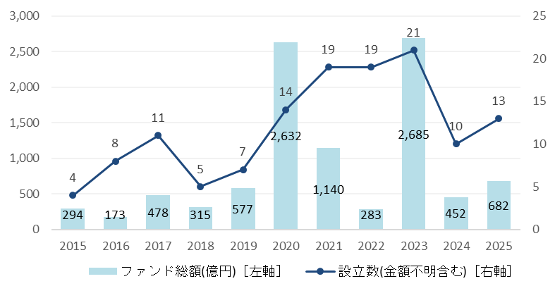
【Reference 4】Results Expected from Realization of Strategy (Illustration)
1-1 Enhancing Investment Attractiveness and Revitalizing the Osaka–Kansai Economy
Current Situation
■ The total amount and number of funds established in the bio, medical, and healthcare sectors
In the bio, medical, and healthcare sectors — areas where Osaka has particular strengths — the total amount and number of funds have increased over the past ten years.
Meanwhile, although fundraising by Osaka‑based startups has also grown during the same period, the gap with Tokyo has continued to widen.
Strategic Directions
［Global city that develops by leveraging finance］
By leveraging major projects such as the Osaka–Kansai Expo 2025, Umekita Phase 2, and the International Center for Future Medicine (Nakanoshima Qross), Osaka aims to enhance the global visibility of the Osaka–Kansai region, attract talent and investment from Japan and abroad, build an ecosystem that supports startup growth through financial functions, and further promote the clustering of financial institutions, fintech companies, and related businesses.
Total Fund Amount (¥100M) [Left axis]
Number of Funds Established (including those with undisclosed amounts)
[Right axis]
Notes
1. The figures for each year represent the values observed as of the time of aggregation.
2. The total fund amount refers to the total amount confirmed as of the aggregation date, including some estimated values. The number of
funds includes those for which fund size is undisclosed.
3. The aggregation covers funds that have been confirmed to invest — or plan to invest —primarily in equity financing for domestic startups
4. Figures may be revised retroactively as future surveys progress.
5. Because multiple preferred sectors may be selected, the total fund amount and the number of established funds may include overlaps.
Source: Speed Startup Information Research (as of January 18,2026)
■ Trends in fundraising by region for domestic startup companies
Expected Results
(¥100 million) | 2015 | 2016 | 2017 | 2018 | 2019 | 2020 | 2021 | 2022 | 2023 | 2024 | 2025
Tokyo | 1450 | 2025 | 2801 | 4029 | 5155 | 4709 | 7379 | 7907 | 6557 | 6916 | 5590
Fukuoka | 43 | 47 | 136 | 136 | 91 | 114 | 181 | 368 | 167 | 125 | 301
Kanagawa | 50 | 140 | 267 | 155 | 183 | 114 | 175 | 261 | 213 | 288 | 221
Hokkaido | 14 | 29 | 20 | 40 | 63 | 37 | 70 | 74 | 61 | 81 | 178
Osaka | 112 | 129 | 122 | 265 | 125 | 142 | 157 | 208 | 244 | 184 | 174
Kyoto | 84 | 53 | 101 | 99 | 96 | 108 | 168 | 272 | 179 | 261 | 167
Innovation is emerging in sectors where Osaka has competitive strengths — such as the social implementation of Expo legacies — and a financial ecosystem that supports startup growth is being established.
The Osaka–Kansai economy continues to grow and develop, enhancing the region’s investment appeal.
Through government support for foreign financial institutions, business operations in Osaka are progressing steadily.
Notes:
1. The figures for each year represent the values observed as of the aggregation date
2. As future survey results are incorporated, figures — including those for past years — may be revised. Such revisions tend to have a
greater impact on more recent years and on items with smaller amounts.
Source: Speed Startup Information Research (as of January 18,2026)

Slide 41
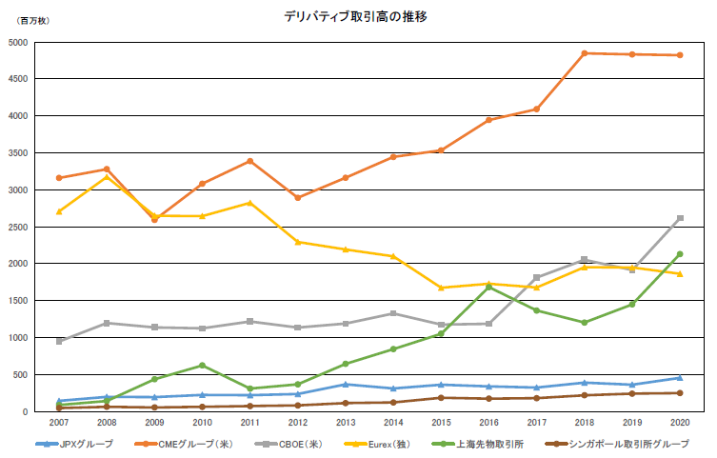
1-2 Enhancing Investment Attractiveness and Revitalizing the Osaka–Kansai Economy
Current Situation
■Global Derivatives Market
（JPY million）
The global derivative trading volume has been increasing and is now approximately 4.4 times larger than it was five years ago. In particular, futures and options related to equities and interest rates have grown significantly.
In contrast, Japan’s derivative trading volume, while increasing, remains modest compared with Europe, the United States, and China, and is roughly on par with Singapore.
Stock Price Index
Single Shares
Approx.4.4×
Interest
Currency
Energy
Precious Metals
Non-Precious Metals
Agricultural Products
Other
Strategic Directions
［Frontrunner City in Finance］
(Source) FIA “Volume by Year”
As Japan’s hub city for derivatives transactions, the city aims to develop cutting‑edge and pioneering financial products that show strong potential for the future.
(million contracts)
Trends in Derivatives Trading Volume
CME(US)
Expected Results
CBOE(US)
Building on its history as the birthplace of derivatives and establishing itself as an innovative derivatives hub in Asia, Osaka will enhance its investment attractiveness.
A wide range of cutting‑edge financial products with strong local characteristics are being developed, attracting global investors and foreign companies.
JPX
JPX Group
CME Group (US)
CBOE (US)
Eurex (Germany)
Shanghai
Futures Exchange
SGX Group
（Source）FIA“AnnualVolumeSurvey

Slide 42
2. Achieving an Economy Resilient to Disasters
Current Situation
■ GDP Comparisons of Major Global Cities
Compared to other advanced nations, Japan’s politics, economy, and population are overly concentrated in Tokyo.
The risks of overconcentration in Tokyo became apparent during times of crisis such as the Covid-19 pandemic.
Furthermore, a systems failure at the Tokyo Exchange in October 2020 caused a loss of three trillion yen in trading opportunities.
Japan
United States
Germany
8.1%
4.9%
12.5%
19.6%
5.9%
7.2%
TOKYO
OSAKA
Others
New York
Los Angeles
Cologne/Düsseldorf
Frankfurt
Strategic Directions
Others
Others
［Global city that develops by leveraging finance］
 | Japan | United States | Germany
Percentage of economic overconcentration (Primate city GDP as a percentage of national GDP) | １９．６％ | ８．１％ | １２．５％
Ratio of primate city to secondary city | ３：１ | ２：１ | ２：１
To reduce investment risks arising from Japan’s frequent natural disasters as well as from systems failures, a structure will be established in which Osaka plays a complementary role to Tokyo. This includes initiatives by financial institutions to establish BCPs and dual‑site operation hubs, expand their functions, and promote the concentration of data centers as well as middle‑ and back‑office operations.
* GDP refers to Prefectural Economic Account
* Data source: OECD country‑level figures for the United States and Germany, and city‑level
figures from The Brookings Institution.
▽ Harmful Effects of Overconcentration in Tokyo
・Maximum estimated damage from a Tokyo inland earthquake(economic impact)
➡ Approximately 83 trillion yen
・Natural hazard risk index of the world’s major cities
➡ Tokyo/Yokohama ranks as the worst among the 50 major cities worldwide
Expected Results
Data centers and middle/back office operations will be concentrated in Osaka, thereby creating a city resilient in its support for Japan’s financial functions.
Source: Central Disaster Management Council- Committee for Policy Planning on Disaster Management
Report of Working Group on Countermeasures Against Tokyo Inland Earthquake (December 2025)
Munich Re Annual Report (March2003)

Slide 43
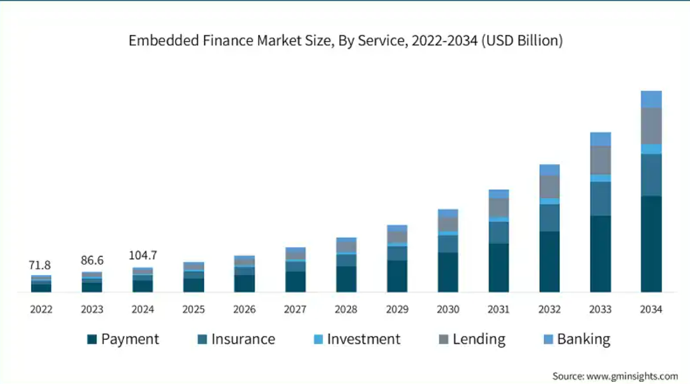
3. Enhancing Daily Convenience through the Use of New Financial Technologies
Current Situation
One example of deepening financial services utilizing FinTech is the recent trend in Embedded finance (financial services that are unbundled from the financial function), which connects “information systems that support lifestyles and corporate activities” with “systems that support financial services”, thereby creating new services.
Strategic Directions
［Frontrunner City in Finance］
New financial services will be created through the development of innovative social demonstrations and implementations, including the use of fintech technologies in areas such as payment, insurance, and other related sectors, as well as the issuance of regional digital currencies and digital IDs that contribute to the region’s development after the Expo.
Expected Results
Innovative financial social experiments and implementations will become possible, and digitalization will progress further.
As financial services are increasingly provided to general business companies, fintech firms that utilize these services are emerging, offering both financial and non‑financial solutions powered by advanced technologies. As a result, daily convenience for residents will improve, including the promotion of cashless payments.

Slide 44
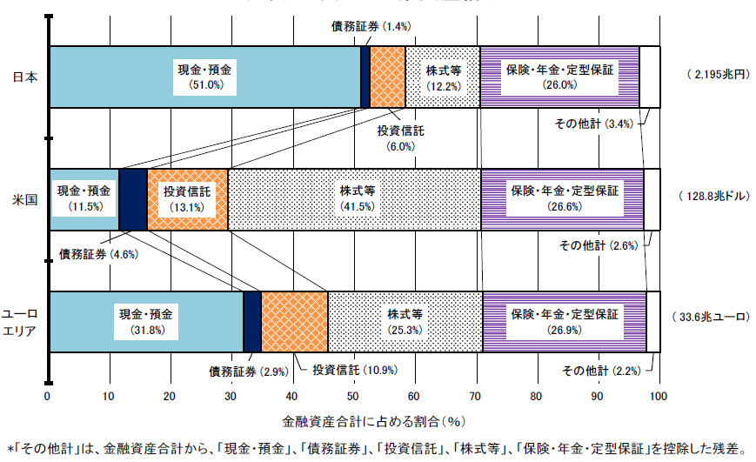
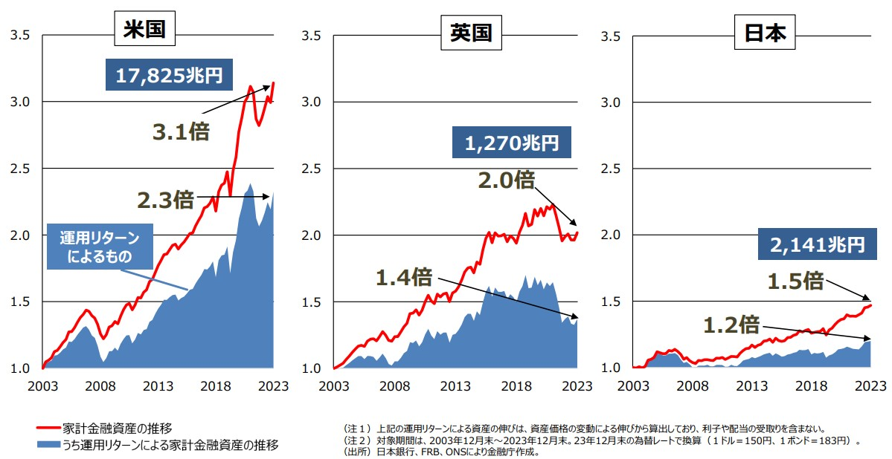
4. Asset Growth through Fostering an Investment Mindset
Current Situation
■ Comparison of Financial Assets Held by Households in US-Japan-Europe
(as of the end of March 2025）
More than half of Japan’s household financial assets are held in currency and deposits, and the share of investment trusts, stocks, and other market‑based assets remains lower than in Europe and the United States.
When looking at trends in household financial assets in the United States and the United Kingdom, their macro‑level household assets have grown to 3.1 times and 2.0 times their previous levels, respectively.
In contrast, the growth of Japan’s household financial assets has remained at only 1.5 times, and investment returns have stayed at relatively low levels.
Debt Securities (1.4%)
Japan
Currency and deposits
(51.0%)
Equity
(12.2%)
Insurance, Pension, Standardized guarantees (26%)
(2,195 trillion yen)
（2,195兆円）
Investment trusts
(6.0%)
Others (3.4%)
United States
Currency and deposits
(11.5%)
Investment trusts
(13.1%)
Equity
(41.5%)
Insurance, Pension, Standardized guarantees (26.6%)
(128.8 trillion dollars)
（128.8兆ドル）
Debt Securities (4.6%)
Others (2.6%)
Currency and deposits
(31.8%)
（33.6兆ユーロ）
Euro area
Equity
(25.3%)
Insurance, Pension, Standardized guarantees (26.9%)
(33.6 trillion euros)
Debt Securities (2.9%)
Investment trusts(10.9%)
Others (2.2%)
Percentage of the total financial assets
"Others" is the residual which is the remaining after deducting "Currency and deposits," "Debt securities," "Investment trusts," "Equity," and "Insurance, pension and standardized guarantees" from total financial assets “Others” equals to “total financial assets” less "Currency and deposits," "Debt securities," "Investment trusts," "Equity," and "Insurance, pension and standardized guarantees"
Strategic Directions
Source: “Flow of Funds — Overview of Japan, the United States, and the Euro area,” August 29,2025, Research and Statistics Department, Bank of Japan
［Global city that develops by leveraging finance］
［Frontrunner City in Finance］
■ Trends in Financial Assets Held by Households (US-Japan-Europe Comparison)
Expand opportunities for financial literacy education at seminars for Osaka residents and at schools.
US
UK
Japan
17,825 trillion yen
3.1x
1,270 trillion yen
2.3x
2.0x
Expected Results
From investment returns
2,141 trillion yen
Improving investment mindset based on correct knowledge will revitalize investments and change the composition of financial assets for individuals
1.4x
1.5x
1.2x
Household financial assets
Note 1) The above growth in assets attributable to investment returns is calculated based on fluctuations in asset
prices and does not include interest or dividends received.
Note 2) The target period is from the end of December 2003 to the end of December 2023. Figures are
converted using the exchange rates as of the end of December 2023 (USD 1 = JPY 150, GBP 1 = JPY 183).
Source: Prepared by the FSA based on statistical data from the FRB, the BOE, and the Bank of Japan.
Household financial assets
from investment returns
Source：金融庁作成資料
Source: Materials prepared by
the Financial Services
Agency (FSA)

Slide 45
5. Enhancing Osaka‑Kansai’s Status as a Global Financial City
Current Situation
Osaka ranked 7th in The Global Liveability ranking in 2025 by The Economist, with particularly high evaluations in stability, healthcare, and education.
■ Ranking the world’s most liveable cities
Rank | City (Country)
1st | Copenhagen (Denmark)
2nd | Vienna (Austria)
2nd | Zurich (Switzerland)
4th | Melbourne (Australia)
5th | Geneva (Switzerland)
6th | Sydney (Australia)
7th | Osaka (Japan)
7th | Auckland (New Zealand)
9th | Adelaide (Australia)
10th | Vancouver (Canada)
Strategic Directions
［Global city that develops by leveraging finance］
［Frontrunner City in Finance］
Promoting initiatives to attract high‑skilled foreign talent, including improvements to living environments such as education and healthcare and the use of special residency schemes, while also enhancing Osaka’s attractiveness as an investment destination.
Expected Results
With the development of international schools and the promotion of multilingual services, among other improvements to living conditions, Osaka will become even more comfortable for both residents and foreign nationals.
With pleasant living conditions and investment attractiveness, foreign financial institutions, including FinTech companies and other investors, will gather in the city.
Source: Economist Intelligence Unit 2025

