Slide 1
Global Financial City OSAKA Strategy
March 25, 2022
General Meeting of the Global Financial City OSAKA
Promotion Committee

Slide 3
Table of Contents
I Compiling the Strategy
Strategy Formulation Objectives
Global Trends & Conditions in Japan and the Current State of Osaka
Key Points in Formulating Strategy
II Image of the Global Financial City Osaka Aims to Be
III Pillars of the Initiatives & Specific Initiatives
IV Strategy Implementation Period and Strategy Goals
V Promotion System
VI Conclusion
References
·········· 5
·········· 6
·········· 9
·········· 10
·········· 12
·········· 31
·········· 34
·········· 35
·········· 36

Slide 4
Summary
◆ Strategy Formulation Objectives (P5)
We aim to strengthen financial functions referred to as “the blood of the economy” and create a global financial city that is unique and functional and will be a new pillar of growth towards the revitalization of the Osaka-Kansai economy in the post-Covid era.
◆ Image of the City Osaka Aims to Be (P10, P11)
Global city that develops by leveraging finance, attracting the energy of Asia and the world · Front-running city in finance, which challenges the world with innovative initiatives
◆ Pillars of the Initiatives and Specific Initiatives (P12–)
Global city that develops by leveraging finance
Promote financial initiatives for attractive community development
Encourage diversity in financing to revitalize start-ups and local communities
Strengthen hub functions to improve resilience
Revitalize domestic financial markets
Front-running city in finance
Create cutting-edge, innovative financial products and markets
Implement initiatives for an advanced city in sustainable finance
Encourage a review of regulations related to financial services
Nurture highly skilled professionals in the field of finance
Shared initiatives to realize the two images of the city Osaka aims to be
Establish attractive living conditions for foreign nationals
Create a business environment that attracts companies and people from within Japan and abroad
Disseminate information and conduct promotion activities
Collaborate with overseas entities
Osaka City and Prefecture to implement innovative and impactful initiatives
Each party will proactively implement specific initiatives in order of priority, from the highest down, and we have compiled such initiatives as the action plan. These initiatives will be reviewed, including the progress, carefully examined, taking account of companies needs, etc., and will be updated every fiscal year.
◆ Implementation Period (P31)
Short Term (Active Stage Phase 1): FY 2025 (until the Osaka-Kansai Expo)
Medium Term (Active Stage Phase 2): FY 2030 (SDGs achievement target year)
Long Term: FY 2050 (Carbon neutrality target year)
◆ Strategy Goals (P33)
[Output Goal]
Number of consultations at the Osaka Global Finance One-Stop Support Center:
Achieve an average of 10 companies per year by FY2025
[Outcome Goals]
Recruitment of foreign financial companies (including FinTech), investors, etc.: Recruit 30 companies by FY2025
Creation of unicorns, start-ups, university-launched ventures:
Generate three unicorn companies and 300 start-ups by FY2024
◆ Promotion System, etc. (P34, P35)
In order to create a new structure to promote strategy from FY 2023, the strategic direction will be determined in the first half of the next fiscal year, and preparations will take place with the government, business community, and private sector working together.
The strategy is planned to be revised at the end of Active Stage Phase 1 in FY2025, based on the achievement status of the strategic goals, the socio-economic situation, etc. at that time.

Slide 5
I - 1. Strategy Formulation Objectives
Given that Japan will proceed at full speed to realize a global financial city, including tax reforms and regulatory compliance owing to substantial changes in the global financial situation, several financial cities with international competitiveness will be required to enhance Japan’s growth potential while taking account of the formation of multiple global financial centers in the US and the UK.
Making Osaka a global financial city is a key initiative for strengthening Japan’s resilience in the financial front to handle critical events when they occur.
Furthermore, to strengthen financial functions, which can be called “the blood of the economy,” this will contribute to the realization of the region’s vision that seeks to achieve growth and development of the Osaka-Kansai economy in the post-Covid era. This in turn will lead to benefit and happiness for the residents of the prefecture and serves not only as a pillar for new growth in the Osaka-Kansai region but also contributes to the economic development of Japan as a whole.
Based on this, to formulate this strategy, we aim to create a proprietarily unique and
functional global financial city by contributing to the further rapid growth of Osaka,
which is one of Japan’s two leading economic centers, of which one is in East Japan and one in West Japan.

Slide 6
I - 2. Global Trends and Conditions in Japan
[Global FinTech Ranking (2021)]
It goes without saying that major financial institutions set up their bases in global financial sites; but in recent years, FinTech company clusters have become a new component of these sites, transforming them into hubs for diverse financial entities.
Additionally, there is a trend for financial institutions, investors, and others to gather in these sites where there are business opportunities (investment targets) and customers (asset holders).
Ranking | Change | City | Country
1 | ±0 | San Francisco | United States
2 | ±0 | London | United Kingdom
3 | ±0 | New York | United States
4 | +1 | Sao Paolo | Brazil
5 | +13 | Tel Aviv | Israel
6 | +3 | Berlin | Germany
7 | +1 | Boston | United States
8 | -2 | Los Angeles | United States
9 | +2 | Hong Kong | China
10 | -6 | Singapore | Singapore
11 | +2 | Sydney | Australia
12 | +12 | Amsterdam | The Netherlands
13 | +3 | New Delhi | India
14 | +21 | Stockholm | Sweden
15 | +4 | Atlanta | United States
16 | +28 | San Diego | United States
17 | +6 | Beijing | China
18 | +12 | Moscow | Russia
19 | -2 | Tokyo | Japan
20 | -13 | Bangalore | India
21 | -7 | Chicago | United States
22 | ±0 | Seattle | United States
23 | -13 | Mumbai | India
24 | +62 | Hangzhou | China
25 | +7 | Melbourne | Australia
FinTech is a combination of the words finance and technology and refers to new financial products and services that were born from the tie up of financial services and technology.
Source: Compiled by KPMG based on data on findexable (https://findexable.com/gfi-download)

Slide 7
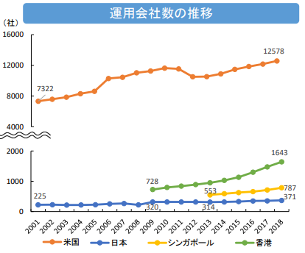
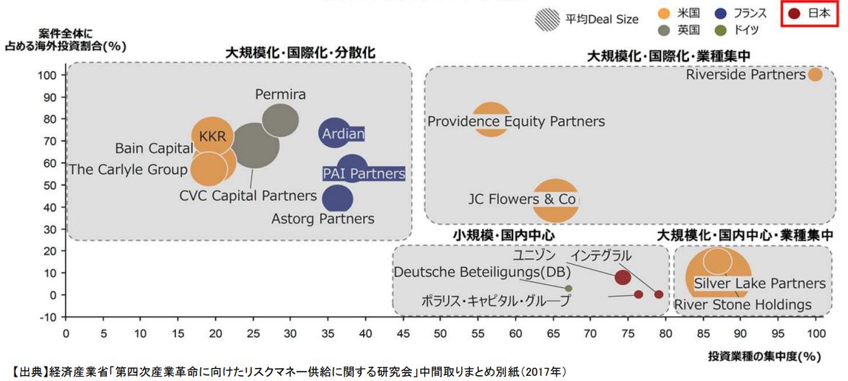
In addition, the global environment for the financial industry is undergoing a transformation; investment management companies are growing immensely in size, and the number of investment funds, etc. is also increasing.
Changes have been taking place in recent years, which have impacted the business environment in global financial cities. These changes include the strengthening of ties with China as a result of the enactment of Hong Kong’s national security law and the Greater Bay Area scheme, as well as changes to the political situation such as the UK’s exit from the EU.
We are also seeing a shift in the way companies think, towards one which considers the benefits to diverse stakeholders such as employees, business partners, customers, local communities, and shareholders. Furthermore, there is also an increase in sustainable finance for the achievement of SDGs.
Trends of Investment Management Companies
[Major Private Equity Funds* of Each Country]
Companies
Avg Deal Size
US
France
Japan
Foreign Investment as a Proportion of All Deals (%)
UK
Germany
Scale Expansion/Globalization/Decentralization
Scale Expansion/Globalization/Industry Concentration
Small Scale/ Domestic Focus
Scale Expansion/ Domestic Focus/Industry Concentration
Unison
Integral
Polaris Capital Group
Source: Appendix of the Interim Report by the Study Group for Risk Capital Supply for the Fourth Industrial Revolution, Ministry of Economy, Trade and Industry (2017)
Industry Concentration of Investments (%)
US
Japan
Singapore
Hong Kong
Source: “FSA Year in Review (administrative year 2019)” FSA, Japan, “Evolution Revolution Reports” IAA, U.S, “Singapore Asset Management Survey” MAS, Singapore, “Asset and Wealth Management Activities Survey” and “Fund Management Activities Survey” SEC, Hong Kong,
A fund whose objective is to purchase unlisted shares and obtain capital gains by taking the shares public or selling to a third party

Slide 8
I - 2. Current State of Osaka
In the March 2022 ranking of global financial centers, Tokyo was ranked ninth and Osaka came in 34th. Osaka is considered a “local” global financial center and is currently thought to lack the financial support structure for targets of investments such as start-ups and is also lagging in attracting foreign financial institutions and FinTech companies.
[Ranking of Global Financial Centers]
[Asia Pacific Region Rankings]
On the other hand, from a business perspective, there is a concentration of the life sciences industry, and with the creation of a new hub of innovation such as Umekita Phase 2 and the international hub for advanced healthcare in Nakanoshima, as well as the Expo 2025 Osaka, Kansai, Japan, business opportunities are increasing in a variety of fields.
In addition to having an established infrastructure with its international airports and ports and an abundant railway network, higher education and research institutions are also concentrated in the Osaka-Kansai area.
Financially, it is also the birthplace of derivatives and possesses two stock exchanges.
 | September 2021 | March 2022
1 | New York | New York
2 | London | London
3 | Hong Kong | Hong Kong
4 | Singapore | Shanghai
5 | San Francisco | Los Angeles
6 | Shanghai | Singapore
7 | Los Angeles | San Francisco
8 | Beijing | Beijing
9 | Tokyo | Tokyo
10 | Paris | Shenzhen
11 | Chicago | Paris
12 | Boston | Seoul
13 | Seoul | Chicago
14 | Frankfurt | Boston
15 | Washington DC | Washington DC
16 | Shenzhen | Frankfurt
··· | Osaka (46th) | Osaka (34th)
 | March 2022
1 | Hong Kong
2 | Shanghai
3 | Singapore
4 | Beijing
5 | Tokyo
6 | Shenzhen
7 | Seoul
8 | Sydney
9 | Guangzhou
10 | Busan
··· | Osaka (12th)
Source: Compiled based on Z/Yen Research, a UK think tank

Slide 9
I - 3. Key Points in Formulating Strategy
<Key Points of the Overall Strategy>
When formulating the strategy, we first consider global trends, conditions in Japan, and the current state of Osaka to identify the key points of the overall strategy.
In a global financial city, the financial functions or “blood of the economy” are strengthened and thereby contribute to the realization of the vision and strategy for a region that seeks economic development. This in turn should lead to benefit and happiness for the residents of Osaka; therefore, the first key point for the strategy is [Regional Development].
A global financial city should contribute to the achievement of SDGs (Sustainable Development Goals); therefore, initiatives including those implemented by individual parties should contribute to a common global objective to realize a sustainable and better society. For this reason, the second key point is [SDGs].
<Key Points to Realize the Image of the City Osaka Aims to Be>
With the two key points of the overall strategy in mind, the following will bring Osaka towards the image of the global financial city it aims to become.
First, Osaka must leverage its strengths and the opportunities that arise while always maintaining global awareness. It should seek to create synergy particularly through cooperation with its geographical neighbors in Asia, which are experiencing remarkable growth, and gather talent, capital, and information by becoming the hub for Asia and the world. Therefore, the first key point is [Asia/Global].
Secondly, given competition between the global cities, for Osaka-Kansai to be selected from amongst the cities of the world, it must be equipped with unique individuality and functionality that come from cutting-edge initiatives that leverage Osaka’s characteristics. At the same time, it is important that Osaka plays its role to reduce the risk of domestic overconcentration and increase Japan’s resilience. For these reasons, the second key point is [Differentiation/Complementarity].

Slide 10
II Image of the Global Financial City Osaka Aims to Be
Given the key points to becoming a global finance city (Asia/Global and differentiation/complementarity), we have identified two images of a global financial city to work towards.
Global city that develops by leveraging finance, attracting the energy of Asia and the world
By increasing international awareness of Osaka-Kansai through large global projects such as the Osaka-Kansai Expo 2025, Umekita Phase 2, Nakanoshima international hub for advanced healthcare, IR, etc., we will attract talent and investments from Japan and abroad to create an ecosystem that financially supports the growth of start-ups while also bringing in financial institutions and FinTech companies. Additionally, to reduce investment risk in Japan, which is known to have many natural disasters, we will improve financial resilience and move forward with the creation of a structure in which Osaka can take a complementary role. We will also work towards improving the financial literacy of the residents of Osaka and revitalize investments.
The results will be increased attention to the investment attractiveness of Osaka-Kansai, a revitalization of the economy due to the circulation of capital to corporations, and a creation of an economy that is strong against disasters. Furthermore, an improvement in financial literacy will foster an investment mindset, thereby potentially increasing the assets of the residents of Osaka.

Slide 11
Front-running city in finance, which challenges the world with pioneering initiatives
As Japan’s hub city for derivatives transactions, Osaka will develop cutting-edge financial products, and as an advanced SDGs city, it will roll out pioneering initiatives in sustainable finance and promote SDGs from a financial perspective. Furthermore, with the use of FinTech technology, it will create new financial services through innovative testing and implementation of social projects in the financial field.
As a result, Osaka’s attractiveness as an innovative derivatives hub in Asia will improve while also contributing financially to the shared global objective of resolving social challenges, namely carbon neutrality. We can also expect improved lifestyle convenience for the residents of Osaka as a result of the spread of new financial services.

Slide 12
To become a global financial city, initiatives must present a clear conceptual story based on the objectives and intent of the key points identified in formulating the strategy, as well as the image of the city Osaka aims to be.
To that end, we first constructed pillars of the initiatives for each image of the city Osaka aims to be.
Following this, we studied the details of the active discussions held to date by the promotion committee and the working groups regarding the initiatives for the realization of a global financial city and arranged specific initiatives for each initiative pillar.
Specific initiatives will be proactively implemented by each party in order of priority, from the highest down, and these initiatives were compiled into an action plan.
The initiatives take into consideration the following key points:
· [Digitalization], which has a high degree of affinity for financial services such as FinTech and will be the impetus for new growth, and
· [Broader Kansai Region], whereby the strengths, history, and culture of each area in Kansai are leveraged.
We will conduct a review of the progress made on these initiatives as well as consider ideas and add implementable initiatives that were discussed by the promotion committee and working groups. The action plan will be updated every fiscal year based on a careful examination of what is necessary to realize a global financial city such as the needs of companies, etc.
III Pillars of the Initiatives & Specific Initiatives

Slide 13
Pillars of the Initiatives
Global city that develops by leveraging finance
1
Front-running city in finance
2
Promote financial initiatives for attractive community development
Encourage diversity in financing to revitalize start-ups and local communities
Strengthen hub functions to improve resilience
Revitalize domestic financial markets
Create cutting-edge, innovative financial products and markets
Implement initiatives for an advanced city in sustainable finance
Encourage a review of regulations related to financial services
Nurture highly skilled professionals in the field of finance
[Shared Initiatives to Realize the Two Images of the City Osaka Aims to Be]
Establish attractive living conditions for foreign nationals | Create a business environment that attracts companies and people from within Japan and abroad
Disseminate information and conduct promotion activities | Collaborate with overseas entities
Undertake innovative and impactful initiatives with Osaka City and Prefecture

Slide 14
Specific Initiatives Currently Being Implemented or Considered (Action Plan)
Global city that develops by leveraging finance, attracting the energy of Asia and the world
Global city that develops by leveraging finance
(1) Promote financial initiatives for attractive community development
Implement initiatives to promote financing using STO and other new methods
Create a system for capital to flow from Japan and abroad into testing and implementation of social projects, triggered by the Expo
  Generalize the use of ST for corporate bonds and other products
  Support demonstration experiments as a “test site for future society”
  Investments by funds related to the theme of the Expo
(3) Strengthen hub functions to improve resilience
Issue and spread a local digital currency and digital ID that lead to development in focus regions, even post-Expo
Establish BCP and dual operation sites for financial institutions, expand functions, and provide support
  Consider issuance of a local digital currency originating from Osaka or utilization of personal data, etc., as part of the Expo legacy
  Conduct fact-finding surveys, etc. on resilience functions at financial institutions
  Disseminate information regarding preferential treatments for dual operation response such as financing, insurance, etc.
  Implement initiatives that improve the social value of dual operation sites
(2) Encourage diversity in financing to revitalize start-ups and local communities
Implement initiatives to attract financial institutions and FinTech companies
Implement initiatives to gather data centers and middle/back office
  Implement strategic activities such as promotions to attract companies
  Establish incentives to attract companies
  Conduct fact-finding surveys, etc. on resilience functions at financial institutions (repeated)
②国内外の観光需要の取り込みの強化
Support promotion of further investments in start-ups
(4) Revitalize domestic financial markets
  Create opportunities for start ups, companies, venture capitalists (VCs), etc. to connect with each other
  Establish and expand information platforms related to startups and support measures, and hold events to promote them domestically and internationally
  Promote use of the “regulatory sandbox framework” (support demonstration experiments of financial services, etc.)
  Form and operate venture funds specializing in specific themes through cooperation of the public and private sectors
  Urge the government to ease regulations on tax and other restrictions (extend open innovation tax incentives and the angel tax system)
  Support IPOs
Encourage the expansion of the scope of aggregated profit/loss for income taxes on financial products (to include derivative transactions)
Implement initiatives that lead to fostering an investment mindset that nurtures assets from a long-term perspective and improving financial literacy
  Implement financial literacy education by establishing and operating a consortium that brings together universities, etc. with corporations
14

Slide 15
(1) Promote financial initiatives for attractive community development
Specific initiatives are categorized into the following three approaches:
“Invite” funds, talent, companies to Osaka from within and outside of Japan
“Nurture” to enhance its own appeal
“Support” by providing a foundation to “invite” and “nurture”
Global city that develops by leveraging finance
1. Create a system for capital to flow from Japan and abroad into testing and implementation of social projects, triggered by the Expo
Policy Name | Summary | Ownership | Initiatives by Phase
 |  |  | FY2022 | Active Stage Phase 1 (until FY2025)
Provision of support for demonstration experiments as a “test site for future society” | Use the Expo as a “test site for future society” and provide support to companies using the regulatory sandbox framework to conduct demonstration experiments by offering subsidies and disseminating information on the website, etc. domestically and internationally. | Osaka Prefecture, Osaka City, Private Sector, Business Community
Investments by funds related to the theme of the Expo | Facilitate financing of companies that use the opportunity of the Expo to create innovation and new business models by creating new Expo funds and using private sector funds. | Private Sector, Osaka Prefecture, Osaka City, Business Community
Implement
Invite
Nurture
Implement
Invite
2. Issue and spread a local digital currency and digital ID that lead to development in focus regions, even post-Expo
Policy Name | Summary | Ownership | Initiatives by Phase
 |  |  | FY2022 | Active Stage Phase 1 (until FY2025)
Consideration of issuing a local digital currency originating from Osaka or utilization of personal data, etc., as part of the Expo legacy | Consider initiatives that utilize data from the local digital currency and digital ID that are used post-Expo. | Private Sector
Review
Implement
15
Invite
15

Slide 16
(2) Encourage diversity in financing to revitalize start-ups and local communities
1. Implement initiatives to attract financial institutions and FinTech companies
Global city that develops by leveraging finance
Policy Name | Summary | Ownership | Initiatives by Phase
 |  |  | FY2022 | Active Stage Phase 1 (until FY2025)
Implementation of strategic activities such as promotions to attract companies | Implement consistent invitation activities from identifying companies by promotion activities at events for overseas investors, marketing entry surveys, etc. to individualized communication and accompanied support. | Osaka Prefecture, Osaka City
Establishment of incentives to attract companies | Establish a subsidy system such as for office rent incurred by foreign financial institutions, etc. conducting preliminary research to establish a hub and for necessary start-up costs, etc. incurred immediately after establishing a business. | Osaka Prefecture, Osaka City
Implement
Invite
Implement
Invite
2. Support promotion of further investments in start-ups
Policy Name | Summary | Ownership | Initiatives by Phase
 |  |  | FY2022 | Active Stage Phase 1 (until FY2025)
Creation of opportunities for start-ups, companies, venture capitalists (VCs), etc. to connect with each other | Create opportunities for start-up companies and VCs to connect with each other by organizing acceleration programs, pitch events, etc. and inviting VCs from Japan and abroad. | Osaka Prefecture, Osaka City, Private Sector, Business Community
Establishment and expansion of information platforms related to start-ups and support measures, and domestic and international promotion by holding events, etc. | Move forward with establishing/growing comprehensive information platforms regarding start-ups based in Osaka and support measures while organizing events to promote the investment attractiveness of start-ups based in Osaka domestically and internationally. | Osaka Prefecture, Osaka City, Private Sector
Implement
Invite
Nurture
Implement
Invite
Nurture

Slide 17
Policy Name | Summary | Ownership | Initiatives by Phase
 |  |  | FY2022 | Active Stage Phase 1 (until FY2025)
Promotion of use of the “regulatory sandbox framework” (support for demonstration experiments of financial services, etc.) | Identify companies using the “regulatory sandbox framework” and subsidize preliminary investigations, consulting expenses, etc. necessary for demonstration experiments. | Osaka Prefecture, Osaka City, Private Sector, Business Community
Formation and operation of venture funds specializing in specific themes through cooperation of the public and private sectors | Consider the formation of venture funds specializing in industries with strengths in Osaka and the operation of existing funds in public and private sectors to facilitate smoother financing by considering. | Private Sector, Osaka Prefecture, Osaka City
Urging the government to ease regulations on tax and other restrictions (extend open innovation tax incentives and the angel tax system) | Encourage the government to improve the tax system, such as creating open innovation tax incentives, widening the eligibility of the angel tax system, etc. | Osaka Prefecture, Osaka City, Business Community
Support for IPOs | Promote IPOs of start-ups by establishing consulting services, organizing seminars with public and private sectors, providing individualized support, etc. | Private Sector, Exchanges
Global city that develops by leveraging finance
Review
Implement
Invite
Implement
Nurture
Implement
Support
Implement
Nurture
3. Implement initiatives to promote financing using STO*and other new methods
*STO: Financing scheme using security tokens (ST), which are securities issued using electronic methods such as blockchain technology
Policy Name | Summary | Ownership | Initiatives by Phase
 |  |  | FY2022 | Active Stage Phase 1 (until FY2025)
Generalization of the use of ST for corporate bonds and other products | Issue/circulate large numbers of publicly offered corporate bonds and other products that use ST so as to generalize its use and diversify financing methods. Consider offering products utilizing ST on the Osaka Digital Exchange (ODX). | Private Sector, Exchanges
Implement
Nurture

Slide 18
(3) Strengthen hub functions to improve resilience
1. Establish BCP and dual operation sites for financial institutions, expand functions, and provide support
Global city that develops by leveraging finance
Policy Name | Summary | Ownership | Initiatives by Phase
 |  |  | FY2022 | Active Stage Phase 1 (until FY2025)
Conducting fact-finding surveys, etc. on resilience functions at financial institutions | Investigate the current status of dual operation and establishment of data centers and middle/back offices at financial institutions, etc., as well as necessary support measures including relaxation of the floor area ratio. Share information regarding status of implementation of dual operation sites to promote initiatives at financial institutions, etc. | Osaka Prefecture, Osaka City
Dissemination of information regarding preferential treatments for dual operation response such as financing and insurance, etc. | Assess and certify business continuity capabilities of corporations with dual operation sites. Release information on the website, etc. regarding initiatives that receive favorable treatment such as financing. | Private Sector, Osaka Prefecture, Osaka City, Business Community
Implementation of initiatives that improve the social value of dual operation sites | Consider approaches that are effective in improving social value such as verifying the merits of introducing dual operation sites from an ESG perspective and urging financial agencies, self-regulating industrial organizations, etc. to recommend dual operations. | Business Community, Osaka Prefecture, Osaka City
Review
Implement
Support
Review
Implement
Support
Review
Implement
Support
2. Implement initiatives to gather data centers and middle/back office*
* Middle office is an intermediary for the front office such as sales, and the back office. Back office is primarily administrative such as finance, legal, sales administration, etc.
Policy Name | Summary | Ownership | Initiatives by Phase
 |  |  | FY2022 | Active Stage Phase 1 (until FY2025)
Conducting fact-finding surveys, etc. on resilience functions at financial institutions (repeated) | Investigate the current status of dual operation and establishment of data centers and middle/back offices at financial institutions, etc., as well as necessary support measures including relaxation of the floor area ratio. Share information regarding status of implementation of dual operation sites to promote initiatives at financial institutions, etc. | Osaka Prefecture, Osaka City
Review
Implement
Support

Slide 19
(4) Revitalize domestic financial markets
Encourage the expansion of the scope of aggregated profit/loss for income taxes on financial products (to include derivative transactions)
Global city that develops by leveraging finance
Policy Name | Summary | Ownership | Initiatives by Phase
 |  |  | FY2022 | Active Stage Phase 1 (until FY2025)
Encouraging the expansion, etc. of the scope of aggregated profit/loss for income taxes on financial products (to include derivative transaction) | Coordinate with private organizations, etc. to request the government to include derivative transactions in the scope of aggregated profit/loss for income taxes on financial products. | Osaka Prefecture, Osaka City, Business Community
Implement
Support
Implement initiatives that lead to fostering an investment mindset that nurtures assets from a long-term perspective and improving financial literacy
Policy Name | Summary | Ownership | Initiatives by Phase
 |  |  | FY2022 | Active Stage Phase 1 (until FY2025)
Implementation of financial literacy education by establishing and operating a consortium that brings together universities, etc. with corporations | Conduct an investigation into the current status of financial literacy education at universities, etc. and consider a structure for systematic and continuous financial literacy education through a consortium. | Osaka Prefecture, Osaka City, Universities, etc., Private Sector, Exchanges, Business Community
Review
Implement
Nurture

Slide 20
Front-running City in finance, which challenges the world with pioneering initiatives
(1) Create cutting-edge, innovative financial products and markets
(3) Encourage a review of regulations related to financial services
Develop innovative product groups to become the leading derivatives market in Asia
Re-examine regulations using the National Strategic Special Zones and the regulatory sandbox framework, etc.
  Consider new commodity futures
Implement initiatives to promote financing using STO and other new methods
(repeated)
  Utilize National Strategic Special Zones related to residence status, etc.
  Promote use of the “regulatory sandbox framework” (support demonstration experiments of financial services, etc.) (repeated)
  Consider local tax incentives
  Generalize the use of ST for corporate bonds and other products (repeated)
Front-running city in finance
Implement initiatives to create green-related derivative products and markets considered promising in the future
Promote the expansion of the scope of aggregated profit/loss for income taxes on financial products (to include derivative transactions) (repeated)
  Urge to expand the range of derivative products that are subject to the Financial Instruments and Exchange Act
(2) Implement initiatives for an advanced city in sustainable finance
(4) Nurture highly skilled professionals in the field of finance
Implement financial initiatives for decarbonization
  Green bond issuances by the government
  Support companies that undertake initiatives towards decarbonization by providing ESG financing such as low interest financing, etc.
  Raise public awareness regarding preferential interest rate treatments, etc. for companies that take on ESG initiatives
  Provide education in finance, entrepreneurship, and technology at universities and in higher education
Promote issuance of SDGs bonds by companies (social bonds, green bonds, etc.)
  Support issuances of SDGs bonds by organizing workshops, etc.
  Support SDGs-themed issuances by proactively accepting ESG bonds and assets under management
  Disseminate information globally regarding SDGs projects
Consider a certification and labeling system based on international standards
  Consider creating a system of certification and labeling associated with added value initiatives such as enhanced monitoring post-issuance
Implement initiatives to create green-related derivative products and markets considered promising in the future (repeated)
  Urge to expand the range of derivatives products that are subject to the Financial Instruments and Exchange Act (repeated)

Slide 21
(1) Create cutting-edge, innovative financial products and markets
1. Develop innovative product groups to become the leading derivatives market in Asia
Policy Name | Summary | Ownership | Initiatives by Phase
 |  |  | FY2022 | Active Stage Phase 1 (until FY2025)
Consideration of new commodity futures | Gather understanding of corporate needs. Consider possibilities for trading of new commodity futures. | Exchanges, Private Sector
Review
Front-running city in finance
Invite
2. Initiatives to promote financing using STO and other new methods (repeated)
Policy Name | Summary | Ownership | Initiatives by Phase
 |  |  | FY2022 | Active Stage Phase 1 (until FY2025)
Generalization of the use of ST for corporate bonds and other products (repeated) | Issue/circulate large numbers of publicly offered corporate bonds and other products that use ST so as to generalize its use and diversify financing methods. Consider offering products utilizing ST on the Osaka Digital Exchange (ODX). | Private Sector, Exchanges
Implement
Nurture
3. Implement initiatives to create green-related derivative products and markets considered promising in the future
Policy Name | Summary | Ownership | Initiatives by Phase
 |  |  | FY2022 | Active Stage Phase 1 (until FY2025)
Urging to expand the range of derivatives products that are subject to the Financial Instruments and Exchange Act | With regards to derivative products that are subject to the Financial Instruments and Exchange Act, request the government to expand to include energy related products, etc. | Osaka Prefecture, Osaka City, Exchanges
Review
Implement
Support

Slide 22
(2) Implement initiatives for an advanced city in sustainable finance
1. Implement financial initiatives for decarbonization
Policy Name | Summary | Ownership | Initiatives by Phase
 |  |  | FY2022 | Active Stage Phase 1 (until FY2025)
Issuance of green bonds by the government | By taking the initiative and issuing green bonds, the Osaka prefecture and city can accumulate knowledge and support issuances by private sector corporations. | Osaka Prefecture, Osaka City
Provision of support for companies that undertake initiatives towards decarbonization by providing ESG financing such as low interest financing | For businesses that promise to practice decarbonization management according to prefectural regulations, coordinate with regional financial institutions to provide information regarding ESG financial products and services for their capital requirements to install equipment, restructure business, etc. | Osaka Prefecture, Osaka City, Private Sector
Raising public awareness regarding preferential interest rate treatments, etc. for companies that take on ESG initiatives | Disseminate information via the website, etc. regarding preferential treatment for financing of ESG initiatives. | Private Sector, Osaka Prefecture, Osaka City, Business Community
Review
Implement
Front-running city in finance
Invite
Nurture
Implement
Support
Implement
Support
2. Promote issuance of SDGs bonds by companies (social bonds, green bonds, etc.)
Policy Name | Summary | Ownership | Initiatives by Phase
 |  |  | FY2022 | Active Stage Phase 1 (until FY2025)
Support of issuances of SDGs bonds by organizing workshops, etc. | Support private sector companies to issue SDGs bonds by organizing workshops, etc. that teach specific methods and knowledge on obtaining certification. | Osaka Prefecture, Osaka City, Business Community
Review
Implement
Nurture

Slide 23
Policy Name | Summary | Ownership | Initiatives by Phase
 |  |  | FY2022 | Active Stage Phase 1 (until FY2025)
Support of SDGs-themed issuances by proactively accepting ESG bonds and assets under management | Carry out financing, accept/sell ESG bonds, etc. that contribute to green finance/sustainability for institutional investors and securities firms. | Private Sector
Dissemination of information globally regarding SDGs projects | Disseminate information overseas via the website, etc. regarding initiatives of businesses registered under the SDGs action charter. | Osaka Prefecture, Osaka City, Private Sector Business Community
Implement
Nurture
Front-running city in finance
Implement
Support
3. Consider a certification and labeling system based on international standards
Policy Name | Summary | Ownership | Initiatives by Phase
 |  |  | FY2022 | Active Stage Phase 1 (until FY2025)
Consideration of creating a system of certification and labeling associated with added value initiatives such as enhanced monitoring post-issuance | Research and consider a certification and labeling system that is based on international standards while also accounting for added value that is uniquely Kansai. | Business Community, Osaka Prefecture, Osaka City, Private Sector
Review
Implement
Invite
4. Implement initiatives to create green-related derivative products and markets considered promising in the future (repeated)
Policy Name | Summary | Ownership | Initiatives by Phase
 |  |  | FY2022 | Active Stage Phase 1 (until FY2025)
Urging to expand the range of derivatives products that are subject to the Financial Instruments and Exchange Act (repeated) | With regard to derivative products that are subject to the Financial Instruments and Exchange Act, request the government to expand to include energy related products, etc. | Osaka Prefecture, Osaka City, Exchanges, Others,
Review
Implement
Support

Slide 24
(3) Encourage a review of regulations related to financial services
Re-examine regulations using the National Strategic Special Zones and the regulatory sandbox framework*, etc.
* Regulatory Sandbox framework: a framework that enables new technologies and business models to be tested for social implementation and uses the information and data obtained to re-examine regulations
Policy Name | Summary | Ownership | Initiatives by Phase
 |  |  | FY2022 | Active Stage Phase 1 (until FY2025)
Utilization of National Strategic Special Zones related to residence status, etc. | Attract highly skilled professionals in the finance field by using the National Strategic Special Zones, as they relate to the point-based system for residence status of highly skilled professionals. | Osaka Prefecture, Osaka City
Promotion of use of the “regulatory sandbox framework” (support demonstration experiments of financial services, etc.) (repeated) | Identify companies using the “regulatory sandbox framework” and subsidize preliminary investigations, consulting expenses, etc. necessary for demonstration experiments. | Osaka Prefecture, Osaka City, Private Sector, Business Community
Consideration of local tax incentives | In addition to the proposal to the government for bold tax benefits, etc., consider local tax (corporate prefectural residents’ tax, etc.) incentives for foreign financial companies. | Osaka Prefecture, Osaka City
Implement
Front-running city in finance
Attract
Support
Review
Implement
Attract
Review
Implement
Support
Promote the expansion of the scope of aggregated profit/loss for income taxes on financial products (to include derivative transactions) (repeated)
Policy Name | Summary | Ownership | Initiatives by Phase
 |  |  | FY2022 | Active Stage Phase 1 (until FY2025)
Encouraging the expansion, etc. of the scope of aggregated profit/loss for income taxes on financial products (to include derivative transaction) | Coordinate with private organizations, etc. to request the government to include derivative transactions in the scope of aggregated profit/loss for income taxes on financial products. | Osaka Prefecture, Osaka City, Business Community
Implement
Support

Slide 25
(4) Nurture highly skilled professionals in the field of finance
Policy Name | Summary | Ownership | Initiatives by Phase
 |  |  | FY2022 | Active Stage Phase 1 (until FY2025)
Provision of education in finance, entrepreneurship, and technology at universities and in higher education | Consider offering practical programs such as practical lectures at universities that invite industry professionals from fields such as economics, management and finance, and provide internships to relevant industries, etc. to nurture finance and entrepreneurial personnel, data analysts, and programming personnel that can participate in a wide range of fields. | Universities, etc., Osaka Prefecture, Osaka City, Private Sector, Business Community
Review
Implement
Front-running city in finance
Nurture

Slide 26
Shared Initiatives to Realize the Two Images of the City Osaka Aims to Be
Global city that develops by leveraging finance
(1) Establish attractive living conditions for foreign nationals
(3) Disseminate information and conduct promotion activities
Provide an environment for education, healthcare, etc.
Conduct PR activities via diplomatic missions, government agencies, local government offices, and private sector network
  Conduct investigations into the current state of international schools and drive environmental improvements
  Establish a structure to accommodate foreign patients
Front-running city in finance
Transmit information via a multilingual website, etc. (repeated)
Transmit information via a multilingual website, etc. and establish a one-stop assistance service in English
Provide support to companies to disseminate information in English
  Transmit information via a multilingual website, etc. and establish a one-stop assistance service in English
  Coordinate with the government to provide support for administrative procedures such as registering financial licenses, etc.
(4) Collaborate with overseas entities
  Execute MOUs with overseas financial cities
(2) Create a business environment that attracts companies and
people from within Japan and abroad
Implement initiatives to promote the acceptance of highly skilled foreign professionals, etc.
(5) Osaka City and Prefecture to implement innovative and impactful
initiatives
  Facilitate business startup activities of foreign students by utilizing the National Strategic Special Zones
  Coordinate with the government to provide support for administrative procedures such as registering financial licenses, etc. (repeated)
  Utilize National Strategic Special Zones related to residence status, etc. (repeated)
Establish a one-stop assistance service in English (repeated)
②国内外の観光需要の取り込みの強化
Nurture employees that are financially literate and possess financial knowledge
Disseminate information as the place for arbitration and hearings for international disputes by coordinating with the Japan International Dispute Resolution Center (Osaka)

Slide 27
(1) Establish attractive living conditions for foreign nationals
1. Provide an environment for education, healthcare, etc.
Global city that develops by leveraging finance
Policy Name | Summary | Ownership | Initiatives by Phase
 |  |  | FY2022 | Active Stage Phase 1 (until FY2025)
Conducting investigations into the current state of international schools and drive environmental improvements | Promote improvements to the education environment for children of professionals who work at foreign financial companies by researching the current state of international schools and promoting the disclosure of information based on this investigation. | Osaka Prefecture, Osaka City
Establishment of a structure to accept foreign patients | Develop a structure to accommodate foreign patients by establishing and operating a call center for remote medicine equipped with multilingual interpretation and establishing a one-stop consultation service. | Osaka Prefecture, Osaka City
Review
Implement
Front-running city in finance
Support
Implement
Support
2. Transmit information via a multilingual website, etc. and establish a one-stop assistance service in English
Policy Name | Summary | Ownership | Initiatives by Phase
 |  |  | FY2022 | Active Stage Phase 1 (until FY2025)
Transmitting information via a multilingual website, etc. and establish a one-stop assistance service in English | Disseminate information via the “Global Financial City Osaka” website and operate the “Osaka Global Finance One-Stop Support Center.” | Osaka Prefecture, Osaka City
Coordinating with the government to provide support for administrative procedures such as registering financial licenses, etc. | Support entry of overseas financial companies by creating our original manual on financial license registration procedures, which includes an introduction into the investment attractiveness of Osaka, etc. | Osaka Prefecture, Osaka City
Implement
Support
Implement
Support

Slide 28
(2) Create a business environment that attracts companies and people from within Japan and abroad
Implement initiatives to promote the acceptance of highly skilled foreign professionals, etc.
Global city that develops by leveraging finance
Policy Name | Summary | Ownership | Initiatives by Phase
 |  |  | FY2022 | Active Stage Phase 1 (until FY2025)
Facilitating business startup activities of foreign students by utilizing the National Strategic Special Zones | By utilizing the National Strategic Special Zones that provide resident status exceptions, encourage foreign students to start a business in Kansai. | Osaka Prefecture, Osaka City
Coordinating with the government to provide support for administrative procedures such as registering financial licenses, etc. (repeated) | Support entry of overseas financial companies by creating our original manual on financial license registration procedures which includes an introduction into the investment attractiveness of Osaka, etc. | Osaka Prefecture, Osaka City
Utilization of National Strategic Special Zones related to residence status, etc. (repeated) | Attract highly skilled professionals in the finance field by using the National Strategic Special Zones, as they relate to the point-based system for residence status of highly skilled professionals. | Osaka Prefecture, Osaka City
Implement
Front-running city in finance
Support
Implement
Support
Implement
Support
Disseminate information about the place for arbitration and hearings for international disputes by coordinating with the Japan International Dispute Resolution Center (Osaka)
Policy Name | Summary | Ownership | Initiatives by Phase
 |  |  | FY2022 | Active Stage Phase 1 (until FY2025)
Disseminating information about the place for arbitration and hearings for international disputes by coordinating with the Japan International Dispute Resolution Center (Osaka) | Provide information at events, etc. regarding the business environment in which the Japan International Dispute Resolution Center (Osaka) can be used as the place for arbitration and hearings for international disputes. | Osaka Prefecture, Osaka City
Implement
Support

Slide 29
(3) Disseminate information and conduct promotion activities
1. Conduct PR activities via diplomatic missions, government agencies, local government offices, and private sector network
Global city that develops by leveraging finance
Policy Name | Summary | Ownership | Initiatives by Phase
 |  |  | FY2022 | Active Stage Phase 1 (until FY2025)
Conducting PR activities via diplomatic missions, government agencies, local government offices, and private sector networks | Conduct PR activities via diplomatic missions such as the consulate-general in Kansai, connections through the Osaka business partner cities, and by utilizing private sector networks. | Osaka Prefecture, Osaka City, Private Sector, Business Community
Implement
Front-running city in finance
Support
2. Transmit information via a multilingual website, etc. (repeated)
Policy Name | Summary | Ownership | Initiatives by Phase
 |  |  | FY2022 | Active Stage Phase 1 (until FY2025)
Transmitting information via a multilingual website, etc. (repeated) | Disseminate information via the “Global Financial City Osaka” website and SNS sites. | Osaka Prefecture, Osaka City
Implement
Support
3. Provide support to companies to disseminate information in English
Policy Name | Summary | Ownership | Initiatives by Phase
 |  |  | FY2022 | Active Stage Phase 1 (until FY2025)
Provision of support for companies to disseminate information in English | Support private sector businesses to convey information in English to attract investments, etc. from abroad. | Osaka Prefecture, Osaka City
Review
Implement
Support

Slide 30
(4) Collaborate with overseas entities
Policy Name | Summary | Ownership | Initiatives by Phase
 |  |  | FY2022 | Active Stage Phase 1 (until FY2025)
Execution of MOUs with overseas financial cities | Establish a partnership agreement (MOU) regarding initiatives for a global financial city with cities that can provide an effective partnership. | Osaka Prefecture, Osaka City, Business Community
Global city that develops by leveraging finance
Review
Implement
Invite
Support
Front-running city in finance
(5) Innovative and impactful initiatives with Osaka City and Prefecture
1. Establish a one-stop assistance service in English (repeated)
Policy Name | Summary | Ownership | Initiatives by Phase
 |  |  | FY2022 | Active Stage Phase 1 (until FY2025)
Coordinating with the Financial Services Agency to establish a one-stop assistance service in English to provide support for various procedures (repeated) | Operate the “Osaka Global Finance One-Stop Support Center.” | Osaka Prefecture, Osaka City
Implement
Support
2. Nurture employees that are financially literate and possess financial knowledge
Policy Name | Summary | Ownership | Initiatives by Phase
 |  |  | FY2022 | Active Stage Phase 1 (until FY2025)
Nurturing employees that are financially literate and possess financial knowledge | Improve the financial literacy and financial knowledge of prefectural and city employees by conducting training, etc. | Osaka Prefecture, Osaka City
Implement
Nurture

Slide 31
IV Strategy Implementation Period and Strategy Goals
1. Strategy Implementation Period
Global financial cities around the world have the background of a long financial history; therefore, becoming a global financial city requires initiatives over the long-term.
Consequently, the period up to fiscal year 2025, the year of the Osaka-Kansai Expo, will be for building a foundation for the realization of a global financial city (Active Stage Phase 1). During this period, we will share with Asia and the world, the business appeal of Osaka-Kansai, our living conditions, etc. so as to improve Osaka’s presence. We will focus on gathering start-ups that will be the target of investments while also working to attract talent, companies, and capital. These will lead to the growth of the Osaka-Kansai economy.
Following this will be the period until fiscal year 2030, the target year for SDGs goal achievement (Active Stage Phase 2). This period will be for deepening the initiatives as well as promoting their implementation from a financial standpoint, showing the world our presence as a global financial city as an advanced SDGs city.
Finally, fiscal year 2050, the year the world aims to achieve carbon neutrality, will be the year we achieve the image of a city we aim to be. Osaka will elevate its status as a city, create new financial products and markets and develop innovative financial products to continuously attract investment from within Japan and abroad, and by doing so, establish its position as a cutting-edge global financial city.

Slide 32
Strategy Implementation Period (Illustration)
2022
2025
2030
2050
Strategy Formulation for
Global Financial City OSAKA
Short Term Goals
Osaka-Kansai
Expo
Medium Term Goals
Strategy Target Year
Start-Up Phase/
Active Stage Phase 1
Share with Asia and the world, the business appeal of Osaka-Kansai, our living conditions, etc.
Gather start-ups that will be the target of investments while also working to attract talent, companies, and capital
Active Stage
Phase 2
Dive deep into the initiatives
As an advanced SDGs city, promote its implementation from a financial standpoint
Create new financial products and markets and develop innovative financial products
Global city that develops by leveraging finance
Front-running city in finance
Currently setting strategy goals
Improve Osaka’s presence, leading to growth of the Osaka-Kansai economy
Show the world our presence as a global financial city
Establish position as a cutting-edge global financial city

Slide 33
2. Strategy Goals
To move forward with our strategy, we have set strategic goals that utilize KPIs as our goals to achieve by FY2025, the end of our active stage phase 1
(Goals for FY2026 and beyond will be considered at a later date)
Output Goal
Outcome Goal 01
Outcome Goal 02
Number of consultations at the Osaka Global Finance One-Stop Support Center
Number of foreign financial companies (including FinTech), investors, etc. recruited
Number of unicorns, start-ups, university-launched ventures created
KPIs for startup ecosystem global hub city (up to FY2024)
Achieve an average of 100 companies per year by FY2025
Recruit 30 companies
by FY2025
Generate 3 unicorn companies and 300 start-ups (of which 100 are companies launched at universities) by FY2024
Reference Index (used to understand domestic and global trends and movements)
Number of new derivative products developed
Number of products using ST issued
Value of green bonds issued through a domestic public offering
Proportion of cashless settlements in the prefecture
Rate of improvement of prefectural residents’ financial literacy
Level of interest of prefectural residents in green finance
GFCI Ranking (*1)
*1 Ranking of “The Global Financial Centres Index” by Z/Yen
Global Power City Index (GPCI) Ranking (*2)
*2 Ranking by The Mori Memorial Foundation of the comprehensive power of major cities of the world, based on a multidimensional valuation in six areas—economy, research & development, cultural interaction, livability, environment, and accessibility

Slide 34
V Promotion System
Initiatives for the realization of a global financial city are expected to span the long term and make progress in a continuous yet powerful manner. It is not only the administration that should bear the necessary responsibility, but rather, an all-Osaka structure must first be created.
To that end, a new structure to promote the strategy from FY 2023 will be created, the strategic direction will be determined in the first half of the next fiscal year, and preparations will take place with the administration, the business community, and the private sector working together.
At the same time, we will consider coordinating with the various cities in the Kansai region.

Slide 35
VI Conclusion
The strategy in this document was formulated to serve as a compass for the realization of a Global Financial City Osaka based on the expertise of the promotion committee members, observers, and advisors.
To become a global financial city, the administration, business community, private sector businesses, etc. must have joint ownership of the philosophy of this strategy, work together closely, and fulfill their respective roles.
Furthermore, to implement initiatives, we will aim to work with the national government and make requests for the necessary easing of regulations, tax measures, etc.
Action plans will be updated every fiscal year upon a review of the state of progress of specific initiatives, while the strategy will be revised in FY2025—the end of the active stage phase 1—based on the achievement status of the strategic goals, the socio-economic situation, etc. at that time.

Slide 36
[Reference 1] Environmental Analysis
Strength | Challenges
[Business environment] Political stability, public order (security) Sites for the creation of new innovation, including Phase 2 of Umekita and the Nakanoshima international hub for advanced health care Accumulation of global companies, including firms in the life sciences field Accumulation of industries, including resilient small/medium-sized suppliers that support large companies Economic revitalization via inbound tourists [Human capital] Gathering of higher education facilities and R&D institutions in the Kansai area ”Yatte minahare” (just give it a try) spirit, disposition of the people of Osaka An attractive city that is easy to live in, including its food culture [Infrastructure] Established transportation infrastructure, including its railway network, international ports, and three Kansai-area airports Affordable real estate Population size [Financial sector] Two securities exchanges, installation of new PTS Abundant individual financial assets [Reputation] Birthplace of derivatives Kansai area as a whole is valued as an appealing tourist destination Proximity to Asia | [Business environment] Corporate HQs, capital, information etc. centralized in/outflow to Tokyo Lack of start-ups that are investment targets Lack of a finance support system for growth process from companies [Human capital] Lack of skilled financial and technological personnel Lack of ratings agencies, lawyers and specialized institutions and personnel related to the finance industry [Financial sector] Lack of FinTech companies [Reputation] Low ranking as a global finance city, lack of external appeal
Opportunity | Threat
Impact of the Osaka-Kansai Expo 2025 Big projects such as Phase 2 of Umekita, IR, etc. Designated as a “global site/city” in the startup ecosystem Rising momentum to reduce the overconcentration in Tokyo from a BCP perspective Development of digitalization and the culture of remote operations Opportunities for capital investment to boost resilience such as data centers, etc. Acceleration of global ESG investment flow Expansion of financial services using FinTech | Regulations, tax system Difficulty and complexity of various procedures at the time of starting business in Japan Risk of natural disasters, climate change, and terrorism Uneven distribution of data center sites Wealthy clients being secured in advanced finance cities overseas Few opportunities for procuring capital by unlisted companies Low liquidity of equities
*The strengths and challenges categorized into five fields (business environment, human capital, infrastructure, financial sector development and reputation) are the evaluation criteria set in the Global Financial Centres Index (GFCI), which is announced annually by a public-sector think tank.

Slide 37
[Reference 2] Review of Important Points
Key Points of the Overall Strategy (Why)
Regional Development
SDGs
Key Points to Become the Image of the City
Osaka Aims to Be (What)
Asia/Global
Differentiation/Complementarity
Key Points for Specific Initiatives (How)
Digitalization
Broader Kansai Region
Key Points of the Overall Strategy
◆Regional Development
As a “lubricant” for economic activity, we utilize the power of finance that directly connects to local communities and economic activity to contribute to regional growth and development and consequently the benefit and happiness of local residents.
◆SDGs
Each individual initiative to make Osaka a global financial city also contributes to the achievement of SDGs.
Key Points to Become the Image of the City Osaka Aims to Be
◆Asia/Global
Businesses, including finance, are expanding globally and transcending international boundaries. Osaka must always maintain awareness of the world to be internationally competitive while also working together with the other cities to become the hub for Asia and the world so as to gather talent, capital, and information to create synergistic benefits.
◆Differentiation/Complementarity
For Osaka-Kansai to be selected, Osaka must leverage its strengths and the opportunities that arise and differentiate with innovative and cutting-edge initiatives while at the same time, playing a complementary role to raise Japan’s international position through increased resilience.
Key Points for Specific Initiatives
◆Clear Conceptual Story
We share the image of the city Osaka aims to become and present a clear conceptual story of the initiatives for the realization of this image.
◆Digitalization
Given the global trend towards digitalization and its particularly high degree of affinity for the field of finance, we incorporate new technology such as FinTech.
◆Broader Kansai Region
With a gathering of cities that possess varying characteristics, we leverage the diversity of Kansai to demonstrate its comprehensive strength and make its
international presence known.

Slide 38
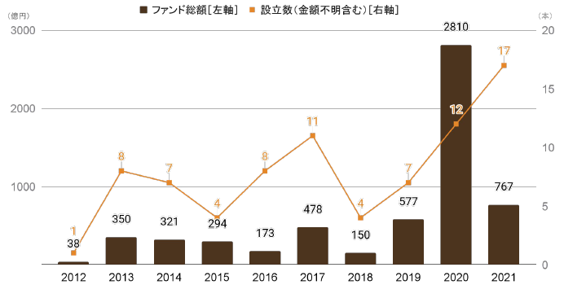
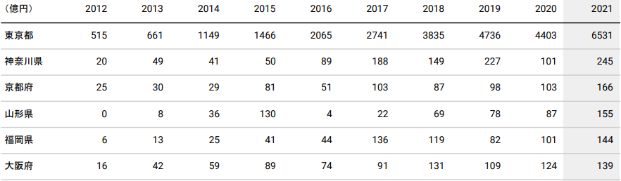
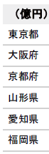
[Reference 3] Results Expected from Realization of Strategy (Illustration)
1-1 Enhanced investment attractiveness and revitalization of Osaka-Kansai economy
Current Situation
■ Value and Number of Bio-tech, Medical, Healthcare Funds Established
In the bio-tech, medical, and healthcare industries in which Osaka has its strength, the total value of funds and number of funds are increasing.
While the amount of financing for start-up companies located in Osaka prefecture has increased over the past ten years, the difference when compared to Tokyo is also increasing.
(JPY 100 million)
Total Fund Value
[left axis]
Number Established
(includes funds of unknown value) [right axis]
(Number of Funds)
Goal of Initiatives
[Global city that develops by leveraging finance]
By increasing international awareness of Osaka and Kansai through major projects such as the Osaka-Kansai Expo 2025, Umekita Phase 2, Nakanoshima international hub for advanced healthcare, etc., we will attract talent and investments from Japan and abroad to create an ecosystem that financially supports the growth of start-ups while also bringing in financial institutions and FinTech companies.
Note 1) Of the funds investing or planning to invest in primarily domestic start-ups, those that have alluded to the industries of their investment target have been aggregated. Those that could not be confirmed to be invested in Japan are not included.
Note 2) As the preferred industry types may have multiple preferences; total fund value and number of funds established may have duplicates.
Note 3) Number of funds with values unknown: 2016: 2, 2017: 0, 2018: 0, 2019: 1, 2020: 0, 2021: 5
Note 4) Values for each year are figures as of the reference date.
Note 5) Due to data characteristics, values, including past data are subject to changes with additional research.
Source) INITIAL (As of January 30, 2022)
■ Changes in Financing for Domestic Start-Ups by Region
Expected Results
(JPY 100 million)
The Expo will enable a trial run of the “test site for future society” for social implementation, creating innovation centered around the industries in which Osaka has its strengths. This in turn will form an ecosystem that financially supports the growth of start-ups.
Investment attractiveness will increase due to the growth and development of the Osaka-Kansai economy.
With support by the administration for foreign financial companies, business in Osaka is solidly on track.
Tokyo
Kanagawa
Kyoto
Yamagata
Fukuoka
Osaka
Note 1) Values for each year are figures as of the reference date.
Note 2) Due to data characteristics, values including past data are subject to changes with additional research. Impact is greater for deals that are small in value, and in particular, more recent.
Note 3) Other represents the sum of the prefectures not listed above.
Source) INITIAL (as of January 25, 2022)

Slide 39
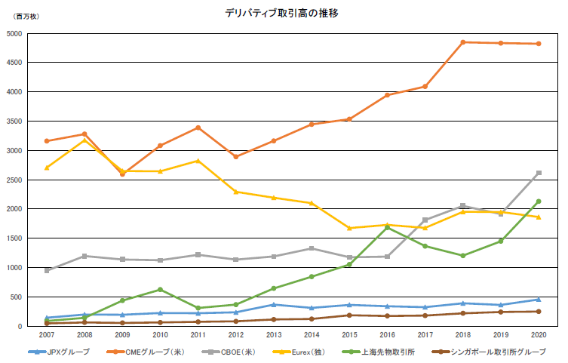
1-2 Enhanced investment attractiveness and revitalization of Osaka-Kansai economy
Current Situation
Approx. 2x
The volume of global derivatives trading has approximately doubled compared to ten years ago. In addition to stocks and interest-related futures and options, which have been the focus thus far, commodities-related transactions are also increasing.
On the other hand, while the volume of derivatives transactions in Japan is increasing, it is still small compared to the western countries and China, remaining at the same level as Singapore.
Other
Agricultural Products
Non-Precious Metals
Precious Metals
Energy
Currency
Interest
Single Shares
Stock Price Index
Goal of Initiatives
[Front-running City in finance]
(Source) Materials provided by Japan Exchange Group Inc.
As Japan’s hub city for derivatives transactions, the city will develop cutting-edge and innovative financial products that hold promise for the future.
(million contracts)
Changes in Derivatives Trading Volume
CME (US)
Expected Results
CBOE (US)
In addition to its history as the birthplace of futures, being the innovative derivatives hub in Asia will increase investment attractiveness.
Many cutting-edge financial products with a sense of locality will be developed, bringing in investors and foreign companies from around the world.
JPX
JPX Group
CME Group (US)
CBOE (US)
Eurex (Germany)
Shanghai
Futures Exchange
SGX Group
(Source) Annual Volume Survey, FIA

Slide 40
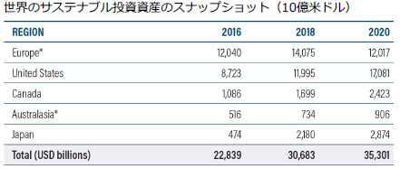
2 Promote SDGs from a Financial Perspective
Current Situation
Snapshot of Global Sustainable Investing Assets (USD billions)
From 2016 to 2020, the world’s ESG market has grown 1.5 times. The issuance of social bonds and sustainable bonds (other than green bonds) has also increased significantly.
While Japan’s ESG market has grown, its market share still remains at 8%.
Goal of Initiatives
Approx. 1.5x
[Front-running City in finance]
Promote SDGs from a financial perspective through innovative sustainable finance initiatives such as those aimed at decarbonization and issuances of SDGs bonds.
Source: Global Sustainable Investment Review 2020
<Value of Sustainable Securities Issued>
(USD billions)
Green Bonds
Social Bonds
Expected Results
Sustainable Bonds
Investments in green bonds, etc., will be accelerated, and the innovative initiatives in sustainable finance will establish the city’s positioning as an advanced SDGs city.
Year
Source: Climate Bonds Initiative

Slide 41
3 Realization of an Economy that is Strong Against Disasters
Current Situation
■ GDP Comparisons of Major Global Cities
Compared to other advanced nations, Japan’s politics, economy, and population are overconcentrated in one place in Tokyo.
The risks of overconcentration in Tokyo during times of crisis became apparent during the Covid-19 pandemic.
Furthermore, a systems failure at the Tokyo Exchange in October 2020 caused a loss of three trillion yen in trading opportunities.
Japan
United States
Germany
8.1%
4.9%
12.5%
5.9%
19.6%
7.2%
Goal of Initiatives
Tokyo
Osaka
Other
New York
Los Angeles
Koln-Dusseldorf
Frankfurt
Other
Other
[Global city that develops by leveraging finance]
 | Japan | United States | Germany
Percentage of economic overconcentration (Primate city GDP as a percentage of GDP) | 19.6% | 8.1% | 12.5%
Ratio of primate city to secondary city | 3 : 1 | 2 :1 | 2 : 1
To reduce investment risk resulting from the many natural disasters that take place in Japan as well as from systems failures, a structure in which Osaka can take a complementary role will be created. This includes initiatives such as financial institutions establishing BCP and dual operation hubs and expanding their functions, as well as gathering data centers, middle and back offices.
* GDP referenced gross prefectural product
* Data are published figures by the OECD for US and Germany at the country level and The Brookings Institution for city figures
▽ Harmful Effects of Overconcentration in Tokyo
Expected Results
Maximum estimated damage in the case of a Tokyo inland earthquake
➡ Approximately 95 trillion yen
Natural hazard risk index of the world’s major cities
➡ Tokyo/Yokohama ranked as the worst amongst the 50 major cities of the world
Data centers and middle/back offices will gather in Osaka, thereby creating a resilient city for financial functions in Japan.
Source: Central Disaster Management Council- Committee for Policy Planning on Disaster Management
Working Group on Countermeasures Against Tokyo Inland Earthquake “Final Report” (2013)
Munich Reinsurance Group Annual Report (March 2003)

Slide 42
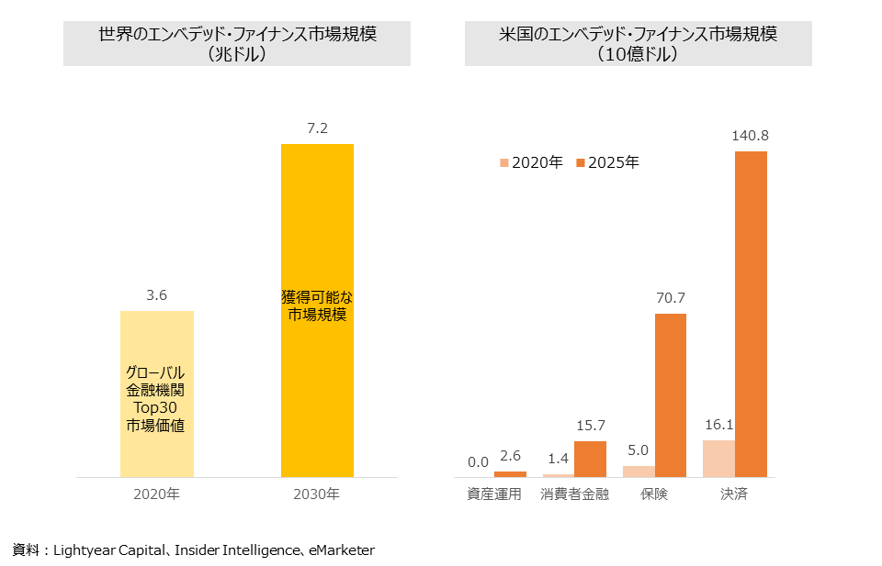
4 Improve Lifestyle Convenience by Utilizing New Financial Technology
Current Situation
One example of deepening financial services utilizing FinTech is the recent trend in embedded finance (financial services that are unbundled from the financial function), which is connecting “information systems that support lifestyles and corporate activities” with “systems that support financial services”, thereby creating new services.
Global Embedded Finance Market Scale
(USD trillions)
US Embedded Finance Market Scale
(USD billions)
Market Scale Available for Acquisition
2020
2025
Goal of Initiatives
[Global city that develops by leveraging finance]
[Front-running city in finance]
Market Value of Top 30 Global Financial Institutions
Create new financial services through innovative testing and implementation of social projects in the financial field such as issuing a local digital currency and digital ID that lead to development in focus regions even post-Expo, utilizing FinTech in settlements, insurance, etc.
2020
2030
Asset Management
Consumer Finance
Insurance
Settlements
Reference materials: Lightyear Capital, Insider Intelligence, eMarketer
Expected Results
The Expo will enable innovative testing and implementation of financial social projects, moving digitalization further forward.
With financial services being provided to general businesses, FinTech companies that utilize them will gain prominence, and with financial and non-financial services utilizing these progressive technologies, cashless settlements, etc. will make progress, thereby improving the lifestyle convenience of Osaka residents.

Slide 43
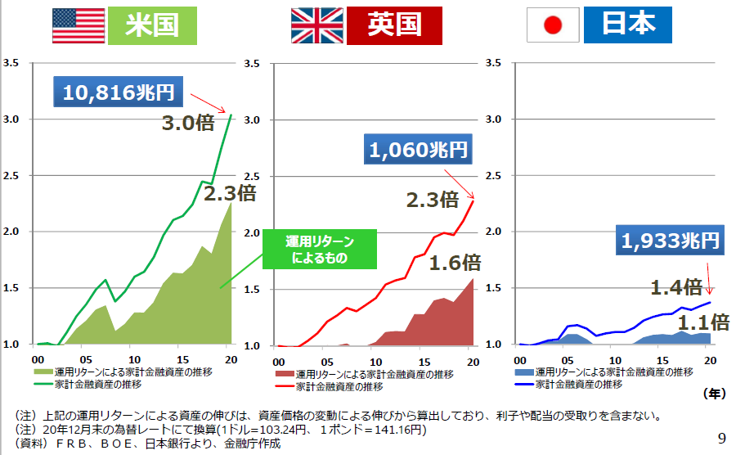
5 Increased Assets by Fostering Investment Mindset
Current Situation
■ Comparison of Financial Assets Held by Households in US-Japan-Europe
More than half of Japan’s household financial assets is comprised of currency and deposits; the proportion of investment trusts, equity, etc. is low compared to the US and Europe.
US and UK’s financial asset trends show that household financial assets at a macro level have increased 3 times and 2.3 times, respectively.
On the other hand, growth in Japan’s financial assets has remained at 1.4 times; investment returns are also at a low level.
(1,946 trillion yen)
(109.6 trillion dollars)
(27.6 trillion euros)
Goal of Initiatives
[Global city that develops by leveraging finance]
“Others” is the residual after deducting “currency and deposits,” “debt securities,” “investment trusts,” “equity,” and “insurance, pension and standardized guarantees” from total financial assets.
Expand opportunities for financial literacy education at seminars for Osaka residents and at schools.
Source: “Flow of Funds—Overview of Japan, the United States, and the Euro area,” August 29, 2021, Research and Statistics Department, Bank of Japan
■ Trends in Financial Assets Held by Households (US-Japan-Europe Comparison)
US
UK
Japan
10,816 trillion yen
Expected Results
3.0x
1,060 trillion yen
Improving investment mindset based on correct knowledge will revitalize investments and change the composition of financial assets for individuals.
2.3x
2.3x
Due to investment returns
1,933 trillion yen
1.6x
1.4x
1.1x
Household financial assets from investment returns
Household financial assets
Household financial assets from investment returns
Household financial assets
Household financial assets from investment returns
Household financial assets
(Year)
(Note) The above growth in assets due to investment returns are calculated based on fluctuations in asset prices and do not include interest and dividends received.
(Note) Calculated based on exchange rates as of the end of December 2020 (USD 1 = JPY 103.24, GBP 1 = JPY 141.16)
(Reference Materials) Created by the FSA based on information from the FRB, BOE, and Bank of Japan
Source: Ministry of Finance materials

Slide 44
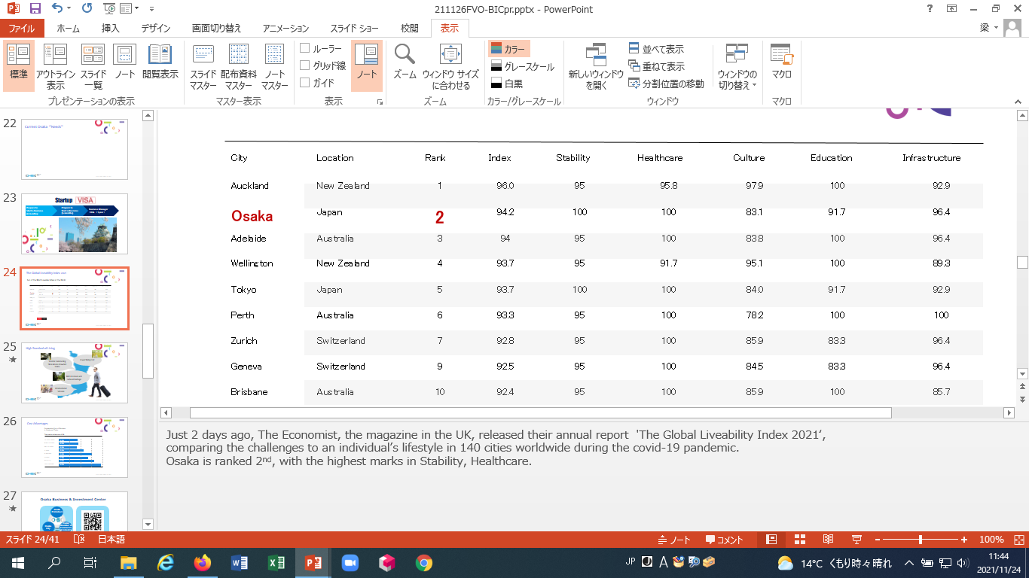
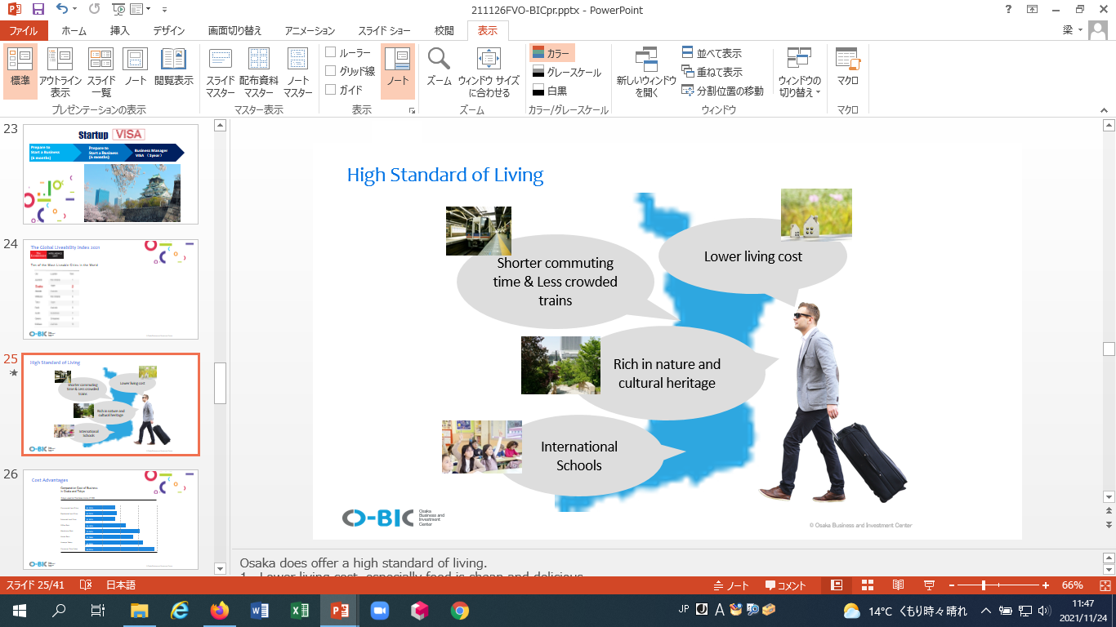
6 Enhance the Status of Osaka-Kansai as a Global Financial City
Current
Osaka was ranked as the second most liveable city in the world (The Economist’s The Global Liveability, 2021) and was particularly valued for its stability and healthcare.
■ Ten of the Most Liveable Cities in the World
Goal of Initiatives
[Global city that develops by leveraging finance]
[Front-running city in finance]
Promote initiatives to invite highly skilled foreign professionals by establishing living conditions such as education/medical facilities, etc. as well as utilizing special provisions for resident status while also transmitting the investment attractiveness of Osaka.
Expected Results
With the development of international schools, provision of multi-language services, etc., living conditions will be in place for Osaka residents and foreign nationals, making it a city that is even more comfortable to live in.
With pleasant living conditions and investment attractiveness, foreign financial companies such as FinTech companies, investors, etc. will gather in the city.
Source: Materials created by O-BIC

