Slide 1
Osaka Prefecture’s efforts to prevent the spread of infections（Outline）
① Area : All parts of Osaka Prefecture
② Period : From May 23 to 29, 2020
③ Details: In response to the lifting of the designation as a prefecture under the State of Emergency Declaration,
the emergency measures that have been implemented up to now are lifted.
However, since infections have still been confirmed in the prefecture and there are no established
treatments or vaccines, Osaka residents and business operators are requested to take appropriate
infection prevention measures and to register at/effectively use the “Osaka coronavirus tracking system.”
In addition, the following cooperation is requested:
●Outings(Article24, Clause 9 of the Act）
Osaka residents are requested to continue practicing “New Lifestyle” to prevent spread of infections.
Cooperation for the following is also requested:
1. Avoid going to facilities where clusters occurred before, such as eateries with hospitality services and Three Cs.
2. Refrain from traveling across prefectures, such as non-essential or non-urgent trips for leisure activities
●Holding events(Article24, Clause 9 of the Act）
Organizers are requested to hold events at a reduced scale until the Declaration is lifted nationwide.
Even after lifting of nationwide Declaration, organizers are to be requested to refrain from holding large and nationwide
scale events if risk countermeasures are NOT taken.
●Facility use
Restrictions, etc. are requested to facilities where clusters occurred nationally(Article24, Clause 9 of the Act）
Restriction requests to facilities other than above ones are to be lifted.

Slide 2
Outings (Article24, Clause 9 of the Act）
Osaka residents are requested to continue practicing “New Lifestyle” to prevent spread of infections Above all, cooperation for the following is emphasized:
【Cooperation details】
１．Avoid going to facilities where clusters occurred before, such as eateries with hospitality services
and Three Cs.
２．Refrain from traveling across prefectures, such as non-essential or non-urgent trips for leisure activities
Examples of practicing “New Lifestyle”
①Keeping social distance（Keep possibly 2 meters between persons）
②Wearing a mask（Wear a mask even if you have no symptoms）
③Washing hands (Wash your hands and face upon coming home. Wash your hands carefully using
soap and water for about 30 seconds)
④ Practicing measures such as teleworking as much as possible
⑤ Registering at the “Osaka coronavirus tracking system” and using it effectively, etc.

Slide 3
Holding events (Article24, Clause 9 of the Act）
Organizers are requested to hold events at a reduced scale until the Declaration is lifted nationwide.
【Cooperation request details】
○Scale of the event:
・Indoor: 100 persons or less and limit the number of participants up to the
half of its capacity
・Outdoor: 200 persons or less, and keep enough distance between people
After lifting of nationwide Declaration, organizers are to be requested to refrain from holding large and nationwide scale events if risk countermeasures are NOT taken.
※When holding events, introduction of the Osaka coronavirus tracking system is requested in order
to prepare for the occurrence of infections.
※It is being considered to request to refrain from holding events if appropriate infection prevention
measures or risk countermeasures are NOT taken or prepared.

Slide 4
Facility use restriction
The following is requested to managers of facilities used by many people
【Details】
１. Facilities NOT requested to close 【Facilities essential for social lives, social welfare facilities, etc.】
⇒Requested to take appropriate infection prevention measures
Lift the business hour restriction request to meal service facilities
２ Facilities requested to close based on the Act
・Facilities where clusters occurred nationally
⇒Facility use restrictions request（Article 24, Clause 9 of the Act ）
３．Facilities to be asked cooperation not based on the Act
(１)Facilities to which the closure request is to be lifted on May 23
・Facilities that are similar to those where clusters occurred nationally
Closure request is to be lifted on the premise that they comply with the guidelines made by industry groups, etc.
based on the authorities’ knowledge.
・Among the facility categories where clusters occurred nationally, large-scale ones, meeting/exhibition halls, and
education facilities
Comply with the guidelines made by industry groups, etc. based on the authorities’ knowledge and take thorough
infection prevention measures
⇒Facilities used by many and unspecified people are requested to introduce Osaka coronavirus tracking system.
(２)Facilities to which the closure request has been lifted since May16
⇒ Comply with the guidelines according to the business type and take thorough infection prevention measures
⇒ Facilities used by many and unspecified people are requested to introduce Osaka coronavirus tracking system

Slide 5
Details of the measures
1 Facilities NOT requested to close ※Requested to take appropriate infection prevention
（１）Facilities essential for social lives
Categories | Facilities
Medical institutions | hospitals, clinics, pharmacies, etc.
Daily necessities stores | wholesale markets, grocery stores/corners, daily necessities corners at department stores and supermarkets, convenience stores, etc.
Meal service facilities | Restaurants (including pubs), restaurants with amusement services, cafés, etc. (including delivery/take-out services) ※Business hour restriction request is lifted Introduction of Osaka coronavirus tracking system is requested
Housing, lodging facilities | hotels and inns, apartment houses, boarding houses, etc.
Transportation | buses, taxies, rent-a-cars, railways, ships, aircraft, logistics services(delivery service), etc.
Factories | factories, working places, etc.
Financial institutions, public offices | banks, stock markets, brokerage firms, insurance companies, public offices, etc.
Others | news organizations, funeral halls, public bathhouses, pawn shops, veterinary clinics, barbers/hair salons, laundries, waste treatment-related companies, etc.
※(“Facilities essential for social lives” are determined based on the “Basic response policies for the novel coronavirus control” revised on May 14, 2020)
（２）Social welfare facilities
Categories | Facilities
Social welfare facilities | nurseries, after-school nurseries, long-term care facilities, other facilities related to these welfare services, facilities providing health and medical services

Slide 6
２． Facilities requested to close based on the Act
・Facilities where clusters occurred nationally
Categories | Facilities | Request details
Entertainment facilities | eateries with hospitality services such as cabarets, night clubs Snacks, bars, pubs, karaoke boxes, and music clubs | Request for facility use restrictions (Article24, Clause 9 of the Act）
Sports/amusement facilities | sporting clubs
３(１) Facilities requested for cooperation in taking infection prevention measures NOT based on the Act
(Facilities to which the closure request is to be lifted on May 23 ）
・ Facilities that are similar to those where clusters occurred nationally
Categories | Facilities | Request details
Entertainment facilities | dance halls adult entertainment facilities | ・Closure request is to be lifted on the premise that they comply with the guidelines made by industry groups, etc. based on the authorities’ knowledge. ・Facilities used by many and unspecified people are requested to introduce Osaka coronavirus tracking system ⇒ Hereafter facility use restrictions might be requested to the facilities where clusters occur based on the Article 24, Clause 9 of the Act
Sports/amusement facilities | gymnasiums, indoor swimming pools, bowling alleys, skating rinks, indoor sports facilities (except sporting clubs)

Slide 7
・Large-scale facilities(with floor areas of over 1,000㎡) among those where clusters occurred nationally,
meeting/exhibition facilities, and education facilities
Categories | Facilities | Request details
Entertainment facilities （facilities with floor areas of over 1000㎡ , other than those where clusters occurred) | private movie theaters, Internet cafés, manga cafés, shooting saloons, horse parlors, ticket counters for bike race outside the stadium, etc. | ・Request cooperation in complying with guidelines made by industry groups, etc. based on the authorities’ knowledge. ・Facilities used by many and unspecified people are requested to introduce Osaka coronavirus tracking system. ⇒Hereafter facility use restrictions might be requested to the facilities where clusters occur, based on the Article 24, Clause 9 of the Act
Sports/amusement facilities （facilities with floor areas of over 1000㎡, other than those where clusters occurred) | mah-jongg game parlors, pachinko parlors, game centers, theme parks, amusement parks, outdoor swimming facilities, etc.
Meeting/exhibition facilities （except rental meeting rooms） | meeting rooms, auditoriums, exhibition halls, multipurpose halls, cultural halls
Education facilities | schools（except universities, etc.）

Slide 8
３（２）Facilities to be asked cooperation not based on the Act
（Facilities to which the closure request has been lifted since May16）
Categories | Facilities | Request details
Theaters | theaters, movie theaters, variety theaters, etc. | ・Request cooperation in complying with guidelines made by industry groups, etc. based on the authorities’ knowledge. ・Facilities used by many and unspecified people are requested to introduce Osaka coronavirus tracking system. ⇒Hereafter facility use restrictions might be requested to the facilities where clusters occur, based on the Article 24, Clause 9 of the Act
Meeting/exhibition facilities | rental meeting rooms
Universities/tutoring schools, etc. | education facilities such as universities, special training schools, miscellaneous schools, etc., driving schools, tutoring schools, etc.
Museums, etc. | museums, art museums, libraries, etc.
Hotels and inns | hotels, inns (meeting spaces ONLY)
Commercial facilities | stores other than daily necessities retailers stores offering services NOT essential in daily lives
Entertainment facilities （with floor areas of 1000㎡ or under, other than those where a cluster occurred) | private movie theaters, Internet cafés, manga cafés, shooting saloons, etc.
Sports/amusement facilities （with floor areas of 1000㎡ or under, other than those where a cluster occurred) | mah-jong game parlors, pachinko parlors, game centers, outdoor swimming facilities, etc.

Slide 9
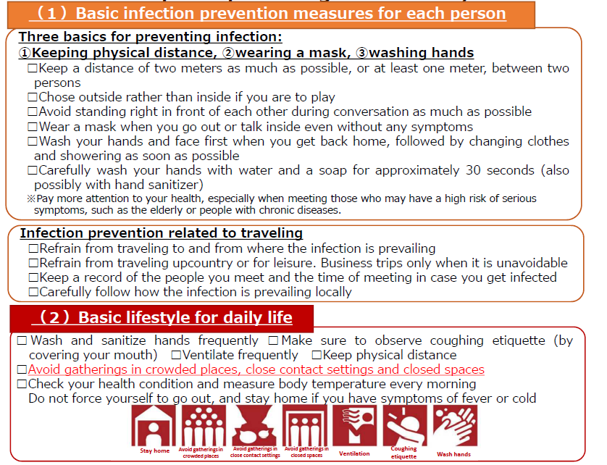
Example of practicing "New Lifestyle“
（extracted from the Expert Meeting on the Novel Coronavirus Disease Control “Analysis of the Response to the Novel Coronavirus (COVID-19)
and Recommendations” (May 4, 2020)
【Attached sheet】

Slide 10
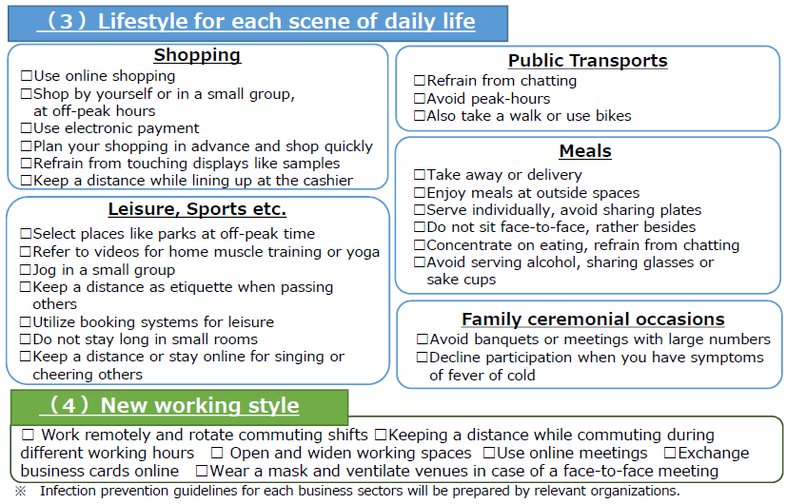
Example of practicing "New Lifestyle“
（extracted from the Expert Meeting on the Novel Coronavirus Disease Control “Analysis of the Response to the Novel Coronavirus (COVID-19)
and Recommendations” (May 4, 2020)
【Attached sheet】

